Slide 1
Patches
Rick Obermeyer
orick@prodigy.net

Slide 2
PATCH DESIGN- What are the parts of the patch and how do they interact in a successful design?
PATCH EXECUTION AND IDEAS - Do's and don't to turn your concept into a good looking
patch. Suggestions for where to go and what to use for effective inspirations.
PATCH ECONOMICS AND ETHICS - How patches can be used to augment your lodge's bottom line. Fair trading and fair distribution of patches.

Slide 4
CHIAROSCURO

Slide 5
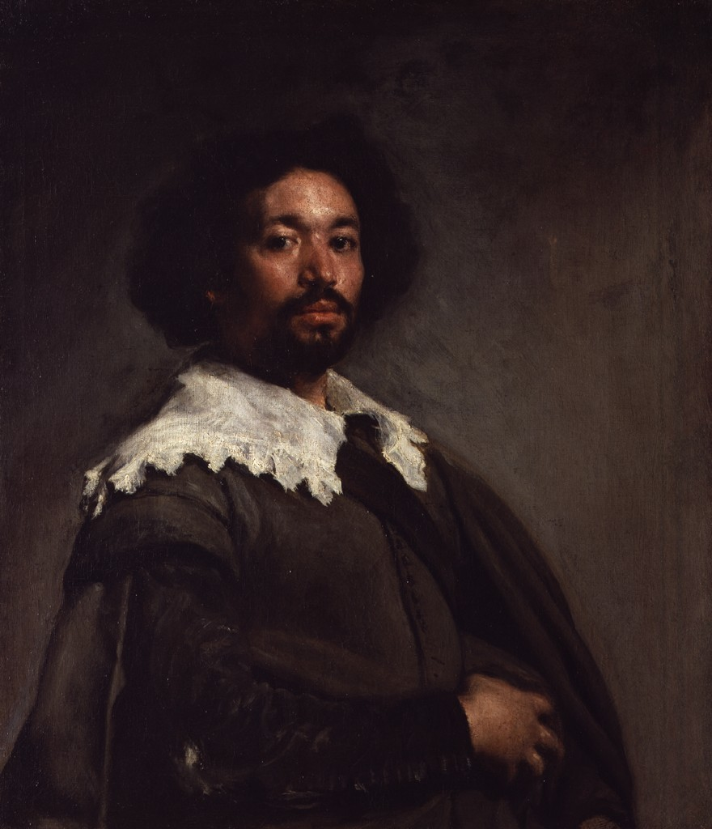

Slide 6
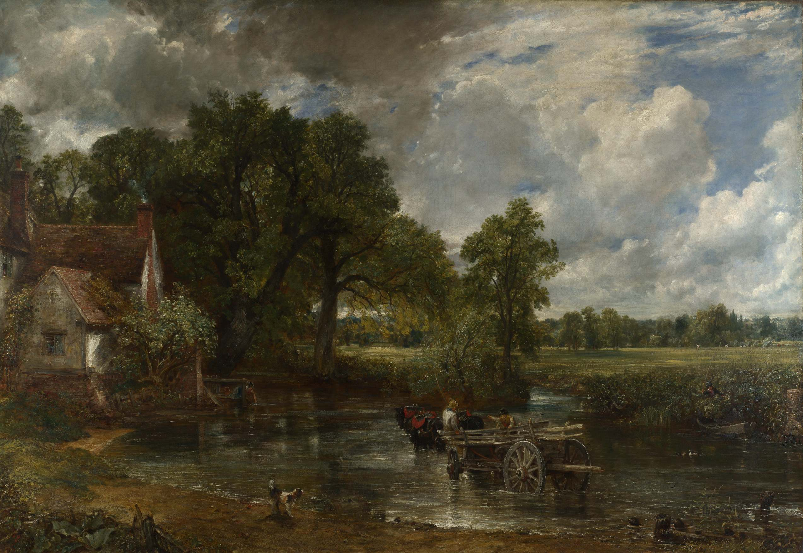

Slide 7
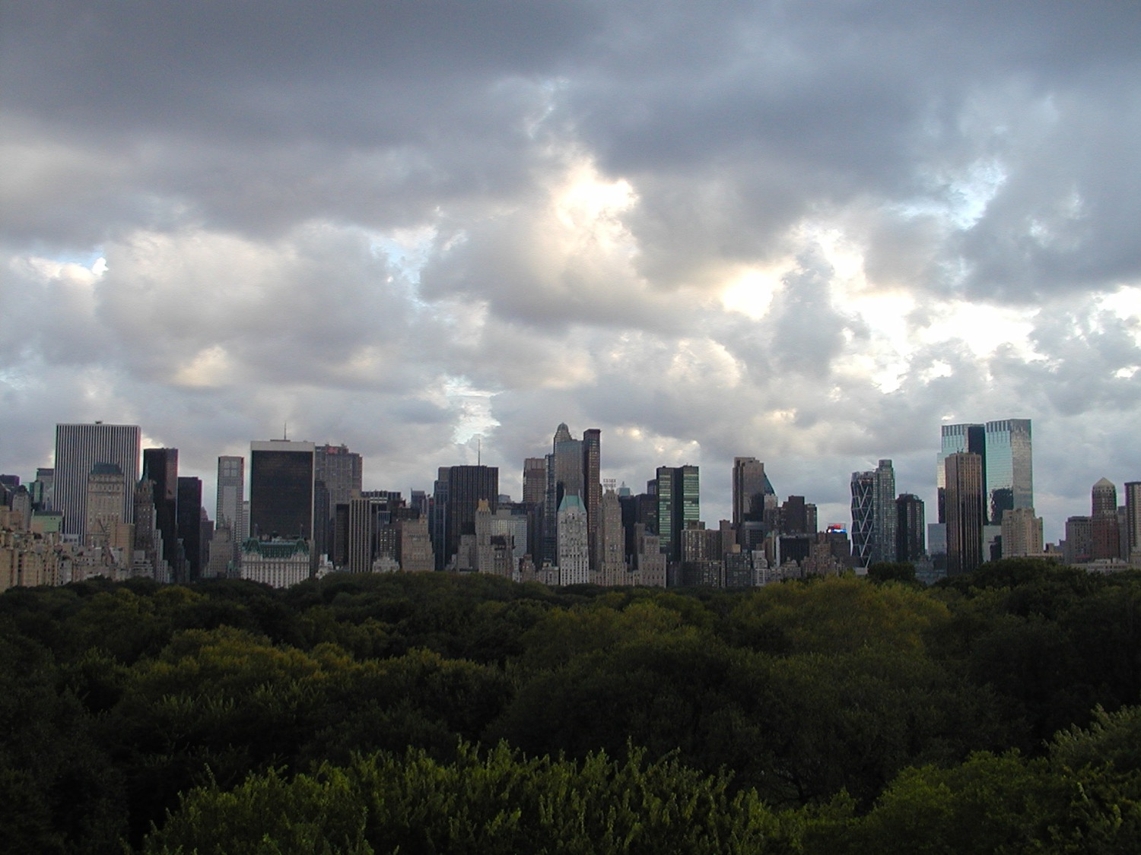

Slide 8
ELEMENTS OF DESIGN

Slide 9
Identifier
Souvenir
Trader
Fundraiser

Slide 10
Troop number
Community and
state strip
Badge of rank
Badge of office

Slide 11
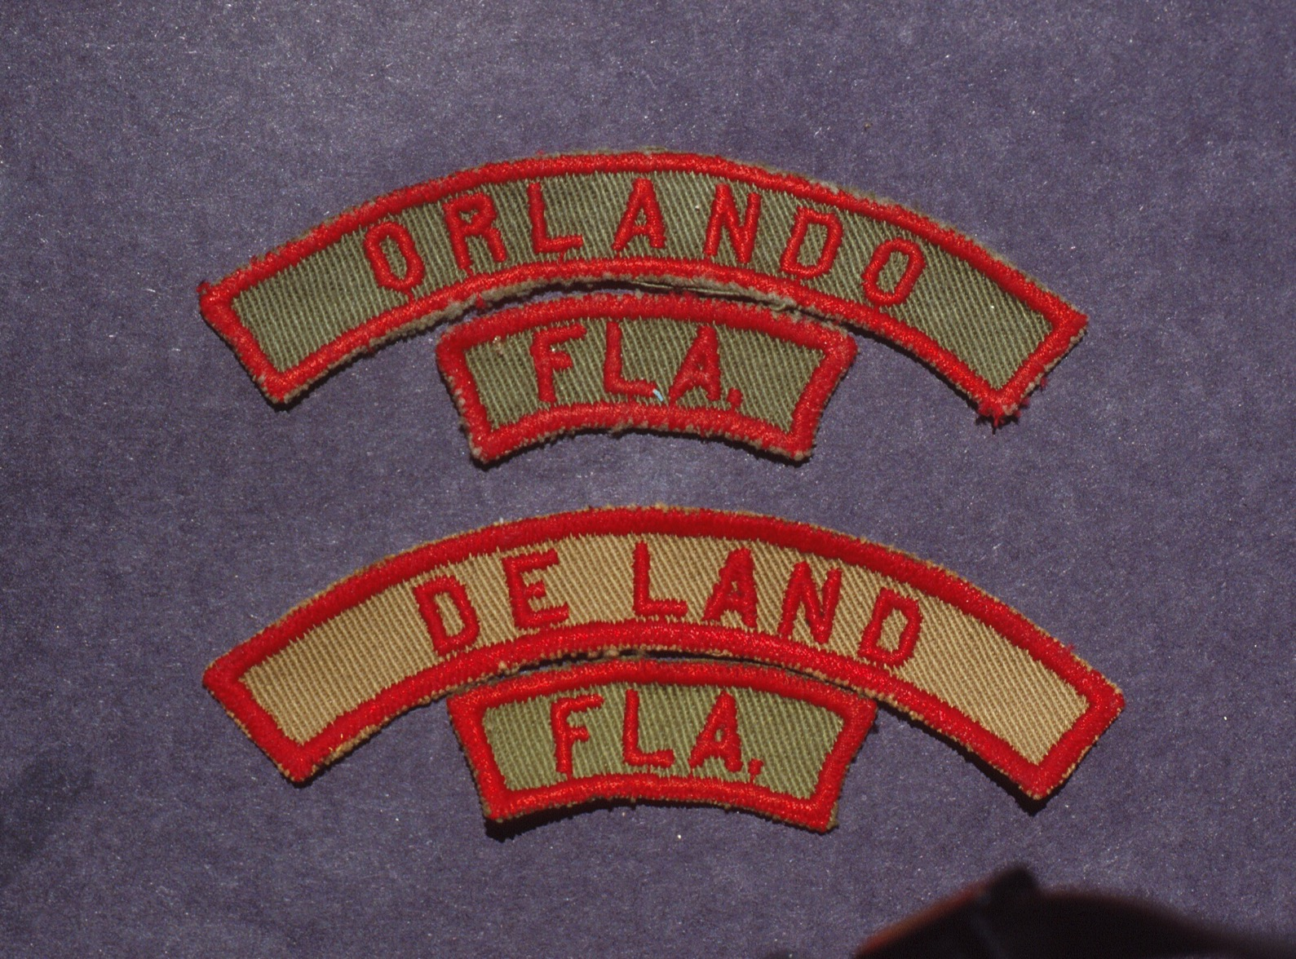

Slide 13
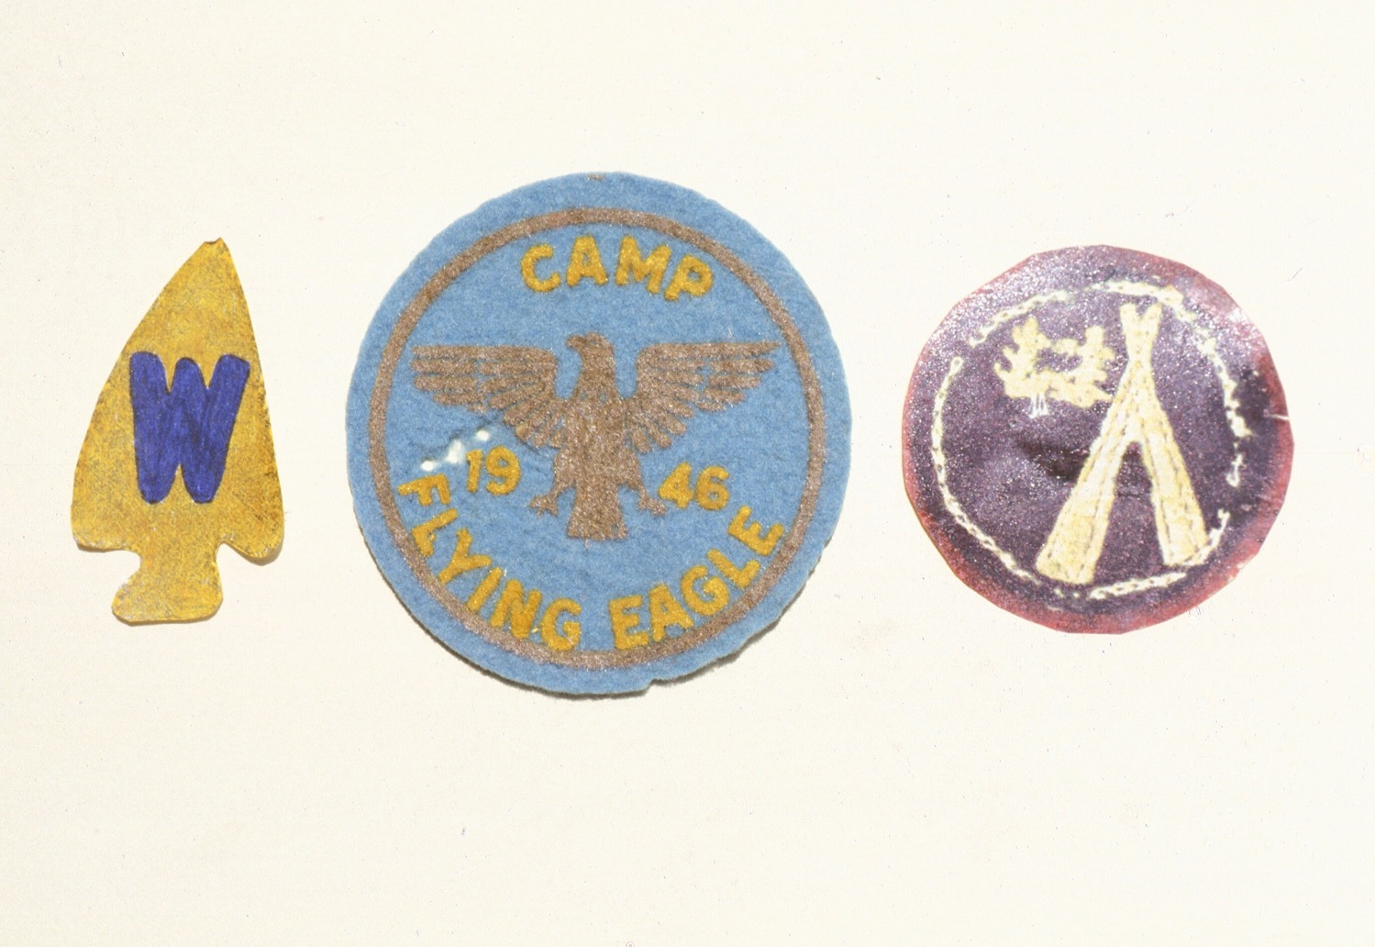

Slide 14
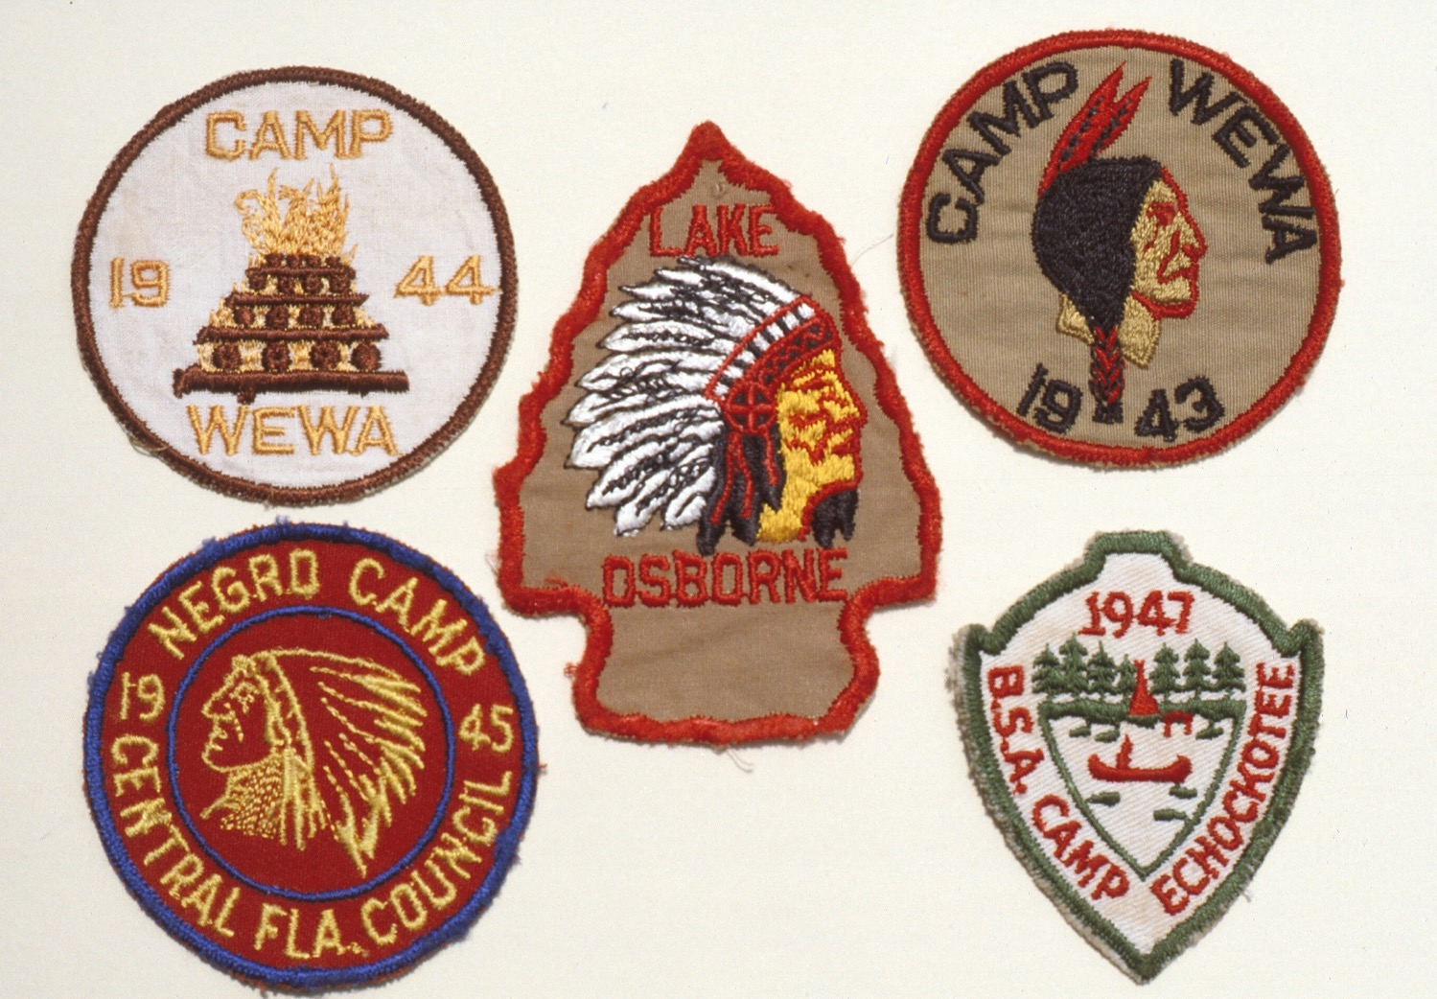

Slide 15
Border
Background
Lettering
Central “thing”
(Key Item)

Slide 16
Their relative size to each other
on the patch
Their placement, or arrangement
on the patch
Their colors

Slide 17
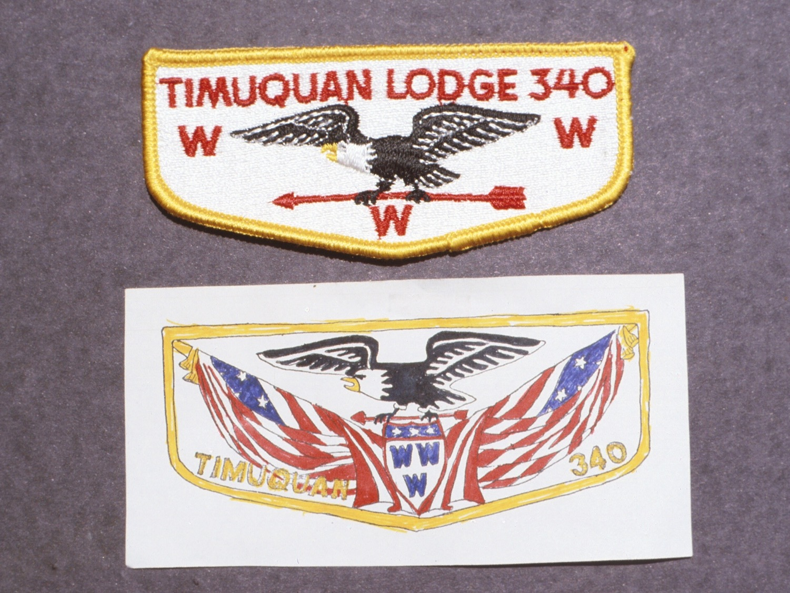

Slide 18
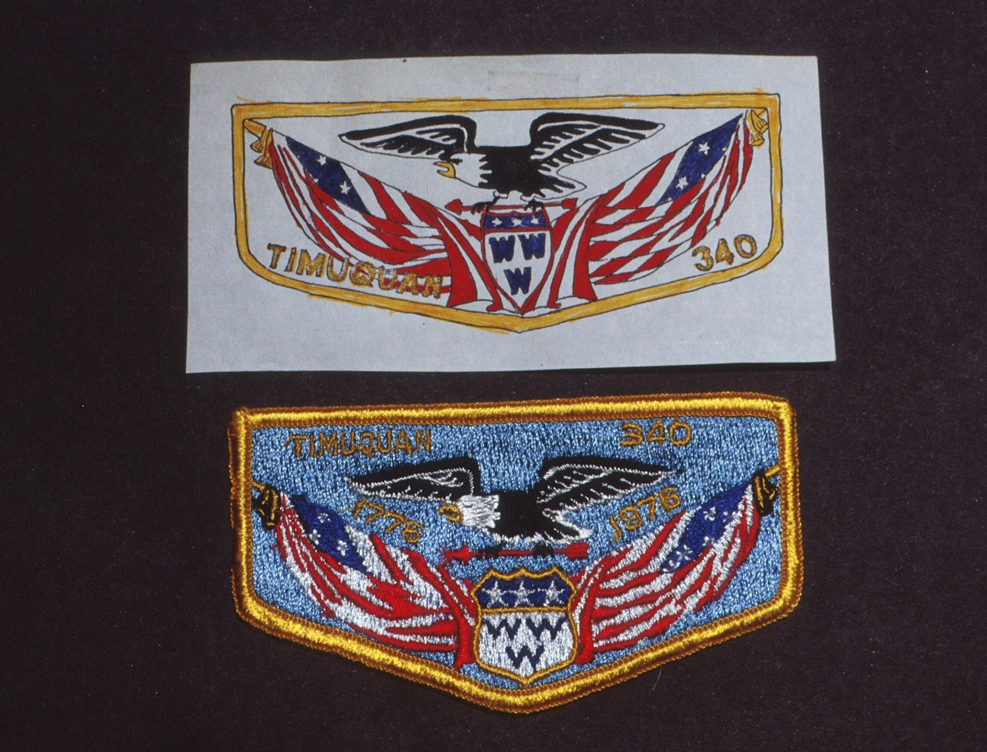

Slide 20
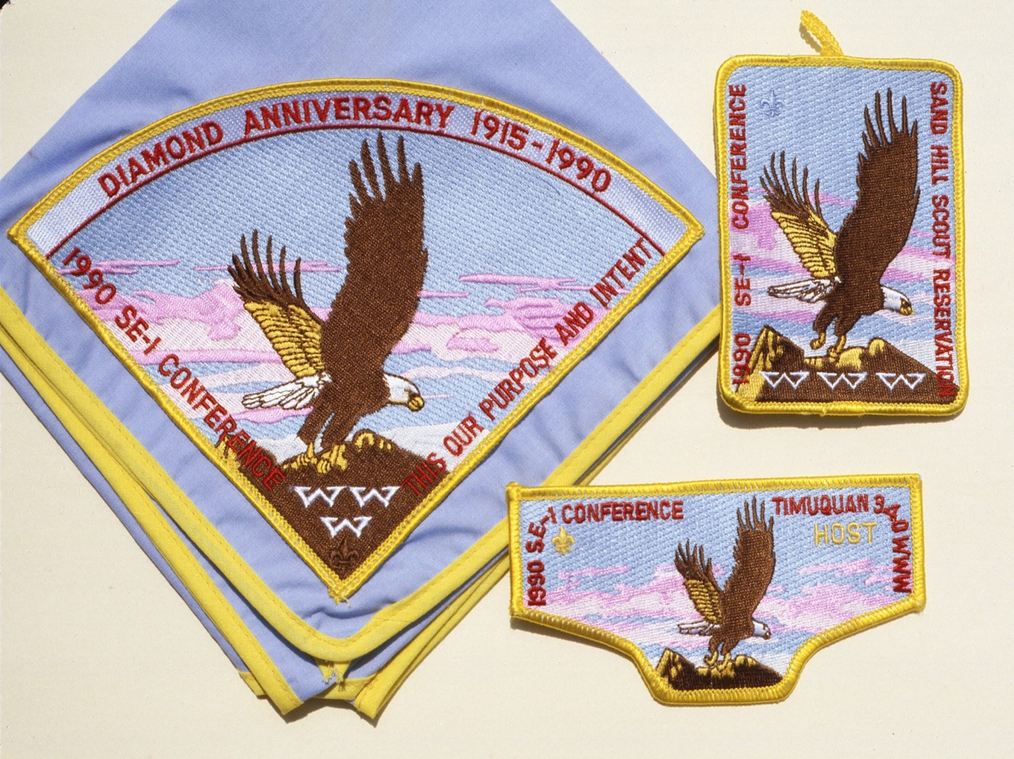

Slide 21
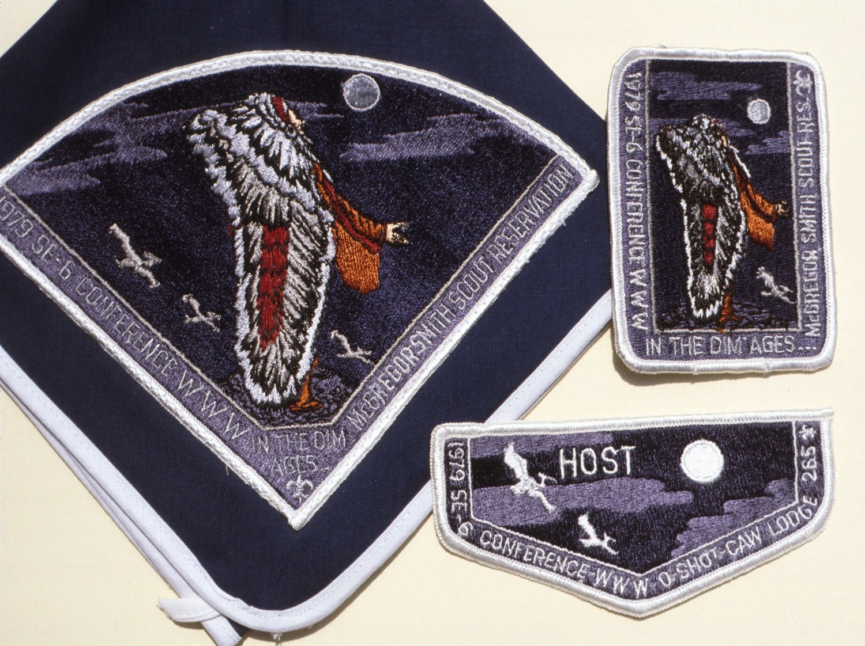

Slide 22
CREATIVE COLOR
by Faber Birren

Slide 24
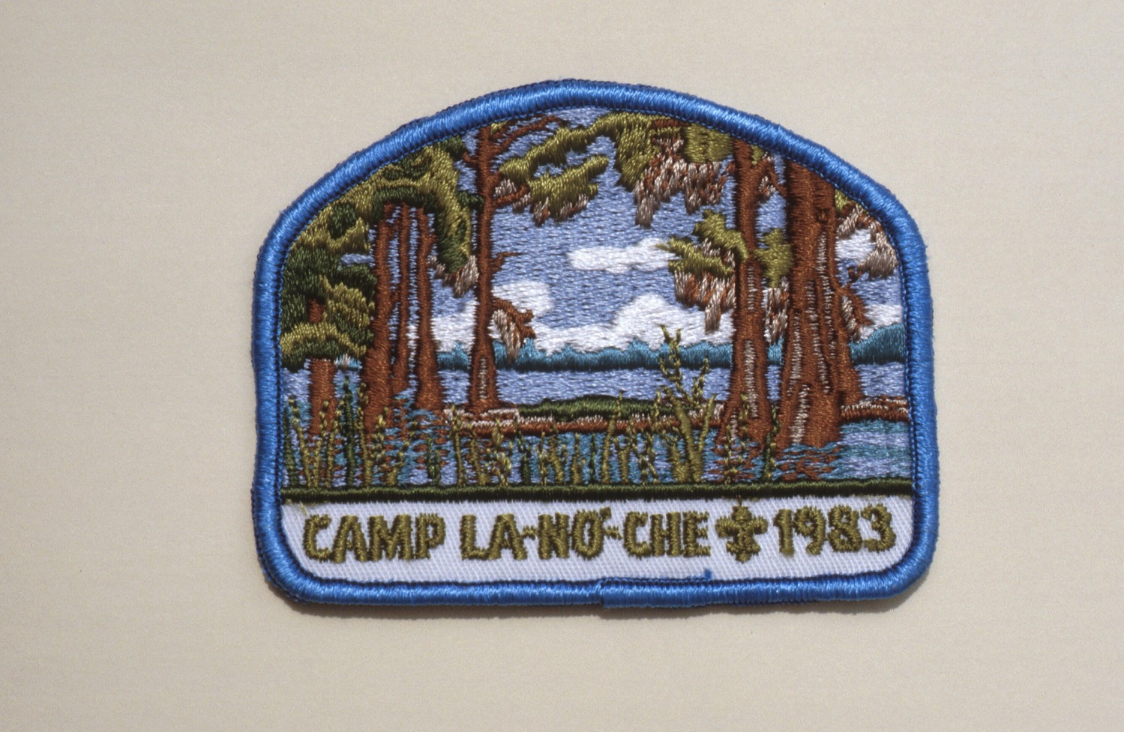

Slide 27
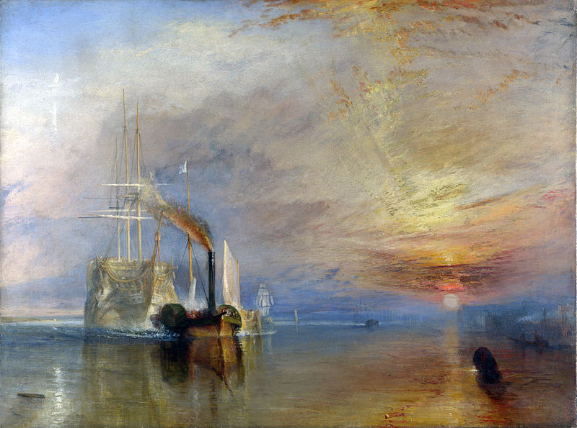

Slide 30
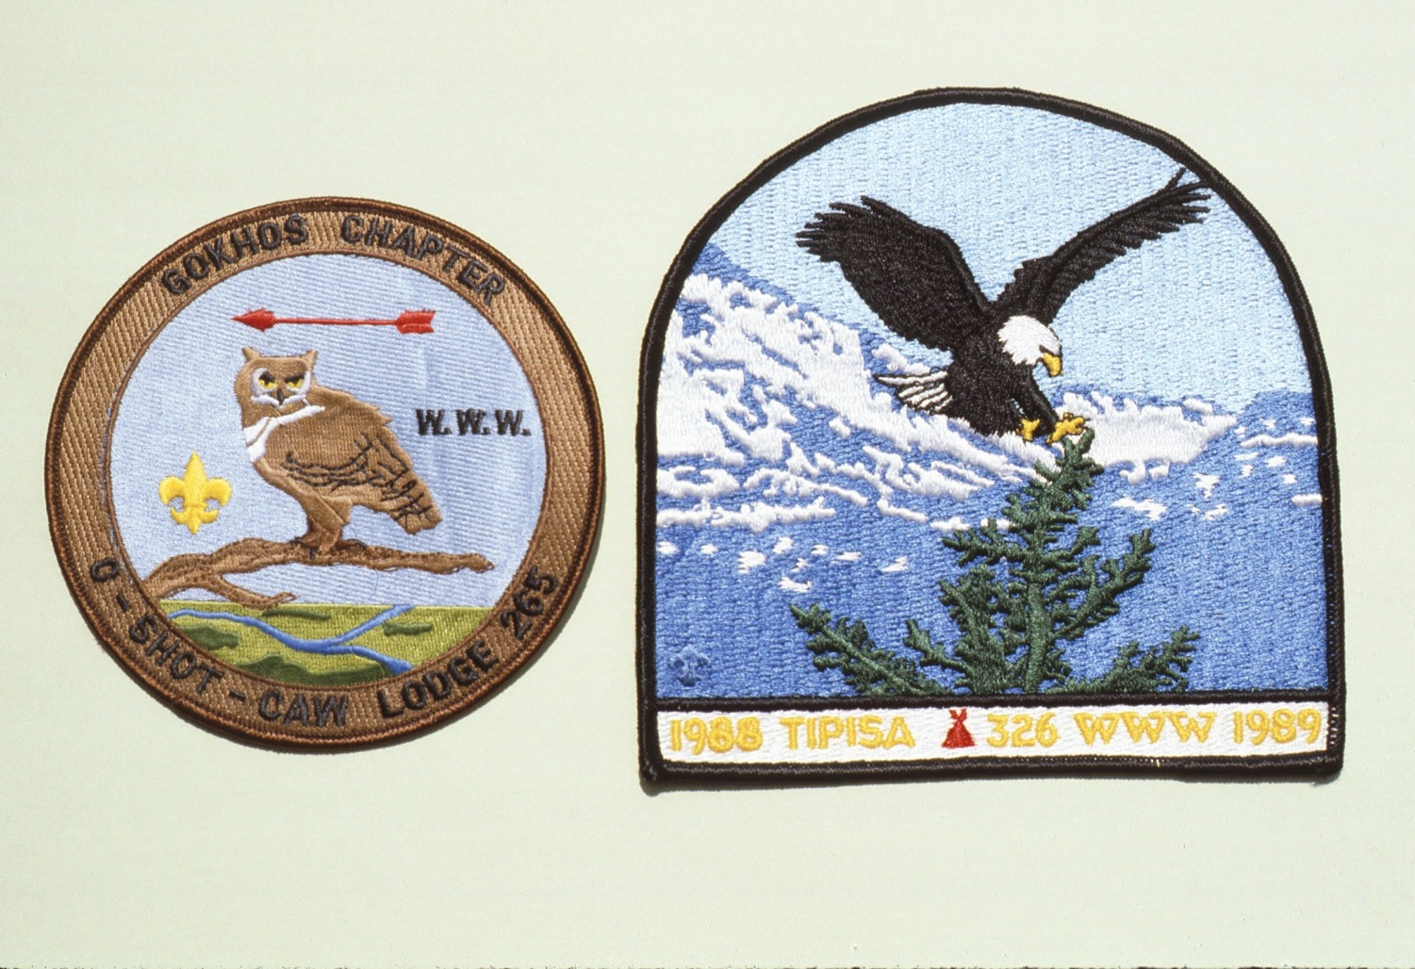

Slide 31
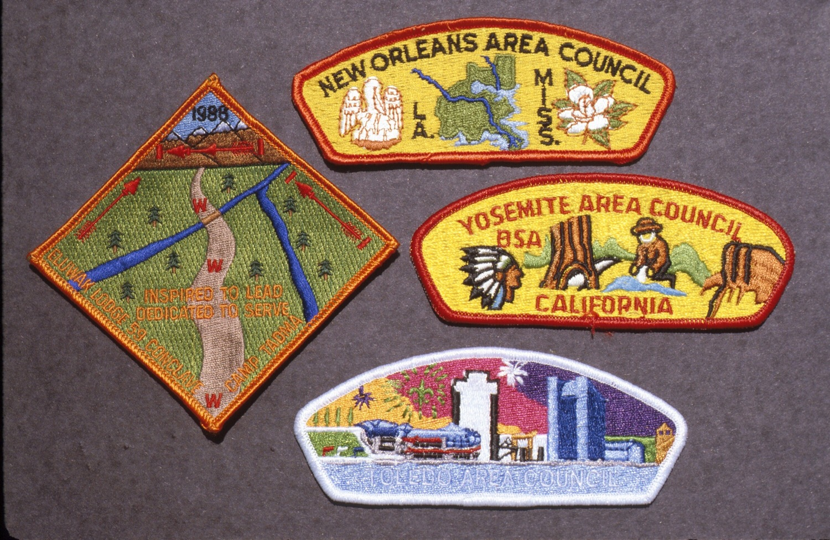

Slide 32
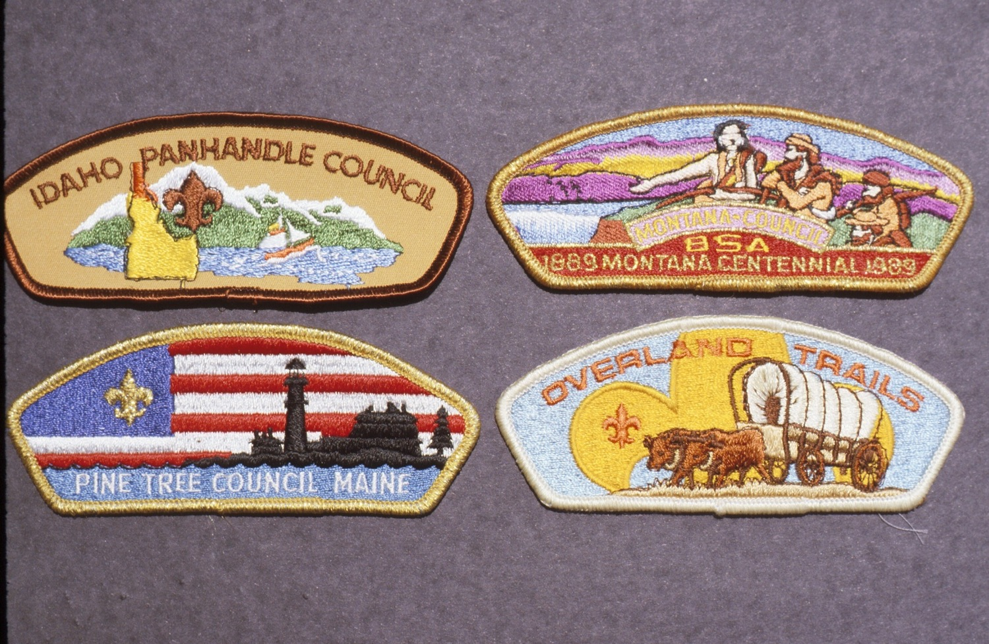

Slide 33
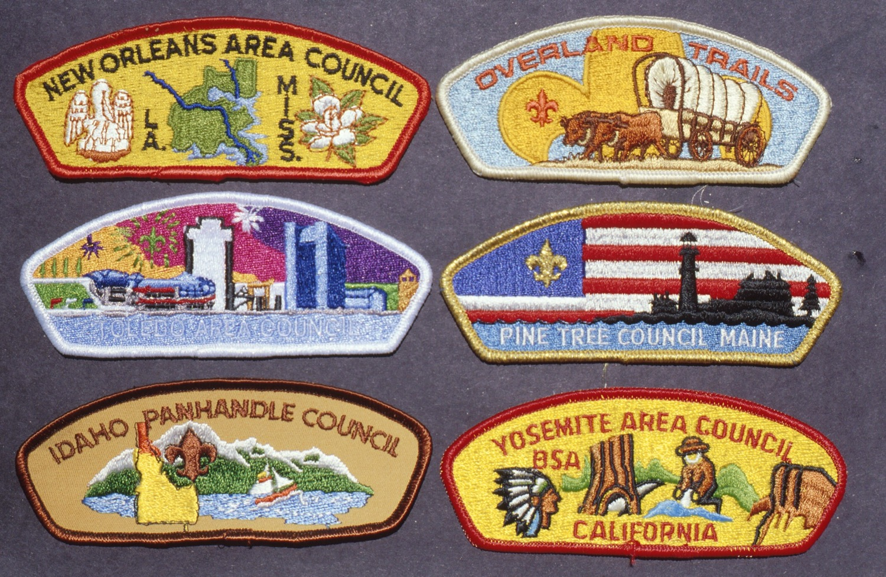

Slide 35
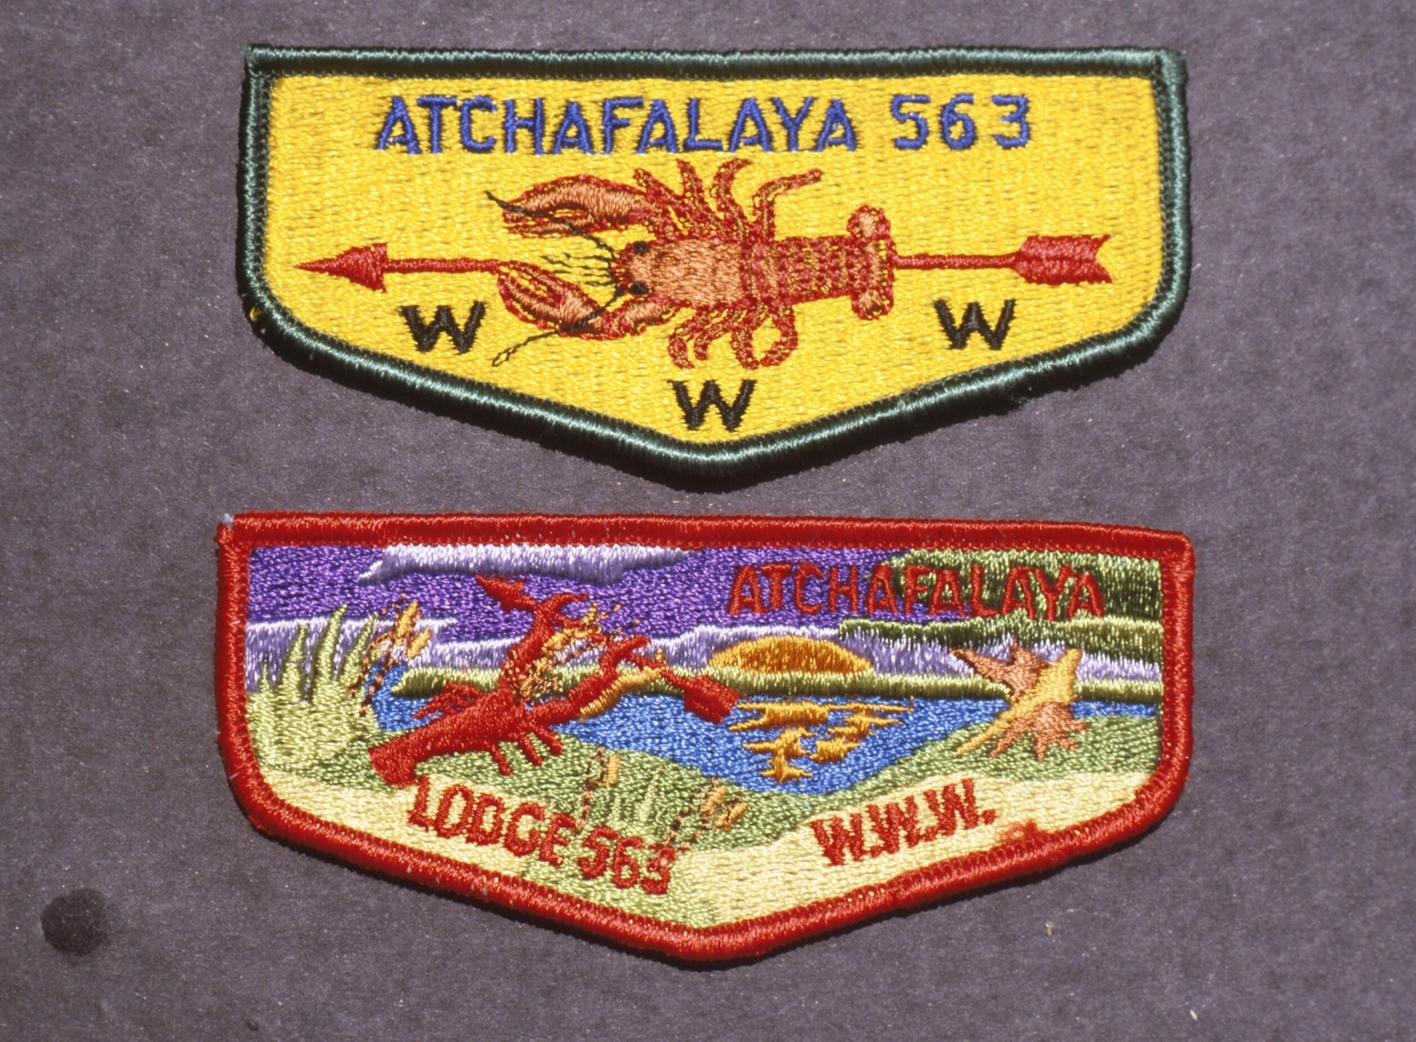

Slide 36
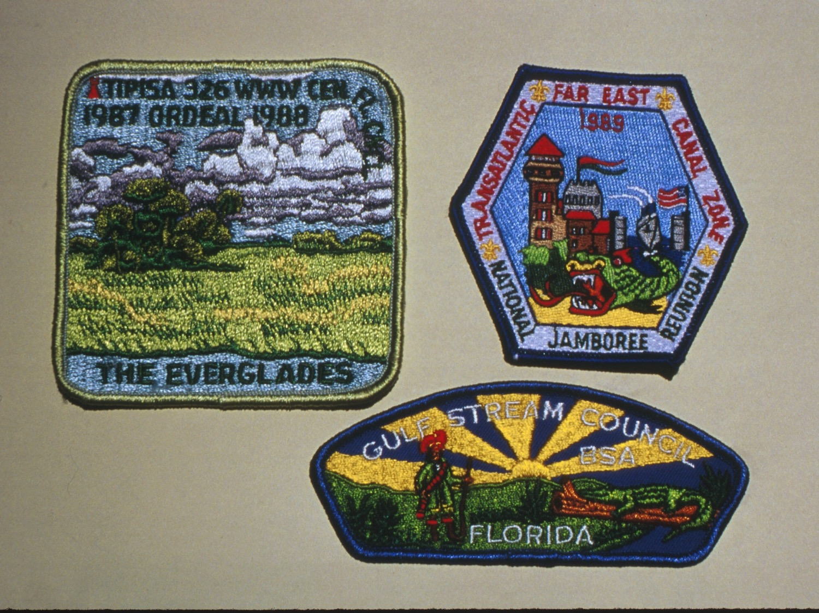

Slide 37
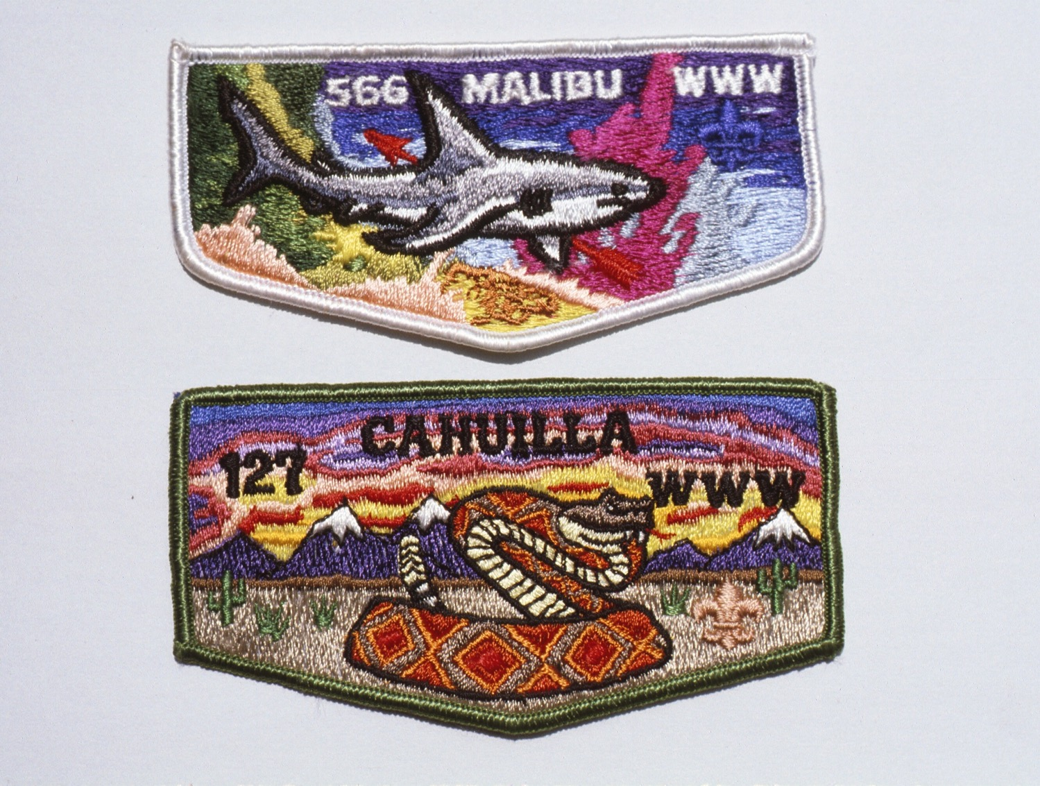

Slide 38
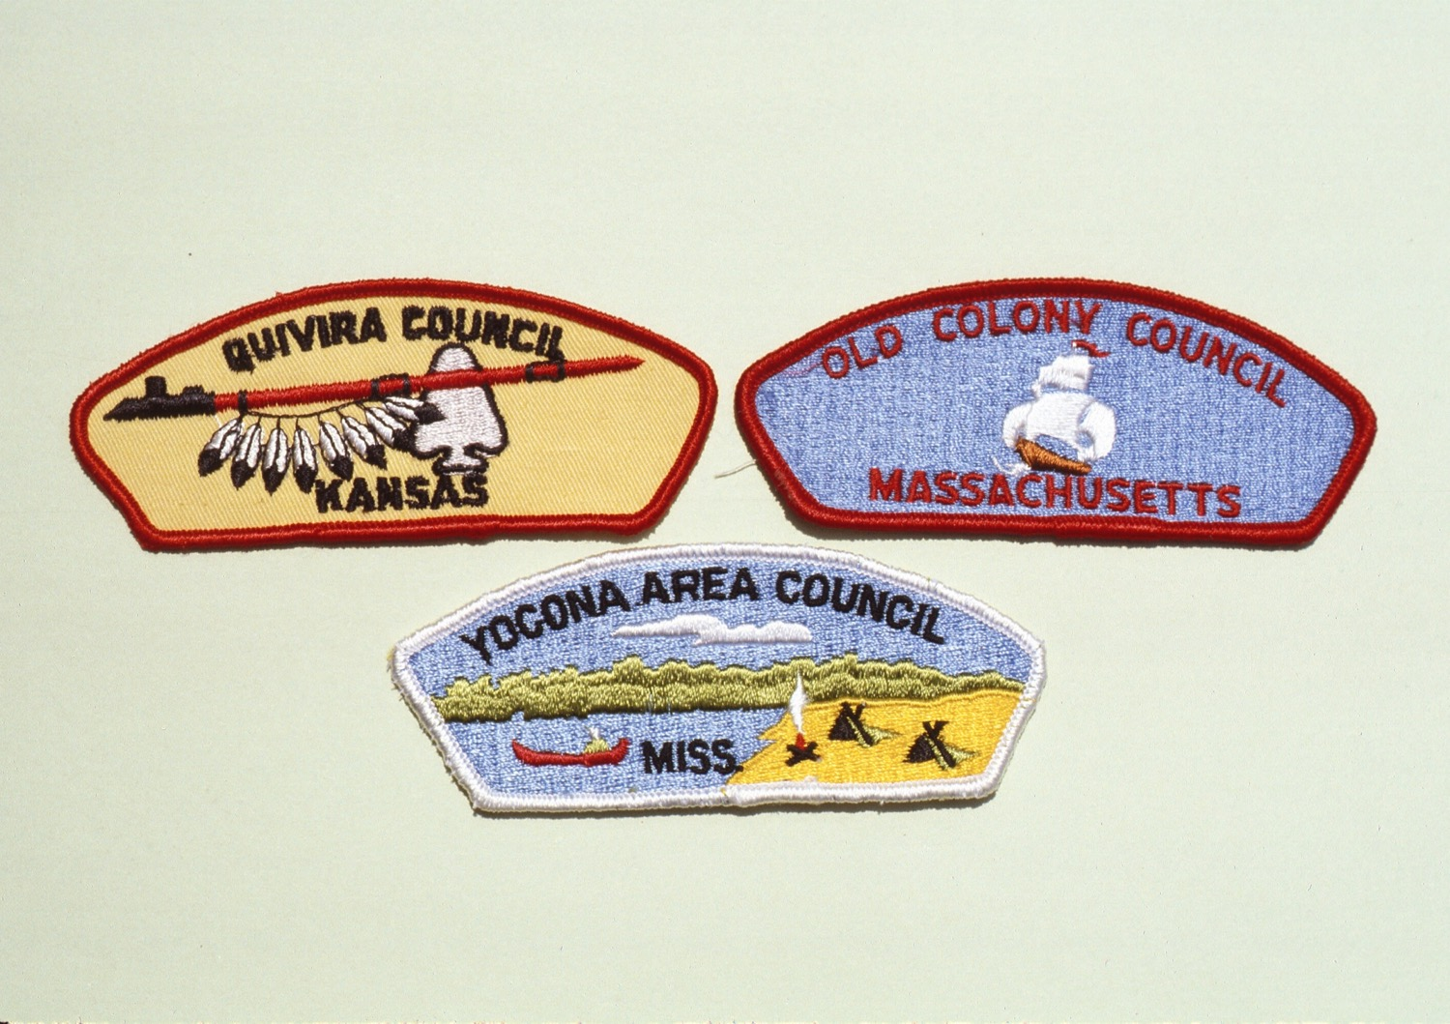

Slide 39
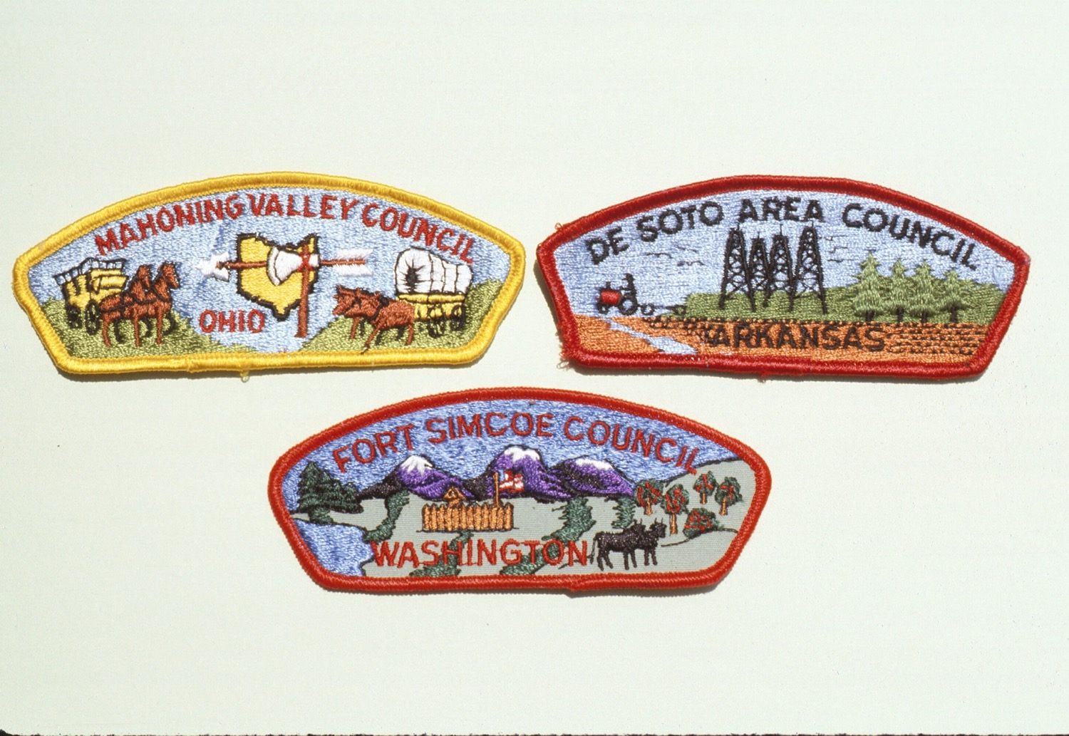

Slide 40
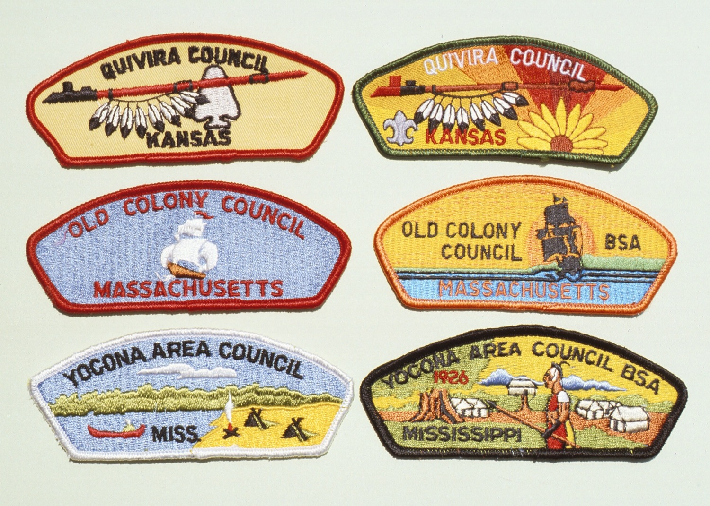

Slide 41
COLORS + DETAIL = ATTRACTIVE

Slide 42
LOTS OF COLORS = COLORFUL

Slide 43
LOTS OF SOLID OVERWHELMINGLY
COLORS + DETAIL = ATTRACTIVE

Slide 44
LOTS OF + SOLID = OVERWHELMING
COLORS DETAIL

Slide 46
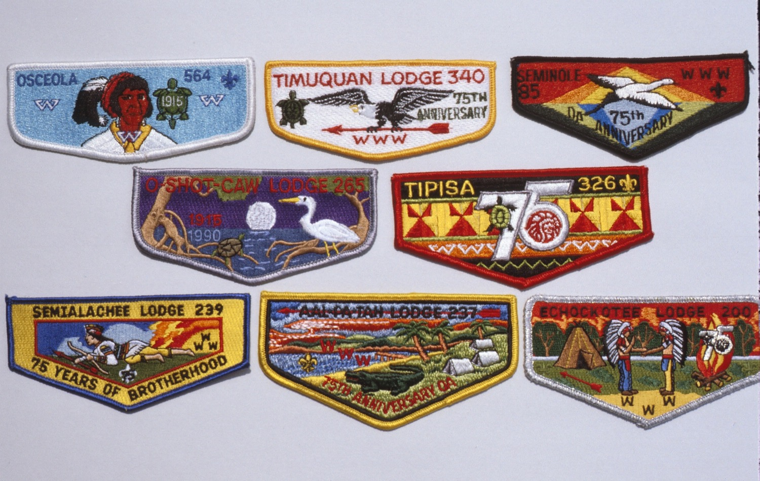

Slide 47
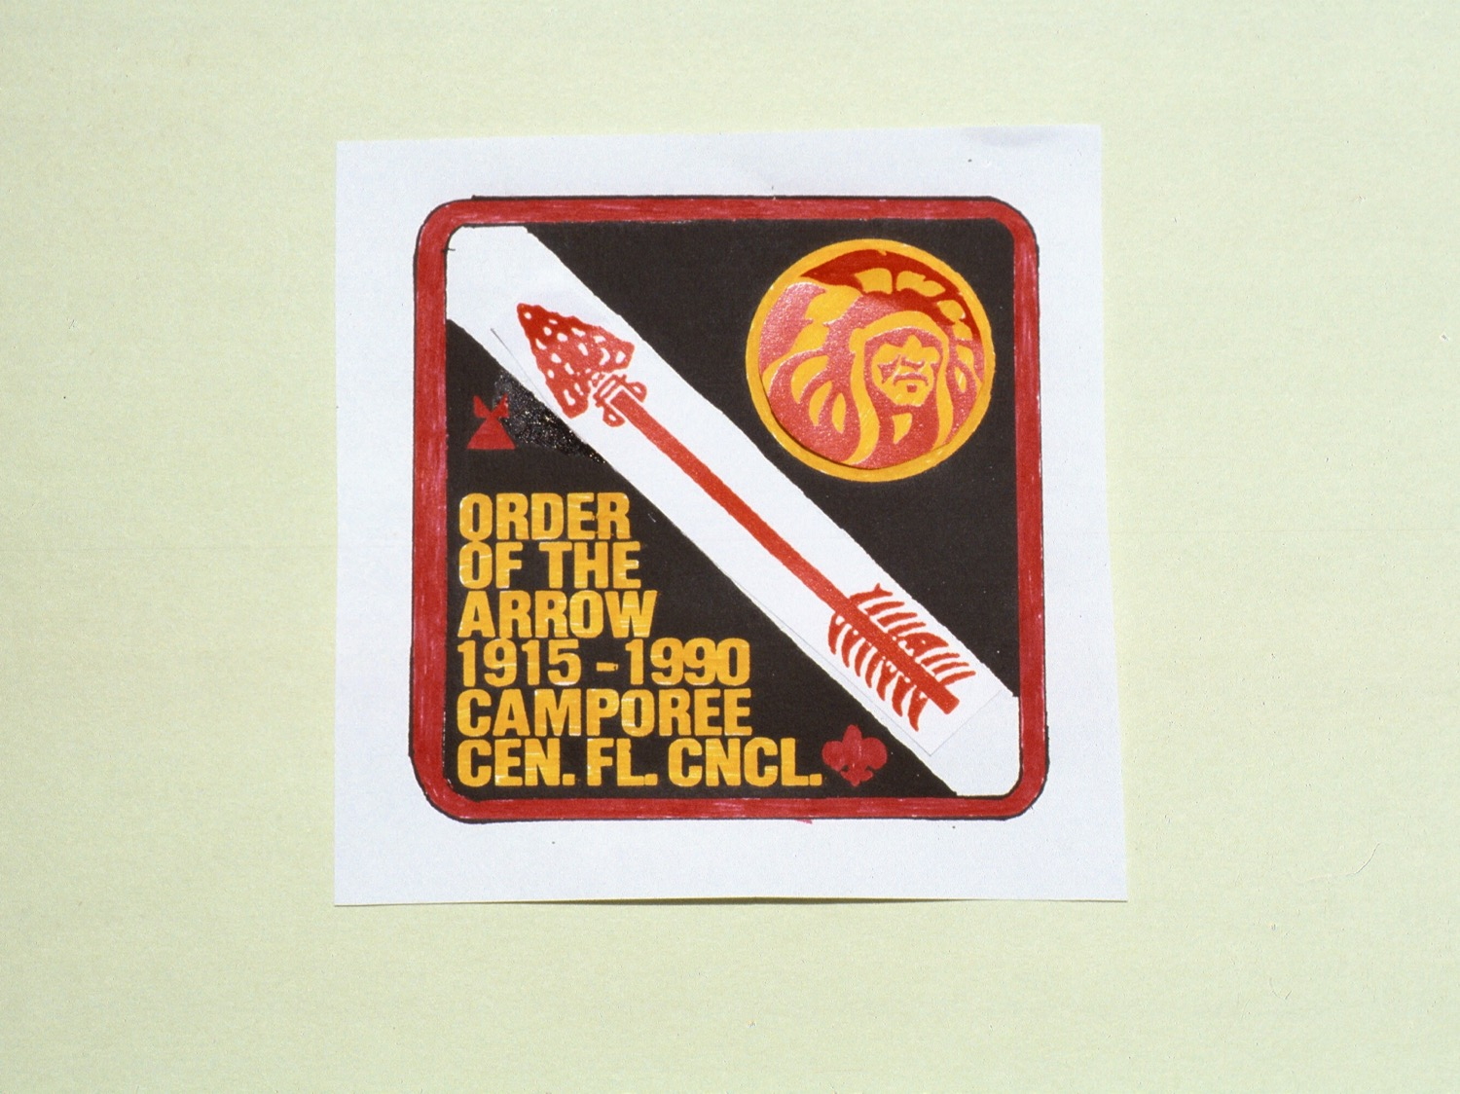

Slide 48
THREAD COLOR
RESOURCES
www.gopatch.com

Slide 49
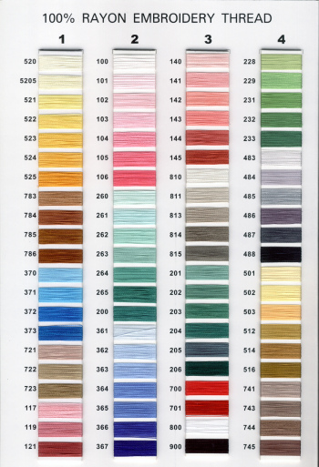
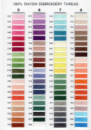
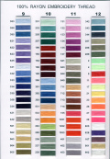

Slide 51
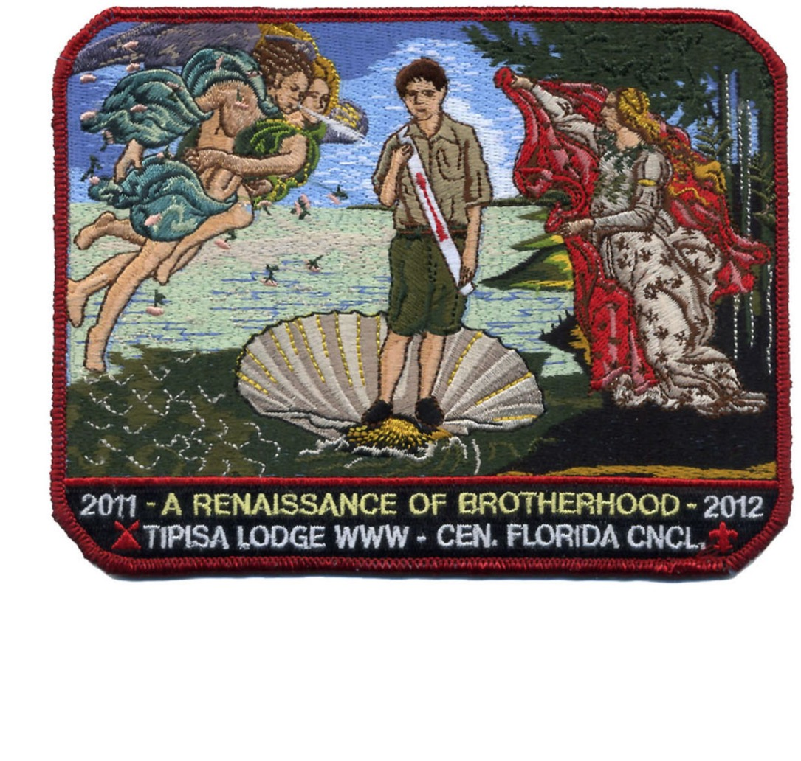

Slide 52
For Training Resources and More Information Visit:
http://training.oa-bsa.org/noac2015

