Slide 1
Patch Economic$

Slide 2
Identifier
Souvenir
Trader
Fundraiser

Slide 3
BUDGETING

Slide 4
HAVE
ACTIVITY.
SELL
PATCHES
ORDER
PATCHES
RECEIVE
PATCHES
BILL
IS DUE
PAY
BILL
FIRST MONTH
SECOND MONTH
THIRD MONTH

Slide 5
MARKETING
- SETS

Slide 6
MARKETING –
WHEN THE STORE
IS OPEN

Slide 7
MARKETING –
A LA CARTE

Slide 8
OLD: Registration Form
Registration $XX,00 x Number attending = _________
NEW Registration Form
Registration $XX.00 x Number attending = ------------------
Patch (one per person) $ 4.00 x Number attending = ___________
Total enclosed ___________

Slide 9
THE SIZE
OF THE
MARKET

Slide 10
PRICING

Slide 11
THE AUCTION BOX

Slide 12
ARROW
PASS

Slide 13
THE PATCH GROUP

Slide 14
Ethical
Patch Trading

Slide 15
THE SOCIAL
CONTRACT

Slide 16
Etiquette

Slide 17
1. Never interrupt another
trade.

Slide 18
1. Never interrupt another
trade.
2. Ask before touching.

Slide 19
1. Never interrupt another
trade.
2. Ask before touching.
3. Finish the trade
with a Scout handclasp.

Slide 20
1. Never interrupt another
trade.
2. Ask before touching.
3. Finish the trade
with a Scout handclasp.
4. Respond to mail quickly.

Slide 21
FAIR VALUE

Slide 22
A FAIR TRADE
–
ONE FOR ONE?

Slide 23
A FAIR TRADE –
-
TWO FOR ONE?

Slide 24
A FAIR TRADE
THE HYPE

Slide 25
RESTRICTIONS

Slide 26
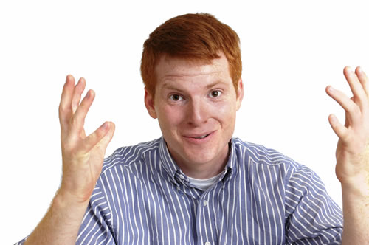

Slide 28
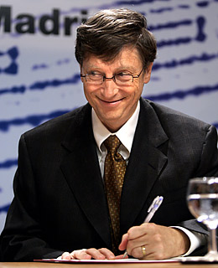

Slide 30
RESTRICTIONS = ??

Slide 31
WORK
HOURS ?

Slide 32
LODGE
EXECUTIVE
COMMITTEE ?

Slide 33
ENCOURAGE
ATTENDANCE ?

Slide 34
ARTIFICIAL
RARITY ?

Slide 35
“ELITE”
PATCHES ?

Slide 36
I think that I shall never see Every issue of every csp, Or every flap upon a chest, Or summer camps and all the rest. I’m always looking, here and there. A need could be ‘most anywhere. Besides the patches in every trade, It’s great to know that a friend is made. Though I hope for every patch. Some will always elude my catch. When on Ebay, the bidding’s high I must let it go, with a sigh. Maybe next time, I’ll be a winner. Does lusting for it make me a sinner? God help a patch hound that’s like me Waiting for the next variety.

Slide 37
For Training Resources and More Information Visit:
http://training.oa-bsa.org/noac2015

