Slide 1
#ChooseOA:
Election Rate & Best Practices

Slide 2
High Performing Lodges
An Introduction

Slide 3
What is a High Performing Lodge?
A High Performing Lodge (HPL) is a lodge that excels in three areas of lodge operation:
1. Unit Elections
2. Induction Rate
3. Activation Rate
Notes:
https://oa-bsa.org/article/high-performing-lodges-meet-in-northeast-region To read more about how HPL is defined from the NE HPL Summit in 11/2018.

Slide 4
High Performing Lodge
HPLs have:
90% Unit Election Rate
90% Induction Rate
50% Activation Rate
Notes:
Slide Order: this one may be more appropriate to go after the 2 Funnel slides.

Slide 5
The Funnel
Notes:
Introduce the concept of the funnel in terms of our retention

Slide 6
The Funnel
Units Visited
Scouts Elected
Scouts Activated
Scouts Inducted
Notes:
Identify the bottlenecks for audience members to highlight how few actually are activated. This drives home our need for excellence in the recruitment/induction process

Slide 7
Our Focus
Units Visited
Scouts Elected
Scouts Inducted
Notes:
Don’t dwell, dive straight into our focus: the Unit Election and Visit. Step one of achieving HPL.

Slide 8
Unit Elections
How to Execute the 1st Critical Function of a High Performing Lodge

Slide 9
Your Goal
Contact and Visit 100%
of Your Council’s Units
Notes:
What we hope to achieve by training our members on how to conduct quality elections.

Slide 10
Who
Pre-2019
Post-2019
Troops Boys aged 17 & under
ASMs aged 18-20
Troops, Crews, & Ships Members aged 21 & under
Notes:
Who are we electing
Plus nights of camping, and rank, approval of unit leader. Adults nomination process static.
Any questions should refer to this page: https://oa-bsa.org/about/membership

Slide 11
Why
It is part of our Purpose Recognize those who best exemplify the Scout Oath and Law in their daily lives and through that recognition cause others to conduct themselves in a way that warrants similar recognition.
Notes:
Why should we be visiting all 100% of units (other than the obvious selfish reason of membership), it is our purpose to honor all members who live out our ideals and acknowledge them in front of their peers for it.

Slide 12
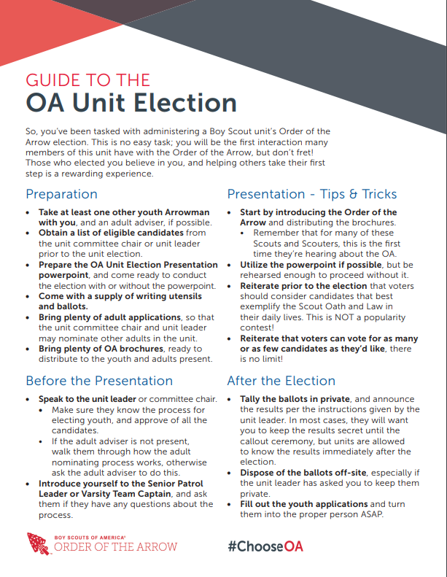
The Basics of An Election
Meet the Unit
Verify Eligibility
Introduce the OA
Conduct the Election
Tabulate Ballots
Prepare Applications
#ChooseOA
Unit Election Info Sheet
Notes:
For the resource, visit: https://oa-bsa.org/chooseoa/

Slide 13
Step 1
Create a Unit Elections Committee
Notes:
Make sure you have people invested specifically in making elections and unit visit happen.

Slide 14
Who Should Be On It?
Any Arrowman
Diversity of Membership Levels
New Members Encouraged
Diversity of Units
Scouts, Venturers, Sea Scouts
Work with Capable Adult Advisers
Those Who Set a Positive Example
Notes:
Creating a Unit Elections Committee
• Explain that a UEC is very helpful in large or small lodges. The arrowmen on this committee should be diverse and growing. They do not need to be a vigil member to join, and scouts/ venturers that are familiar with a large number of
1
troops can be great in this committee. Think Camp Staff for your local summer camp.
• These members should work with adult advisers to volunteer to conduct unit elections, inform troops, etc about the Order of the Arrow, and serve as a positive example of what it means to be an Arrowman.
- Maintaining a committee
• What to expect from your committee (updates, data, goals, etc)

Slide 15
What Should You Do?
Determine Scope
Lodge Election Team or Chapter Teams
Monitor Metrics
How Many Units Contacted
How Many Scouts Elected
“What gets measured, gets managed”
- Peter Drucker

Slide 16
Step 2
Begin Reaching Out

Slide 17
How To Reach Out
Let them contact you
Create a form on your Lodge site so units can request a visit
Visit District Roundtables
Do an information session and be visible
Talk with Unit Commissioners and DEs
Notes:
How to conduct unit elections
- Large lodges vs. small lodges
• Further develop needed. Self explanatory.
- Communicating with Troops, Crews, and Ships
• How to have a UEC work with SPLs, OA Troop Reps, & Scoutmasters on when to visit, etc
• Suggest a google forms, survey monkey, etc request form to have troops fill out when they would like a unit election to manage information
- See appendix for form emails, backdater, script, sample form.
- How to utilize adult advisers
• Lodge advisers and paid professionals have access to information that is valuable (email addresses, connections to adult district reps, etc) that could be used to make “first contact” with a troop, crew, etc if no information is available.

Slide 18
Build Relationships Beyond 2019
Maintain contact information to use next year
Build relationships with the units so they reach out to you
The more units you have established with, the more time that can be spent reaching out to those new to the OA

Slide 19
Visits With Units New to the OA
Try to establish a relationship with unit members prior to the visit
Roundtable, Council events
Provide a unit activity in addition to the information session
Establishes goodwill and maximizes value of OA to the unit
Notes:
Reaching out to units who have never had a unit election
- Council resources for communication
• Roundtables, council meetings, district reps, etc can be useful to make announcements regarding the new policy change, and what it means for units that would not be eligible for membership prior to 2019
- Explaining what the OA is
• Reference the elevator pitch document we produced in 2018

Slide 20
Units With No Eligibile Members
Visit and provide an OA information session and talk about what an election might look like
Provide a unit activity in addition to the information session
Establishes goodwill and maximizes value of OA to the unit
Notes:
Reaching out to units that have no eligible members, but are still interested in
the OA
• Self explanatory

Slide 21
Step 3
Get Organized

Slide 22
Make Sure
Every Unit Election is marked on a calendar for all UEC members to see
Follow-up after every election to make sure that candidates information is collected completely and posted to LodgeMaster in a timely manner.

Slide 23
Resources
Backdaters
For the Unit Election Committee to plan out when units should be contacted and visited
Sample Google Form
Email Templates

Slide 24
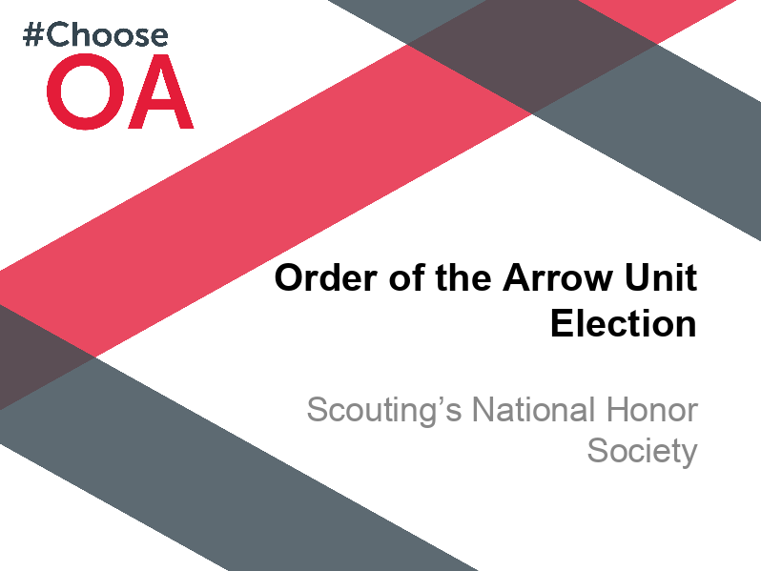
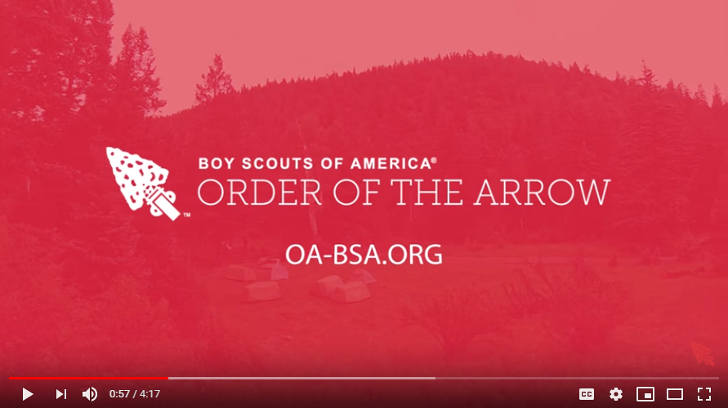
Resources
#ChooseOA
Unit Election Presentation
Conducting Unit Elections
Video

Slide 25
#ChooseOA:
Election Rate & Best Practices

