Slide 1
BROTHERHOOD BOUND
“Just another stop along the way….”

Slide 2
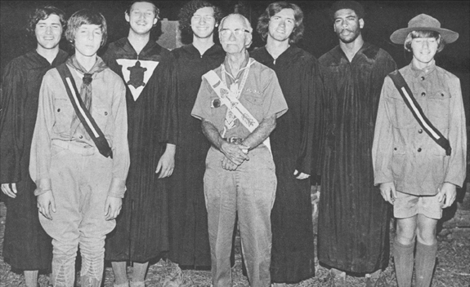
History of the Brotherhood

Slide 3
What is the Purpose of the Brotherhood?
To strengthen a member’s commitment to the Order
To increase membership retention
To increase the amount of service provided to council and community

Slide 4
ORDEAL BREAKOUT SESSION
The Five Challenges of Brotherhood Membership

Slide 5
1.) Memorize the Signs of Arrow Membership
Obligation
Order of the Arrow Song
The Admonition
Sign of Ordeal Membership
OA Handclasp

Slide 6
2.) Advance in Your Understanding of the Ordeal
What the four principle characters and their actions represent in the Pre-Ordeal Ceremony
The four principle characters of the Ordeal Ceremony
The four tests of the Ordeal
The three symbolic preparations for the Obligation
The tradition given to us by Uncas as described in the legend
The Arrow

Slide 7
3.) Serve your Unit
Plan a campout
Organize a unit community service project
Larger leadership role
Troop OA Rep.

Slide 8
4.) Plan for Service in your Lodge
Work as a member of kitchen crew
Join a dance team
Become a ceremonies team member
Join and serve as a member of chapter leadership
Serve the LEC as part of a committee, or as a committee chairman

Slide 9
5.) Review your Progress
Letter to the Secretary
Explain what you think the Obligation means
Describe how you have been fulfilling the Obligation in your troop and in your daily life, and how you have used your understanding of the Ordeal to aid in your service
Describe your specific plans for giving future service in the Lodge program

Slide 10
CONCLUSION
“Getting into the driver’s seat…”

Slide 11
For Training Resources and More Information Visit:
http://training.oa-bsa.org/noac2015

