Slide 1
Induction Rate
Converting Candidates to Members

Slide 2
Session Objectives
Explain the Induction Rate Metric and importance of making an impact on newly elected candidates and the importance of going through the ordeal.
Demonstrate Creative and innovative strategies to improve this metric
Guide participants in a reflection of their lodge’s current actions, what their lodge can do in the future.
Enable participants to innovate and improve their lodge’s process of getting candidates to their induction.

Slide 3
Introduction
Did you know that over the course of the last five years, youth OA membership has declined by more than 10,000 Arrowmen?
We’ve finished our Unit Elections; Now What?

Slide 4
FOCUS Area #2
Induction Rate measures the percentage of Scouts elected to the OA who attend the Ordeal
Number of candidates inducted
Induction Rate =
Total number of elected candidates
Inducted
Induction Rate
=
Elected

Slide 5
How is Induction Rate Calculated?
No Shows
Elected Candidates
and Selected Adult Candidates
This percentage is the Induction Rate
New Ordeal Members
Elected
Inducted

Slide 6
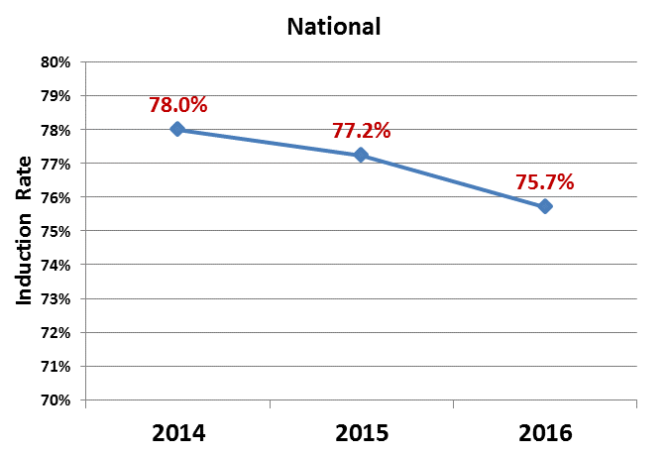
National Induction Rate Averages

Slide 7
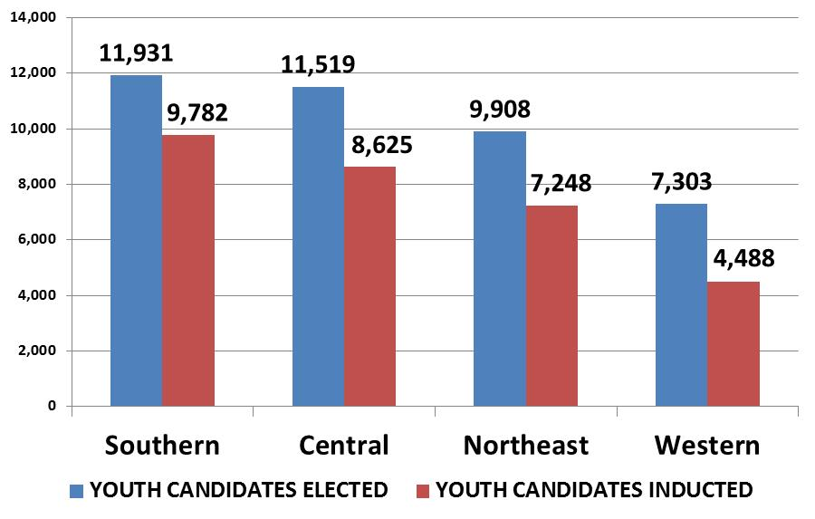
2017 Regional Induction Rate
Elected
No Shows
Inducted

Slide 8
How Can Lodges Improve Their Induction Rate?
What are some barriers that prevent an elected Scout from registering for and completing his Ordeal?
5 Minute Buzz Session

Slide 9
Questions?

