Slide 1
OA Involvement in the district
Chapter Operations

Slide 2
Session topics
Understand a BSA District structure and how your OA Chapter fits in and what your Chapter’s responsibilities are within your District.
Discover how your Chapter can find new opportunities or enhance existing programs within your District.
Gain an understanding of areas that OA members can enhance the program of your District’s Cub Scout Packs, Boy Scout Troops, Venturing Crews, and Ships

Slide 3
introduction
Who we are and why we are here.

Slide 4
introduction
Who we are and why we are here.
Who are you and why are you here?
You are Arrowmen, just like us, who are ready to learn more about OA within their district.

Slide 5
introduction
Who we are and why we are here.
Who are you and why are you here?
You are Arrowmen, just like us, who are ready to learn more about OA within their district.
It Starts With Us!

Slide 6
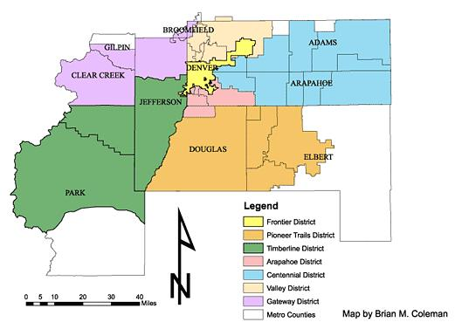
BSA District Structure What It Contains
You District is a part of a larger council

Slide 7
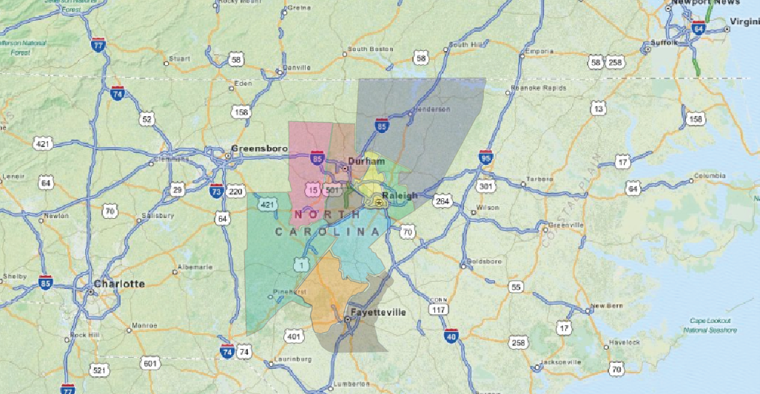
BSA District Structure What It Contains

Slide 8
BSA District Structure What It Contains
A District Contains:
Scouting Units such as Cub Scout Packs, Boy Scout Troops, Venturing Crews (and Ships).
These scouting units are normally service by a district executive (who works for the local council)
Plus Dozens, if not Hundreds of volunteers
The district is operated by the District Committee.
These volunteers and professionals provide the
Scouting Experience at the unit level or as a district volunteer.

Slide 9
BSA District Structure The OA Chapter
Your Chapter is a part of a district and covers the exact same units.
It is run by elected youth volunteers with the backing of volunteer advisors who are guided by the lodge as well as the district committee.
Each Scouting Unit that Participates (not Cub Packs for example) will have one or more youth leadership positions established as the OA Troop Representative.
Additionally, an adult advisor will be assigned (typically an ASM).
These representatives normally attend monthly chapter meetings and are the communication pipeline back to their respective units.

Slide 10
BSA District Structure Chapter Responsibilities
The number one responsibility of your chapter is to PROMOTE CAMPING
This is accomplished in several ways
At District Roundtable Meetings
During Unit Visitations
By the nature of our membership eligibility rules and induction methods
Promote OA Troop Representative Leadership Position and encourage each troop to participate in chapter activities.
Provide “Loaner” Leadership Teams to give struggling troops a boost.
Additional Responsibilities include helping with district program.

Slide 11
Discover new opportunities within your district
WHAT ELSE? There are endless possibilities
Volunteer to help with, or better yet, run district events
Camporee or Klondike Derby
Staff Cub Scout Day Camp
Run the annual District Pinewood Derby Race
Provide training and demonstrations at district roundtable meetings
Help serve and cleanup during the annual district volunteer recognition dinner.
Make a visible difference as an Arrowmen during these events

Slide 12
Discover new opportunities within your district’s Units
What about your district’s scouting units? Again, there are endless possibilities for arrowmen to make a difference.
HOW?
Provide temporary leadership for a new or struggling boy scout troop
Provide a unique activity or game to a troop during a unit visitation
Provide the GO-TO ceremony team for Cub Scout programs such as award presentations, webelos awards and crossover ceremonies.
Visit a cub scout pack meeting and provide or assist with opening flag ceremony
Provide tailored leadership training to new troop leadership

Slide 13
CONCLUSION
It Starts with Us
Maybe your chapter isn’t doing all of these items for your district or units, or maybe you aren’t doing any of them.
Choose one or two that you can tackle in a given timeframe AND
Do a good job with them
Stage your effort so that OA will be the GO-TO group of scouts to keep these OA sponsored activities or service projects going year-after-year.
It Starts with Us

Slide 14
For Training Resources and More Information Visit:
http://training.oa-bsa.org/noac2015

