Slide 1
Creating the Cutting Edge Conclave
Developing your Training Sessions

Slide 2
Learning Objectives
Become familiar with conclave training programs
Discuss various types of sessions to include
Share lessons learned based past experiences
Discuss options for conclave training awards and recognition
Learn about promotion strategies
Become comfortable with OA training resources

Slide 3
What is training?
This training session is titled, “Developing your Training Sessions”
Let’s begin with a simple question…
What do we have to consider when putting together a training program for conclave?

Slide 4
Key Considerations
Types of training sessions (e.g., “best practice” demonstrations or skill-based sessions)
Number of training sessions to offer
Logistics (camp/building facilities)
Keynote or special “guest” presenter sessions
Awards or special recognition for participation
Ways to promote training offerings, prior to or during conclave

Slide 5
Types of Training Programs
Open Style
Certain number of sessions are offered each block
Participants can select their own curriculum
May be similar to a lodge run LLD program
University Style
Tracks containing related sessions topics are grouped together
Non-required, ‘elective’ sessions may be offered
Participant takes all sessions within a cell
NOAC utilizes a hybrid methodology

Slide 6
Exercise
Break into groups
Develop a degree path (need course title and descriptions)
2 core sessions
2 electives
Course tracks
Ceremonies
Lodge/Chapter Management
Leadership
OA Service
Relationship Building

Slide 7
What Do Participants Need to Know
The people who are providing the training (Who)
The purpose of the training (What)
The expected outcome of the training (Why)
The location of the training (Where)
The time of the training (When)

Slide 8
Exercise Team Reports
Debrief
This exercise was meant to show how to structure a training track and give you an opportunity to develop some sample courses

Slide 9
Case Study
Section NE-1B: College of Conclave Science
Benefits
Multi-year program that supports any training program structure
Engages Arrowman of all levels to actively participate in training at conclave
Helps recruit new trainers in your section

Slide 10
College of Conclave Science
Associates Degree
Attend a training session in at least two of the three training time blocks
OR be on the Section Conclave training staff
Bachelors Degree
Have earned the Associates Degree in Conclave Science
AND attend a training cell in all three of the available training blocks
OR be on the Section Conclave training staff

Slide 11
College of Conclave Science
Masters Degree
Have earned the Bachelors Degree in Conclave Science
AND attend a training cell in all three of the available training blocks
OR be on the Section Conclave training staff and attend at least one other training cell (unless that staff member is training more than one cell)

Slide 12
College of Conclave Science
Doctoral Degree
Have earned the Masters Degree in Conclave Science
AND serve on the Section Conclave training staff
AND submit a thesis paper on a topic regarding the Order of the Arrow that has received prior approval from the CVC of Training and Section Training Adviser

Slide 14
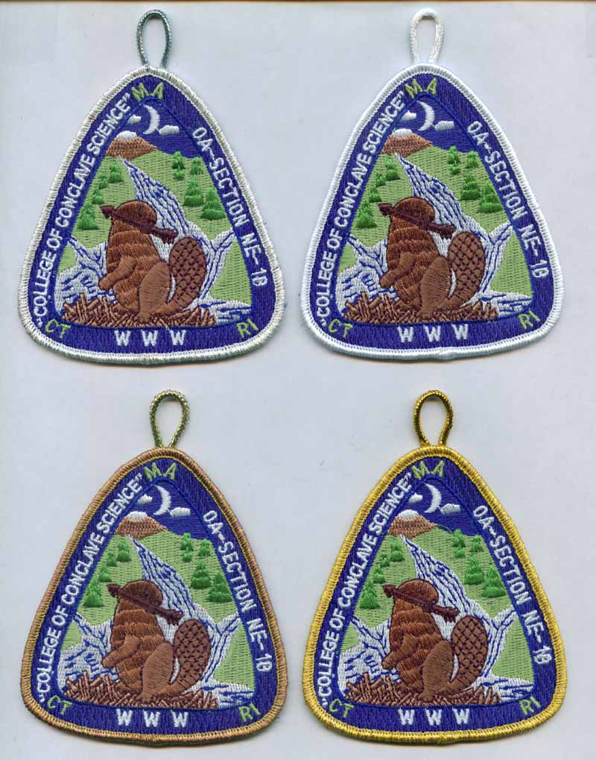
Masters
Associates
Bachelors
Doctoral

Slide 15
Promotion Strategies
Advertise your training program well in advance of conclave
Include information on section website, in section newsletters, social media postings, etc.
Use creative training session names to attract interest
Free Coffee and Donuts, How to Pick up Chicks in a Scout Uniform, etc.)
Leverage experts to teach appropriate sessions (they bring credibility to a specific topic)

Slide 16
Resources
Prior Training CVCs (talk to your Section leadership team)
Your own lodge’s LLD program materials
District and Council training committee members
Other experienced Arrowmen (think PhD candidates)
OA Training website (training.oa-bsa.org)

Slide 18
Summary
We’ve talked a lot about training –
How to structure a conclave training program and possible training sessions to include
Ideas for participant recognition
Avenues for training promotion
Resources to leverage
It’s important to remember that when you’re planning your training program, you should provide a well-rounded list that is fun and engaging to everyone who is in attendance.

Slide 20
For Training Resources and More Information Visit:
http://training.oa-bsa.org/noac2015

