Slide 1
Sharing the OA Message
Lodge Leadership Development

Slide 2
Introduction
<Instructor’s Name>
Lodge Leadership Development
Notes:
The trainer should introduce himself to the audience and give a brief introduction of himself, especially as it relates to communications, marketing/public relations, and training.

Slide 3
Objectives
After this session, participants will be able to:
Understand the differing dynamics of small and large groups
Develop an understanding of basic public speaking skills
Lodge Leadership Development
Notes:
The trainer should give an overview of the session’s objectives and explain that this training will also try to answer as many as possible questions that were written before the start of the session.

Slide 4
Objectives
Recognize various forms of message delivery
Acquire insight into digital communications
Create a SMART vision for communications in their unit, chapter, or lodge
Lodge Leadership Development

Slide 5
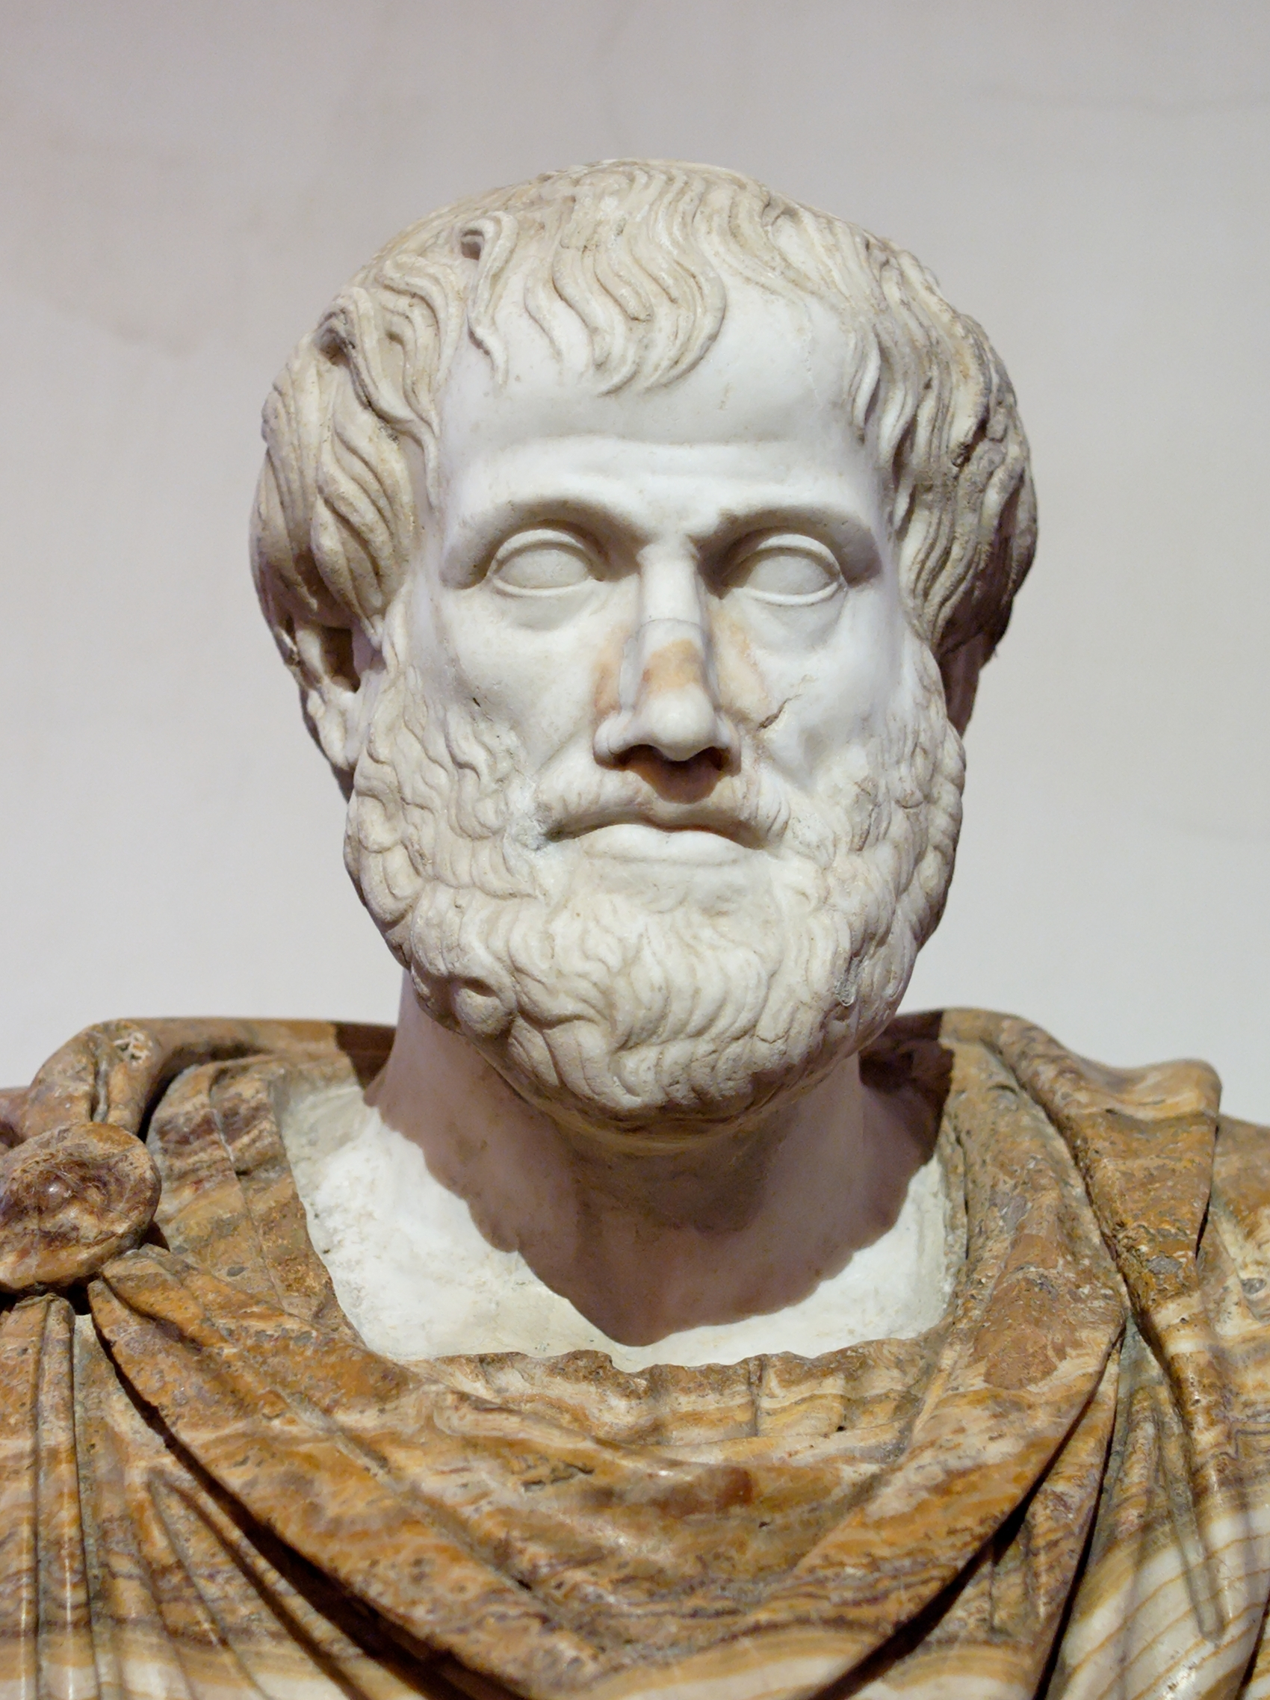
What is Communication
Sender
Message
Receiver
Lodge Leadership Development
Notes:
The trainer should ask: “what is communication?” and allow for several responses. Then, the trainers should ask if there are any NYLT, NLS, NAYLE, or Wood Badge alumni in the room. He should then ask them, “What are the three parts of communication”?
The correct responses to the second question should consist of “message”, “sender”, and “receiver”. A concise definition of each part should be given.
Just like Aristotle said the same thing 3,000 years ago, communication consists of a message, a sender, and receiver. If we understand that all communication is based on this model, then communicating in front of both small and large groups and on social media becomes much more understandable. As communication, in short, is just an interaction of these three parts.
The trainer should then ask: “What are some barriers to effective communication?”. Responses could include disruptive environment, differing languages, lack of visual aids, and other appropriate answers. The trainer should explain that all these and other barriers are known as “noise” and can disrupt communication.
Effective communication takes into account noise that can affect the message, sender, and receiver. When communicating, in any form, it is important that we all consider these barriers and how we can overcome them.

Slide 6
Small Group Communications
Lodge Leadership Development
Notes:
Scouts and Scouters, especially, have spoken publicly at one point or another. Being able to speak in front of live groups is crucial and necessary. Therefore, those speaking in front of a group should be prepared ahead of time usually with an outline or plan of their main points. It can be difficult to use a script effectively during a presentation, so the speaker should strike a balance between the two.
In Scouting, communicating with small groups is one of the most common communication scenarios a Scout will experience. For this session, a small group is defined as any setting that includes two (2) to sixteen (16) individuals. This means meetings of a patrol leader council, a lodge executive committee, or a senior patrol leader meeting with his troop’s committee are all considered a small group.
Small group communications are necessary for success in not only Scouting but also in academic and workplace settings. At one point or another, a person will have to work in a small group.
The trainer should explain that small groups can be one of the easiest settings to communicate in. Small groups can be more relaxed and allow a trainer to interact personally with each participant.
Small groups are an opportunity to utilize preparation-intensive delivery methods. At this point, the trainer should invite participants to look at “Handout 1”. Demonstrations, simulations, and other methods are more practical in this setting, as fewer participants reduce the amount of preparation needed by a trainer.
The trainer should close this topic by explaining that Scouting prepares youth to tackle these situations.

Slide 7
Large Group Communication
Lodge Leadership Development
Notes:
For the average Scout, communication with a large group is not as common. Unless involved in the Order of the Arrow or in a large troop or team, an annual or biannual court of honor is the most common form of large group communication for a Scout.
In this session, we’ll call a large group as any gathering that has more than 30 people present. As such, a trainer is less likely to be able to genuinely connect with each participant.
This is due to communication with a large group usually involves a single person at any given time lecturing an audience. However, panels and “round-robins” are often used as well. It is important to remember that this potential decreased interaction can be reduced using a variety methods including breaking the larger group into smaller groups for discussions or activities and frequently engaging the audience with questions to be answered or asking for a “show of hands”.
When communicating to a large group, there are many other resources and skills that can be utilized to improve the speaker’s message, their clarity, and the engagement of the audience. Distribute “Handout 2” at this point, and invite participants to ask questions and share ideas they have as well.

Slide 8
Electronic Communication
Lodge Leadership Development
Notes:
Ever since the introduction of the computer into public life, electronic communication has become more prevalent. First, e-mail was the fastest way to reach a crowd, then came social media and apps, and, now, new communication methods are constantly being developed.
It is important that every lodge, chapter, and unit consider how they are utilizing these methods and how effective is their current communication. In this session, we will go over three of the most common electronic communication methods: e-mail, mass texts, and social media and websites.

Slide 9
Order of the Arrow Audiences
Arrowmen | Families | Scouting Units
Lodge Leadership Development
Notes:
In the Order of the Arrow, we have three main audiences: Arrowmen, their families, and their units. For younger, youth Arrowmen, they are often dependent on their family or other adults for transportation to and from Order of the Arrow activities. For older, youth Arrowmen, they often have responsibilities in the unit. It is important to remember that your communication must consider both the Arrowman and their family and unit.

Slide 10
READY
READY is a marketing checklist anyone can use to improve and support their communication strategy. Collectively, READY stands for:
Rewarding Engaging Attractive
Dynamic You
Lodge Leadership Development
Notes:
Creating content for communication can be difficult. Encourage participants to use the READY checklist by having each participant look at “Handout 3”. Briefly, explain each aspect of the READY checklist:
Rewarding: Every piece of communication should have a reason for the receiver to respond. This could be encouraging “early-bird” registration for an event, or inviting Scouts/Scouters to join Scouting’s National Honor Society.
Engaging: Additionally, a call to action is a must. To simply put, a call to action is any directive or instruction for the receiver to do, e.g. asking Arrowmen to pay their lodge dues, recruit an Arrowmen for ceremony team, and visit the lodge’s Facebook page.
Attractive: The Order of the Arrow is volunteer-led, but lodges have a wide array of resources at their disposal to produce attractive, quality communication pieces. Unprofessional-looking publications are an immediate turn-off for receivers.
Dynamic: At all times, be looking how to personalize and make communications relevant. If you can change e-mail headers to reflect each receiver’s name, use this chance to connect with your audience. Additionally, consider giving your communications a holiday or seasonal flair.
You: Every communication piece should emphasize the sender’s interest or passion. If the sender is disinterested in the message, this can easily be injected into the message. Also, show the personal side of your lodge. Your audience wants to see the humans sending the message and involved in your lodge.

Slide 11
Electronic Communication
Lodge Leadership Development
Notes:
Now, let’s consider e-mail communications. E-mail is the staple in every unit’s and lodge’s communication strategy. Whether it’s a Scoutmaster e-mailing transportation plans or a lodge advertising their spring event, e-mail is a cheap and effective way of broadcasting your message to a large audience.
Mass texts are becoming more common in schools, community groups, and conferences. With millions of cell phone users in the United States, the ability to push information into their palms is an exciting prospect. This system can effective to send short, brief, and text-only messages to receivers and can be especially effective in reminding Arrowmen of upcoming meetings, registration deadlines, and updates during an event.
Finally, social media and websites are an integral part of a lodge’s communication. If you are not utilizing either social media or a website, you severely limit your lodge’s capabilities. Both social media and websites provide nearly 24/7 access to information you share, and social media can push that information into your audience’s palms similar to mass texting. Over half of all American adults, use social media according to the Pew Research Center, and one can ask any teenager to find similar high usage rate as well.
The trainer should emphasize that no matter which methods are used a consistent message must be conveyed. The team of Arrowmen supporting a lodge’s communication must be constantly working and communicating with each other. The trainer should close the session by explaining with emphasis, the value of electronic communication in developing an effective communication strategy.

Slide 12
Takeaway Challenge
How will you Share the OA Message?
Lodge Leadership Development
Notes:
As Arrowmen, we have a responsibility to share the mission and purpose of the Order of the Arrow to its members and our communities. Effective communication can increase awareness of the Order of the Arrow in councils and units.
The trainer should ask every participant to look at “Handout 4” and give a brief challenge for each participant to take a look at how their unit, chapter, or lodge is communicating. The trainer should tie in any relevant council, district, or lodge goals for membership, retention, or marketing to give emphasis to the challenge.
The trainer should then thank participants for attending Sharing the OA Message.

Slide 13
Questions?
Lodge Leadership Development
Notes:
At this time, the trainer should go over any questions not answered yet. Additionally, he should offer his support to the participants in their future communications. This could include sharing his contact information, in accordance with YPT policies.

