Slide 1
Link 2017: Activation Rate

Slide 2
Focus Area #3
Activation Rate

Slide 3
What is Activation Rate?
Activation: Lodge program, the Ordeal experience, and personal inspiration result in a newly elected member attending his first OA event
A new member is “activated” when he attends his first OA event!

Slide 4
The Journey of a New Member
Awareness
Election
Call-Out
Induction
Activation
Engagement
Renewal

Slide 5
Activation
How long until the new member attends his first event?
Activation
First OA Event
Ordeal
Brotherhood
Service to Unit

Slide 6
2016 Activation

Slide 7
2016 Activation Percentages
 | 2016 Activation Percentages
Total Inducted | 1-5 Months | 6-11 Months | 12-17 Months | 18+ Months | Never Activated
33,461 | 17% | 8% | 6% | 0% | 69%

Slide 8
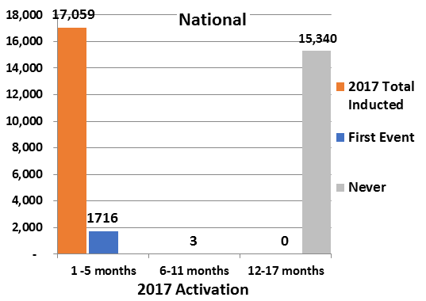
2017 Activation

Slide 9
2017 Activation Percentages
 | 2017 Activation Percentages
Total Inducted | 1-5 Months | 6-11 Months | 12-17 Months | Never Activated
17,059 | 10% | 0% | 0% | 90%

Slide 10
How Can Lodges Improve Activation?
Rethinking “Sash and Dash”
The term “Sash and Dash” focuses on whom?
The term “Sash and Dash” place blame where?
The Candidate
The Candidate

Slide 11
Barriers to Activation
Ceremonies
Educational Issues
Ceremonies were uninspiring
Ceremonies did not convey meaning
Ceremonies seemed unimportant
No new member orientation
Candidates unaware of lodge events
Candidates never visit lodge website
Ordeal Projects
Focus
Projects were not meaningful
Too much standing around
OA is all work and no fun
Untrained Elangomats
Candidates only joined for sash/patch
Candidates focused on other priorities
Administrative
Poor communication/no follow up
No OA troop rep in candidate’s unit
Poor record keeping
Ordeal Atmosphere
Perception of hazing
Lack of respect from members
Induction principles not recognized
Candidates did not feel welcome
Other
No friends to attend lodge events with
Poor quality of lodge events
OA not visible in council

Slide 12
Strategies for Improving Activation
Make the induction weekend fun with a new member party
Hold a new member dinner

Slide 13
New Member Party
Inflatables
Games
Popcorn/cotton candy
Music
Swag giveaways

Slide 14
New Member Dinner
Read about one lodge’s new member dinner here:
http://bit.ly/BestPracticesNewMemberDinner

Slide 15
Closing Challenge

Slide 16
Closing Challenge
[This slide intentionally left blank]

Slide 17
Questions?
link@oa-bsa.org

