Slide 1
Link 2017: Induction Rate

Slide 2
Focus Area #2
Induction Rate

Slide 3
How is Induction Rate Calculated?
Is this significant?
Youth No Shows
Elected Youth Candidates
New Youth Ordeal Members
Youth Induction Rate
Elected Youth
New Youth Members

Slide 4
Induction Rate Averages

Slide 5
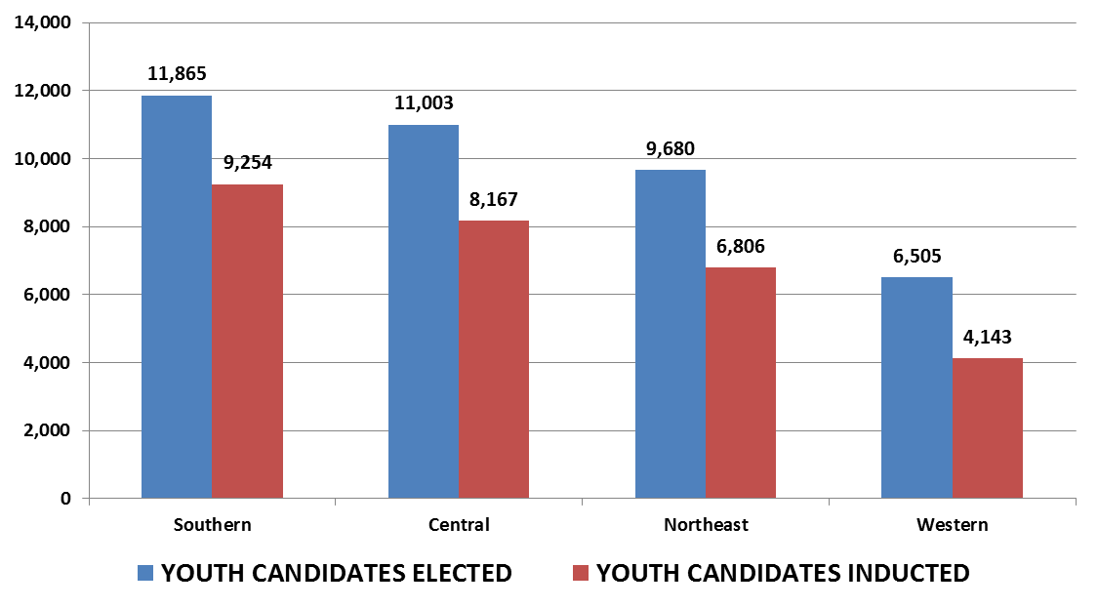
2017 Inductions: Regional Figures
“No Shows”

Slide 6
How Can Lodges Improve Their Induction Rate?
What are some barriers that prevent an elected Scout from registering for and completing his Ordeal?
5 Minute Buzz Session

Slide 7
Improving Induction Rate
Maintain several forms of contact with candidates after election
Maintain dialogue with the Unit Leader
Use snail mail
Lodge Rideshare
Recognize the power of call out ceremonies

Slide 8
Maintain Several Forms of Contact
Solicit Scout and parent e-mail addresses
Ask Scouts to follow lodge on social media
Call each of the candidates after the election
Sit down with the Scoutmaster

Slide 9
Use Snail Mail
See an example here: http://bit.ly/BestPracticesOrdealLetter

Slide 10
Lodge Rideshare
Read about a lodge’s rideshare program here: http://bit.ly/BestPracticesLodgeRideshare
Use a facebook group
Be sure to comply with Youth Protection

Slide 11
The Power of Callout Ceremonies
94% of survey respondents said the callout ceremony was the most meaningful
How does your lodge run call out ceremonies? What makes the special?

Slide 12
Questions?
link@oa-bsa.org

