Slide 1
Moving On with LeaderX
Innovation in your hands

Slide 2
Presenter Information
Name
Phone Number
Email
<Name>
<Phone Number>
<Email>

Slide 3
NEXT: A New Century
Module 3: Moving Forward with LeaderX

Slide 4
Being [good] is not a static thing. … Tomorrow morning you have to start over, continue the process and make adjustments. … [It is] a game that moves as you play, and if you don’t move you can’t play.
Viggo Mortenson (American Actor)

Slide 5
Moving Forward with LeaderX
ToolBox for Decisions & Action
Adopt LeaderX as an ongoing attitude for collaboration
Decide and Act on the Discoveries of LeaderX
Apply LeaderX beyond a single opportunity (“pain point”) and to the broader organization

Slide 6
LeaderX Approach
EXPLORE
DREAM
DISCOVER
Testing
Testing

Slide 7
What’s
???

Slide 8
Attitude to Action
DECIDE
ACT
Feedback
Feedback
Based on the OODA Loop developed by USAF Colonel John Boyd.

Slide 9
Pain Point…to…Program
Explore
Decide
Act
Dream
Discover
Event or Program
Single Decision

Slide 10
Decide Vision Together
Group Discussion
Anonymous Voting
Prioritize
Mature Teams
Delphi Technique
Eisenhower Matrix
A
B
C
B
A
C
C
A
B
A
C
B
SCHEDULE
DO IT
B!
C?
B
IMPORTANT
A
C
A
C
C
A
A
C
LATER
(DELETE)
DELEGATE
A!...
B...
A
URGENT

Slide 11
Action!
The six P’s to a successful action, especially events and programs!
Point!
People!
Program!
Promotion!
Planning!
Perspective!

Slide 12
Going Big
Council
Lodge
Function*
Event
Meeting
LeaderX
Kotter’s 8 Steps to Leading Change
www.kotterinternational.com

Slide 13
Forward!
Moving
Forward
…and Beyond…
Explore
Decide
Act
Dream
Discover
Small Wins
Repeat!
Shared Vision
Team Action
Leader
Leader

Slide 14
Additional Resources

Slide 15
Web Resources
As of NEXT Conference 2016
OODA Loop: www.idea-sandbox.com/blog/decision-making-like-a-fighter-pilot/, and https://en.wikipedia.org/wiki/OODA_loop
Delphi Method: http://www.rand.org/topics/delphi-method.html, and https://en.wikipedia.org/wiki/Delphi_method#Use_in_policy-making
Eisenhower Matrix: http://eisenhower-matrix.com/, and http://blog.trello.com/eisenhower-matrix-productivity-tool-trello-board/
Perspective (Lessons): help your team learn faster with their own After Action Review https://www.google.com/#q=after+action+review
Change: www.kotterinternational.com and Kotter’s books Leading Change (theory) and The Heart of Change (stories) are only the introduction to an entire world of “big time” action

Slide 16
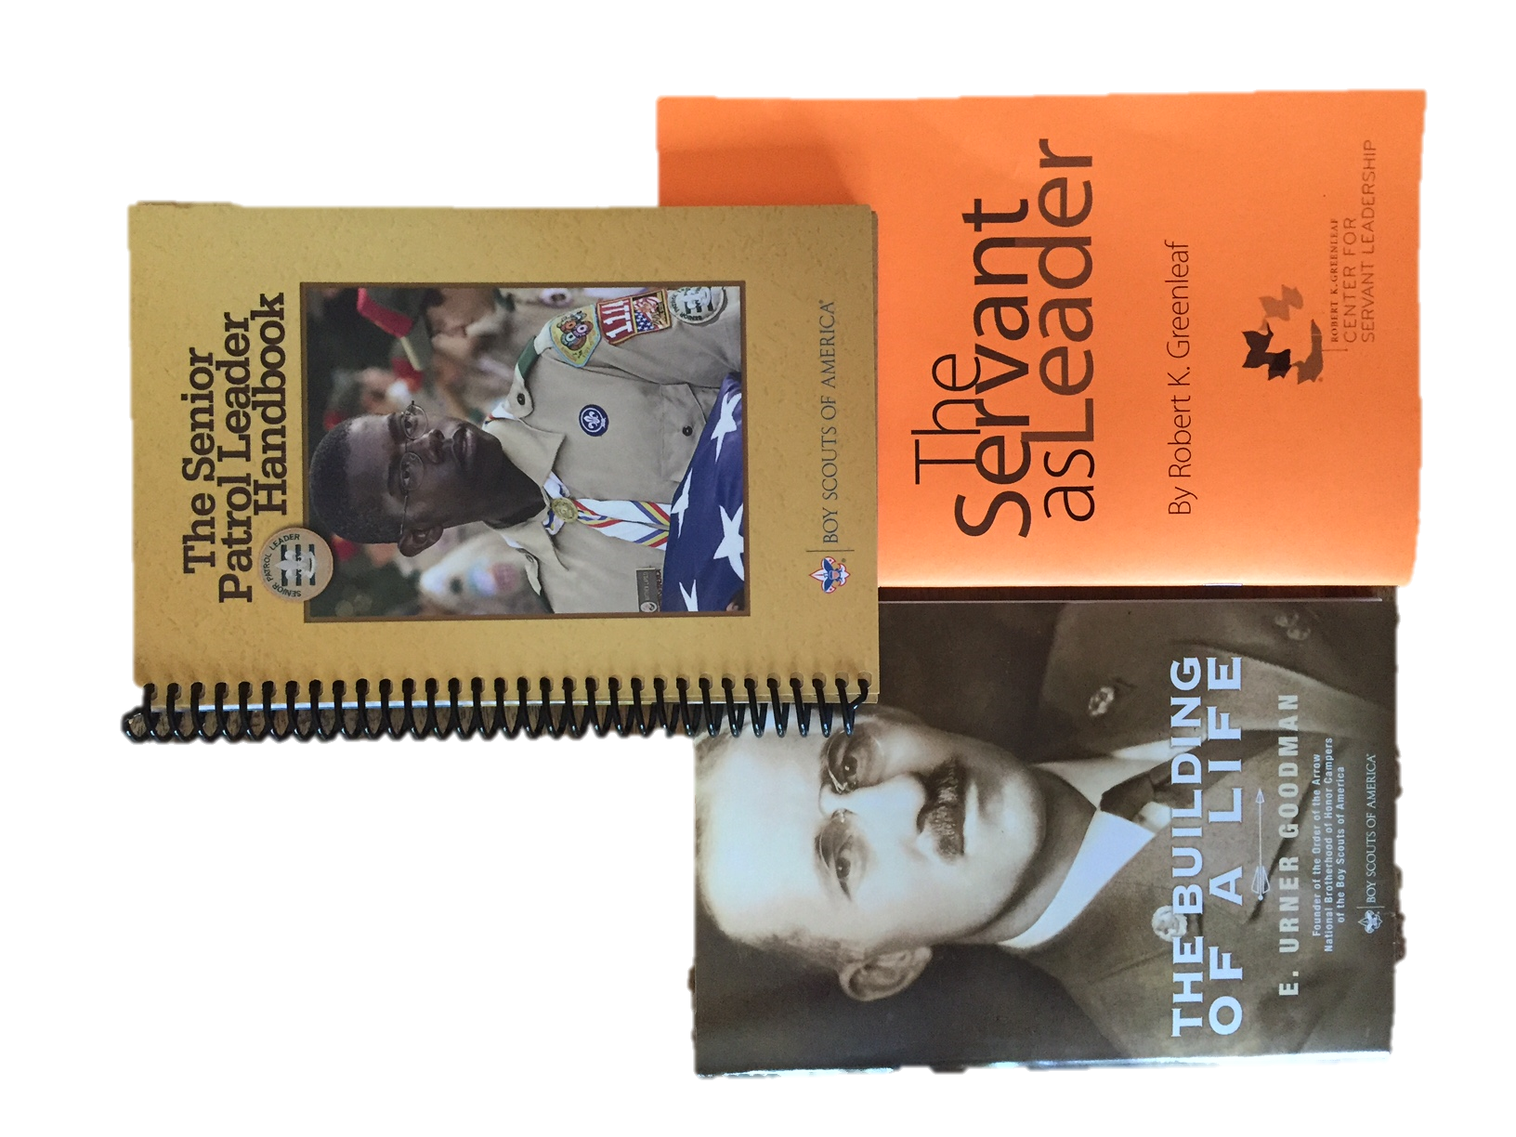
Books
Dig into these books and authors to learn more about Moving Forward with LeaderX.
This presentation created by Bob Crume of Tahosa Lodge 383. Contact bob.crume@gmail.com with questions or ideas on making change “stick” in your lodge.

Slide 17
A New Century

