Slide 1
Communications 101

Slide 2
Welcome!
Objectives:
Introduce Arrowmen to different communication channels.
Explain how to use the different channels effectively.
Spark an interest in getting involved with the National OA Communications team!

Slide 3
Session I : The Basics

Slide 4
OA Communications Team Overview
Mike DeSocio - Brand & Identity Lead
Na Tsi Hi Lodge
mike@mikedesocio.com

Slide 5
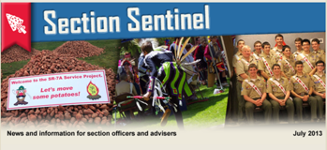
OA Communications Team Structure
Content Team
Writers, Photographers, Videographers
Production Team
Formatting, lay-out, designing
Web Team
Social Media Team
Brand & Identity Team
Graphic Design, Visual Branding
Mike DeSocio – Brand & Identity

Slide 6
Communicating with your Lodge
Timothy Hinson – Production Team (Enews Adviser)
Klahican Lodge
Timothy.c.hinson@gmail.com

Slide 7
Writing
Ned Lundquist - Content Team (NatCo)
General Assignment Adviser
Amangamek Wipit Lodge
lundquist989@cs.com

Slide 8
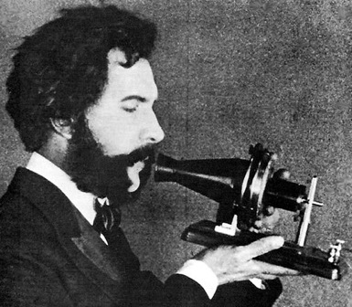
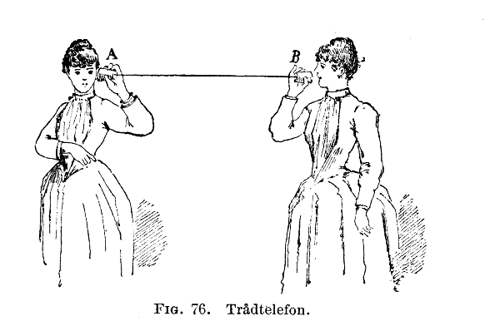
What is Communication?
It is a process
Transmitter
Receiver
Medium
Message
Ned Lundquist – NatCo – General Assignment Team

Slide 9
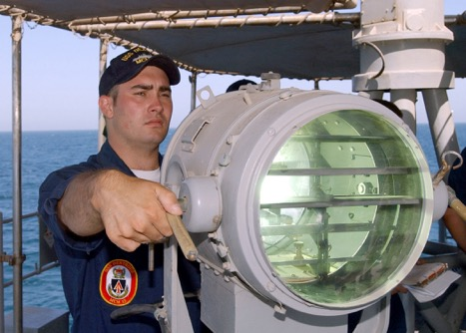
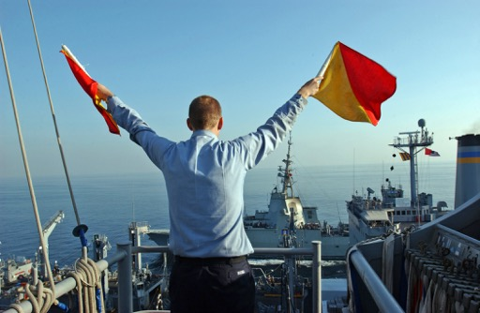
What is Communication?
Symmetrical communications is a two-way process.
Ned Lundquist – NatCo – General Assignment Team

Slide 10
What is Communication?
Communication has purpose.
Communication is a continuum:
If you communicate effectively, you will generate awareness
If you continue to communicate effectively, you will achieve understanding
If you continue to communicate effectively, you will achieve conviction/belief
Ultimately, if you have been communicating effectively, you will influence behavior
Ned Lundquist – NatCo – General Assignment Team

Slide 11
What is News?
The Ten Elements of “Mass Appeal”
Immediacy
Proximity
Consequence
Conflict
Oddity
Sex
Emotion
Prominence
Suspense
Progress
Ned Lundquist – NatCo – General Assignment Team

Slide 12
What is News?
Immediacy is critical.
Seventy-five percent of news is new.
Ned Lundquist – NatCo – General Assignment Team

Slide 13
What is News?
Spot news or “created news”
Opinion / editorial
Catchy headline
Engaging lead paragraph
Solid news peg
Ned Lundquist – NatCo – General Assignment Team

Slide 14
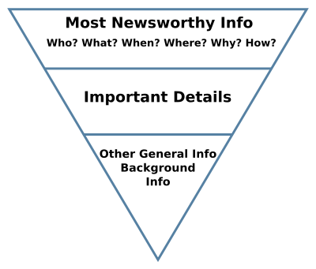
What is News?
The inverted pyramid
Ned Lundquist – NatCo – General Assignment Team

Slide 15
What is News?
ABCs of newswriting
Accuracy
Attribution
Brevity
Clarity
Coherence
Emphasis
Unity
Ned Lundquist – NatCo – General Assignment Team

Slide 16
What is News?
SAPP
Security
Accuracy
Proprietary
Policy
Ned Lundquist – NatCo – General Assignment Team

Slide 17
What is News?
Avoid jargon, gobbledygook and wordiness
Be specific
Avoid trite or cute expressions
Use active verbs
Tense (says or said; be consistent)
Ned Lundquist – NatCo – General Assignment Team

Slide 18
What is News?
Types of leads
Active and Passive
Contrast
Picture
Novelty
Background
Punch
Question
Quotation
Direct address
Ned Lundquist – NatCo – General Assignment Team

Slide 19
What is News?
Editorializing
Editorializing happens when a writer consciously or unconsciously expresses doubt, censure or praise in a news story. The only persons permitted to express an opinion in a straight news story are the persons in the story itself. Even then, the opinion quoted must be attributed to the person who gave it. News stories should be written in the third person. The writer’s personal opinions should never be injected into a news story. Facts should be reported as they are found, without personal pronouns referring to the writer
Ned Lundquist – NatCo – General Assignment Team

Slide 20
LODGE STRENGTHENS TIES, REMEMBERS HISTORY AT LEGACY BANQUET
By Chris Gadd
On April 11, 2015, Chippanyonk Lodge held its annual banquet, celebrating the past year of Ordeals and events. However, that was not what made the banquet special. Chippanyonk Lodge was formed through a merger of two councils and their related OA lodges--Taunkacoo Lodge and Musketahquid Lodge --in 1996. After many years, Chippanyonk is a strong lodge with firm roots. At the annual banquet, Chippanyonk Lodge had the honor of seeing many members from Taunkacoo and Musketahquid who hadn’t been to an event in over 40 years. Many members came with their sons, whom they had helped bring into the tradition of the Order of the Arrow.
For the youth on that day, it was clear that the older members didn’t just come for the food. Throughout the night there were moments of recognition and saying hello to people that had been forgotten. The moment old friends met each other, it was as if they had been talking forever. As the youth looked on, they realized that the OA doesn’t just exist for the few years when you are a youth member or if you go on to be involved as an adult. Many Taunkacoo and Musketahquid members were there simply because they wanted to be.
One Scout who has been involved with Chippanyonk Lodge for several years said seeing so much history in one room was inspiring. “To witness the longevity of the friendships and camaraderie between those who mirror the spirit of the lodge today was a strong motivator to continue to work for and embrace the success of Chippanyonk."
Perhaps the most magical and stunning part of the evening was when it came time for the Vigil callout. As tradition, all Vigil Honor members were asked to stand and say their name, Lenni Lenape name, translation and when they kept their Vigil. As soon as one person stood up, it was clear that there was more than just one table. Almost two-thirds of the room stood up, and it was then that people realized how much the OA matters to them. Seeing so many members stand up, some of whom had not worn the sash in decades, was enough to make a real impact on the youth of today.
The current lodge chief was ecstatic to have so many lodge members return for the special night. “I was very pleased to see many lodge members that had been in Taunkacoo and Musketahquid Lodges return for some excellent fellowship!” he said. “I hope to see them at our future events having a great time and helping further the lodge through the advice and wisdom they have to offer.”
Ned Lundquist – NatCo – General Assignment Team

Slide 21
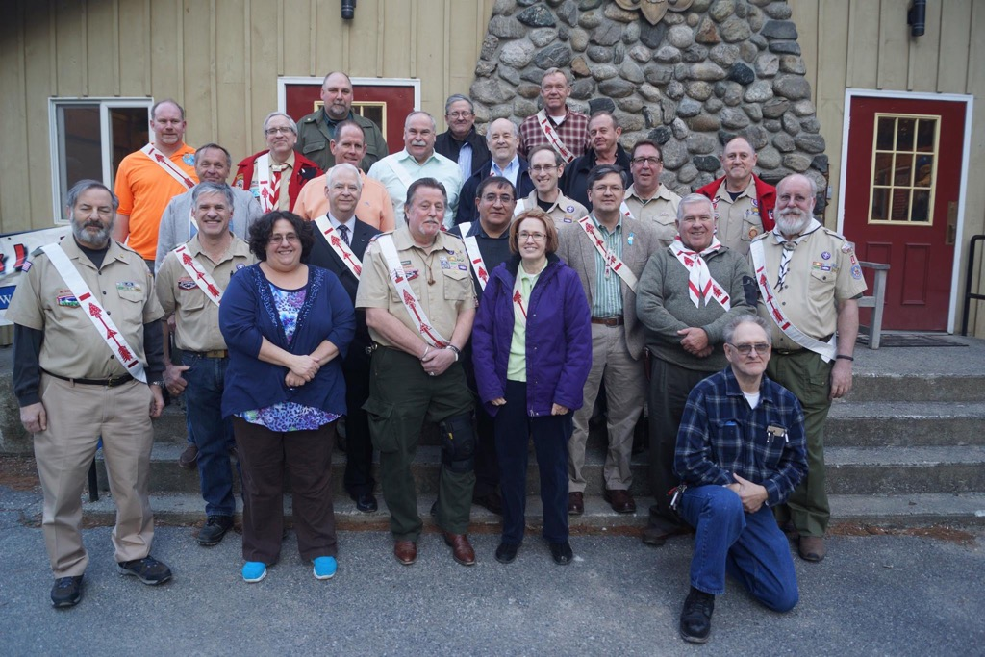
What is News?
Ned Lundquist – NatCo – General Assignment Team

Slide 22
What is News?
Interviews
News interview
Telephone interview
Casual interview
Personality interview
Symposium interview
News conference
Prepared question interview
Ned Lundquist – NatCo – General Assignment Team

Slide 23
What is News?
Interviews
Be prepared
Know what you want
Take careful notes or record
Be accurate
Look for color
Let your subject do the talking
A good interview will the “write the story”
Ned Lundquist – NatCo – General Assignment Team

Slide 24
What is News?
Style
The Order of the Arrow Style and Branding Guide
The OA Branding and Style Guide contains proper logo usage and spelling of common terms. This guide is a staple for every lodge to ensure a clear and consistent representation and message.
oa-bsa.org/pages/content/publications#branding
Ned Lundquist – NatCo – General Assignment Team

Slide 25
What is News?
Ask yourself…
…”So what?”
Your editor will ask the same question: So what? How will the reader or viewer react to it?
Ned Lundquist – NatCo – General Assignment Team

Slide 26
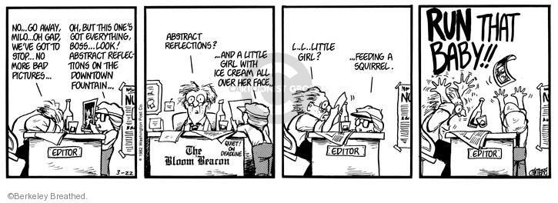
What is News?
Ned Lundquist – NatCo – General Assignment Team

Slide 27
5 Minute Break

Slide 28
Session II : Social Media

Slide 29
Social Media
Nick Hessler – NOAC Social Media Team
Ku-Ni-Eh Lodge
nthessler@gmail.com

Slide 30
Social Media Basics
The Power of Social Conversation
It’s where our members are.
They can engage at any time, in any place.
We can interact with individuals 1:1.
The heart of social media is the conversation.
Nick Hessler – NOAC Social Media Team
Notes:
secret or surprise that social media is a powerful force. We’re all familiar with it – some of us more than others; some of us, perhaps, a little too familiar with it. We connect to our families, our friends, and our favorite organizations and even favorite brands through social media. Today, we will expand your understanding of social media and challenge you to think differently about how the Order of the Arrow can effectively use this powerful tool.
Social media has much in common with any other form of communication, in that it is, essentially, a sender, a message, and a receiver. Social media is unique, though, in several ways – and several of social media’s unique benefits offer excellent opportunities for membership organizations, including our Order of the Arrow lodge, to connect with their members.
First, it’s where our members are. As a small sample, we just revealed our own participation in various forms of social media. Undoubtedly, a significant percentage of our brothers engage in social media on a regular basis as well. With so much competition for time and attention, it’s no longer realistic to expect our members to seek us out – we need to be where they are if we want to reach them. We recognize that not all members are active in social media, so it can’t be the only way we try to connect with our brothers – but social media use is only increasing, even among older people. It has become one of the primary ways we share information about our Order.
Secondly, the prevalence of social media across a wide variety of devices means that our members can engage in social media at any time and in any place. It’s very follower-friendly; members can either ‘subscribe’ to or ‘follow’ favorite accounts to have relevant information “pushed” to them, or they can use search features and hash tags to seek out new content. For creators of social media, we can reach people instantaneously at any time of day. We don’t need to worry about the post office delaying a printed newsletter, or finding the right time of evening for a phone call. We can share our content immediately, at any time, and it’ll be there ready for our followers when and where they choose to receive it.
Lastly, social media may be one of the best ways we have to quickly and easily interact with individuals on a personal, 1:1 level. Perhaps only secondary to a live, in-person meeting, social media enables a natural back-and-forth conversation, in near real-time, that printed materials and even static web pages can’t offer. Instead of a one-way broadcast of information from us to them, we can receive real feedback and honestly engage with an individual, personalizing their communications experience and enhancing, ideally, their Order of the Arrow membership experience.
The heart of social media is that it’s a conversation; perhaps shifted in time and space, but a real conversation nonetheless. In most other forms of communication, there is a sender and a receiver, but in social media we are all both consumers and contributors. This is an active, not passive, form of communication.

Slide 31
Youth Protection & Social Media
Understand and apply privacy settings
Abide by the Oath and Law
Safety, including Youth Protection, is a key focus
No “one on one contact” online
Public exchanges: OK!
Private / direct messages: >1 adult has access / monitors
Maintain youth privacy (no last names, phone numbers, etc.)
Nick Hessler – NOAC Social Media Team

Slide 32
Choosing the Right Platforms
Who do we need to reach?
What do we want to do?
New candidates
Lodge members
Brotherhood candidates
Committees
Chapters
Event attendees (e.g. NOAC)
Others?
Parents
Unit & council leaders
Lodge alumni
General public
Others?
Inspire
Educate
Entertain
Different audiences = different needs = different platforms = different content.
Nick Hessler – NOAC Social Media Team
Notes:
Before we get into the nuts and bolts of building a social media program, as with any effective communications program we need to first define who our audience is, and what we want them to do.
Who are the different types of people who may want to learn more about the Order of the Arrow and your lodge?
While many of these people may be interested in general lodge news and happenings, each one has a unique relationship with the lodge, and probably has different sorts of questions, different levels of understanding, and different desires for engagement. The messages we share, and the ways in which we share them, need to be relevant to the particular audience. Proper use of social media allows us to easily personalize messages to a particular audience member.
For the audiences we are normally trying to reach, most of our social media messages will fall into one of three general purposes:
Education: Sometimes there is a need for simple one-way dissemination of information; announcing an upcoming lodge event and sharing the details about it, for example. Other types of education may require more of a conversation, either through multiple people commenting publicly, or a private one-to-one conversation. In either case, social media allows us to share knowledge widely and quickly, helping to educate our audience members.
Inspiration: As a values-based membership organization, the Order can use social media to share content that specifically reinforces the ideals of our Obligation and Admonition. Quotes, images, and stories can be a daily reminder of what was learned during ceremonies and training. Asking questions and soliciting examples can help members think about how to apply the Order’s principles in our daily lives. Regular posting of values-based content can, in effect, help members re-dedicate themselves to the Order each and every day, between the in-person events and meetings of the lodge. This is a tremendously powerful opportunity to affect how individual members think and act. In a best case scenario, we can actually help people better live the Obligation on a daily basis, through a daily reminder of our principles and regular exploration of how to apply those principles to our lives.
Entertain: Being educational and inspirational doesn’t have to be dry or boring. Social media conversations should be just that – a friendly conversation between brothers. Our social media posts probably shouldn’t be overly casual or informal, but they can be friendlier and more familiar than the tone taken by other forms of communication. They can even be lighthearted and funny; however, care must be taken that our posts are not sarcastic, offensive, or misconstrued. Scout-like humor and wit are powerful tools for making a message engaging and memorable.
Through education, inspiration, and entertainment, we can use social media to both help change the way our followers think, and change the way our followers act. The specific thoughts and actions we want to encourage will differ, perhaps, depending on the audience member we’re trying to reach.
Understanding our audiences and their needs is the critical foundation for a successful social media program.

Slide 33
Social Media Basics
Which Platforms to Play On?
Nick Hessler – NOAC Social Media Team
Notes:
There are literally hundreds, if not thousands, of social media opportunities. Even for our largest lodges, it’s difficult to be active and effective on more than a couple. Leaders should, keeping in mind their audiences and what they want each one to do, focus on using a smaller number of channels well – the ones that your audience members regularly use – rather than doing a poor job of maintaining many different channels with limited value.
Each of the major social media channels has basic demographic trends and feature sets that may suggest it as being better for a specific audience or purpose. Social media is dynamic – leaders need to constantly be aware of shifting trends in social media usage and keep up to date with the features available in each channel to make sure that the chosen channel is an effective tool for reaching the desired audience.
Ideally, the lodge will be able to develop a unified ‘brand’ across their social media channels. Consistent use of avatar images, cover or banner photos, and channel names / handles will make it easier for you to integrate your messages between social media outlets, and help your followers find related content across channels.

Slide 34
Which Platforms to Play On?
Facebook / Google+
Twitter
YouTube
Instagram
Snapchat
Pinterest
Others?
Nick Hessler – NOAC Social Media Team
Notes:
With that in mind, lodges should consider the following major social media networks and understand the unique features and benefits each channel offers in an integrated communications program. Individually, and perhaps more effective when used in a coordinated fashion, these channels can help your lodge tell its story.
Facebook
Robust social media platform. Good for posting short-form content, links to external articles, and
photos and videos, with threaded commenting.
With over 890 million active users, it’s the largest social media channel.
With that many users, it’s likely many in your lodge and Scouting communities are already
involved.
Facebook has more daily teen users than any other network.
Some recent news reports suggest teens are ‘leaving’ Facebook, it is more likely that they’re
adopting other channels, e.g. Instagram, in addition to Facebook.
Google+
Similar to Facebook in terms of features and capabilities (posts, shares, content).
Not as widely adopted as Facebook; 300 million active users.
Google+ content and “likes” are weighted heavily in Google search engine results; this could be
an important consideration in choosing to use Google+ as a complement to your lodge website,
especially for public, community-facing content.
Using a social media management tool to post simultaneously to Facebook and G+ makes
managing a Google+ page less onerous; however, you still need to monitor, manage, and reply to content and comments on Google+.
Twitter
Users can quickly post 140-character ‘micro-blogs’ in the moment, allowing users to share
breaking news and live updates.
284 million active users. Growing usage among teens and young adults; less so among older adults.
Quick updates, reminders, timely and relevant topical content.
The “pulse” of the Internet – what people are talking about, right now.
YouTube
World’s 2nd largest search engine, following Google.
Video sharing website, allows comments. Videos from a few seconds to several hours.
1 billion active users each month
300 hours of video are uploaded every minute.
Reaches more teens and young adults than any single cable channel. Rated by Millennials as the
top place to watch content.
Good video content is more difficult to create than written or photographic content, but is far
more engaging for ‘branding’ and promotional messages.
Video is also powerful for instructional, “how do I..” content.
Instagram
Photo sharing site for mobile devices; pictures can be viewed from a computer, but not posted
from a computer.
300 million active users. 16 billion photos shared. 53% of young adults use Instagram.
Instagram has edged out Facebook and Twitter among teens as “the most important” social
network.
It integrates easily into Facebook and Twitter.
Snapchat
Similar to Twitter for “in the moment” messages, but uses a picture or short video as the primary
message, with brief captions and annotations.
Messages disappear once viewed.
Sends only to a defined contact list, limiting the audience.

Slide 35
Best Practices for Creating Engaging Content
Emoticons ☺
Questions?
Short
“What’s in it for me?”
Photos & video
Infographics / illustrations
Share good 3rd party content
“Rule of Thirds”
1/3 about “us”
1/3 from “thought leaders”
1/3 personal interations
Be provocative & bold
No clickbait!
Be innovative!
Learn from others
Nick Hessler – NOAC Social Media Team

Slide 36
Managing Social Media
Appoint youth/adult leadership
Create a team
Use an editorial calendar
Set up channels with security
Consider a management tool (e.g. HootSuite)
Monitor, respond, delete, ban
Follow BSA and OA style conventions & branding
Be consistent across channels & with your own lodge’s brand
Get educated and keep learning & experimenting! ☺
Nick Hessler – NOAC Social Media Team
Notes:
The successful implementation of an effective social media program requires the right sort of team, with just enough hierarchy and policy to ensure that our image and message are protected while giving the team the ability to be innovative within those boundaries. Successful lodge social media programs adopt the following operational practices:
Based on your lodge’s operational structure, determine where in the organizational chart social media falls. Social media works best when it’s a coordinated part of an overall communications program. There should be strong integration between social media, your website, printed newsletters, mailings, and any other communications program your lodge uses.
A youth lead and an adult volunteer adviser should be appointed. These individuals need to “get it” when it comes to social media. They should be strong interpersonal communicators who are active in social media themselves. They need to commit, along with their team, to regularly post content and constantly monitor your chosen channels. They should also commit to ongoing learning concerning best practices through blogs, webinars, and other resources. The lodge leadership should also be willing to delegate a fair amount of trust to this team to make quick decisions and responses on social media without a lengthy approval process through multiple layers of hierarchy.
Along with the youth lead and adviser, the team will need additional members. As social media requires active contribution and management, a team of committed individuals will be able to better shoulder the burden. Depending on the depth and breadth of your social media program, you may want to consider the following roles, noting that some of these roles, perhaps, may be shared among your lodge’s communication programs:
Individual managers for each channel, responsible for posting content and monitoring comments
Content contributors and authors, who source or write new posts Graphic designers, illustrators, photographers, and video editors Analysts who will review social media metrics and make recommendations for improvement
Working with the other communications functions in the lodge, the social media team should develop an “editorial calendar” that helps them create content around time-bound activities, e.g. pre-event promotion and post-event summaries and feedback, non-religious holiday messages, historical remembrances, themed days (#TBT), etc. Then, in and among the pre-planned content, more “organic” and timely / topical content can be created more tactically.
The team should set up their social media channels with an appropriate degree of security. Social media accounts should be set up with generic / shared e-mail addresses (e.g. socialmedia@lodgename.org, if you have a lodge domain, or lodgesocialmedia@gmail.com) and not personal e-mail addresses. The youth lead and the adviser should both always have access to these email accounts. Passwords for the email accounts and social media accounts should be changed regularly, or when there’s a change in team membership or leadership.
The use of a social media management tool is strongly recommended. Social media management tools (e.g. HootSuite, Buffer, Sprout) allow you to manage all of your social media channels through one dashboard, giving you a one-stop shop for access to your social networks. You can save time and maximize efforts online by scheduling posts to go out over multiple channels automatically. Multiple users can have access without having to share passwords to all of your social media accounts. The fewer people with password knowledge means the less likely you are to experience a mishap with poorly placed content. Good social media management tools also help you easily gather data about your social efforts, giving a better idea regarding what’s working.
You will need to develop an understanding of your lodge’s tolerance for disagreeable or negative comments on your posts. Honest conversation includes critical feedback, and where appropriate, lodges should attempt to have a “thick skin” regarding constructive criticism. However, some commentary is not appropriate; the BSA’s Facebook page provides one good model for a comment policy:
This digital Scouting community is governed by the Scout Oath and Scout Law. We will delete any comment that we believe does not reflect the Scout Oath and Scout Law.
This includes comments that use inappropriate language or are potentially libelous or injurious to the privacy of an individual or group. Users posting these comments will be banned from commenting on this site.
Off-topic comments as well as those promoting unapproved products and services will also be removed.
Users posting any comments, photos, videos, links or other items that fall into one or more of the congressionally mandated CyberTipline reporting categories of the National Center for Missing & Exploited will be reported to the proper law enforcement agencies.
As an active form of communication, social media requires active monitoring and rapid responses to comments and messages. Social media consumers have become used to timely responses; delays in responses erode the effectiveness of your social media program. The lodge social media team should develop a “duty roster” to ensure that a team member is checking each channel frequently and responding to questions appropriately.
For clarity and consistency, posted content should follow the vocabulary and visual identity conventions of the Boy Scouts of America and the Order of the Arrow. Content contributors should regularly review publications including The Language of Scouting and the Order of the Arrow Brand and Identity Guide to ensure that their posts are using the proper terms, capitalization practices, and style conventions.
Similarly, to enable people to find your content across multiple platforms, the social media team should develop a coordinated list of official hash tags, and encourage social media consumers to use these hash tags when commenting, sharing photos, etc.
Lastly, the world of social media changes constantly. Best practices may become invalid shortly after they’re published; things just change so rapidly. Commit to ongoing learning and experimentation, and have fun!

Slide 37
Key Takeaways
Social media may be one of the most effective, fastest ways to have inspire, educate, and even entertain lodge members through relevant conversations.
Used correctly, social media can empower Arrowmen to better live a life of servant leadership through daily interaction with the Order of the Arrow’s programs and values.
Nick Hessler – NOAC Social Media Team
Notes:
As we have discussed, there are many effective social media channels and if you can make your content relevant, timely and high quality, your lodge can educate, inspire, and entertain your members through social media. One person cannot create and implement a communication plan; it will take a team that is dedicated and consistent in furthering the message of the lodge. Social media is a powerful tool in the lodge’s communications toolbox, and when used correctly, can empower Arrowmen to better live a life of servant leadership through daily interaction with the Order of the Arrow’s programs and values.

Slide 38
Website Basics
Doug Kupec – Production Team
Web Adviser
Wapashuwi Lodge
dmk11@case.edu

Slide 39
Website Basics
Please raise your hand if your lodge has a website
Doug Kupec – Production Team – Web

Slide 40
Website Basics
Is your primary audience Arrowmen?
NO
Doug Kupec – Production Team – Website

Slide 41
Website Basics
The website primary audience is…
Mom, dad, guardians!
They need to know the details.
(when?, where?, how much?)
Doug Kupec – Production Team – Website

Slide 42
What Makes a Great Post on the Website?
A. Who can attend?
Vigil members, the entire lodge
B. What is the event?
Describe the event, cost, and promote, promote, promote!
Add a picture
C. When?
Dates and times, including deadlines for registering
D. Where?
Location of the event
E. How to sign up
Registration forms can be printed or register online
Doug Kupec – Production Team – Website

Slide 43
Website Basics
Additional Important Items
Event Calendar
Contact information for lodge leadership is essential for getting questions answered
Remember to use generic email addresses such as lodgechief@
Doug Kupec – Production Team – Website

Slide 44
Website Basics
Who, What, When, Where…How
Doug Kupec – Production Team – Website

Slide 45
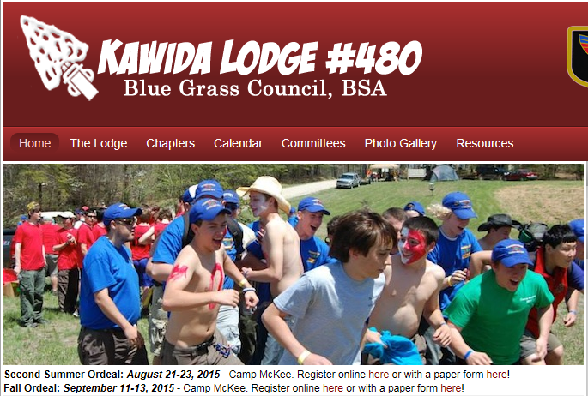
Doug Kupec – Production Team – Website
Notes:
Picture: Youth Arrowmen are having fun at an activity
Information below the picture has the event, date, location, and how to register

Slide 46
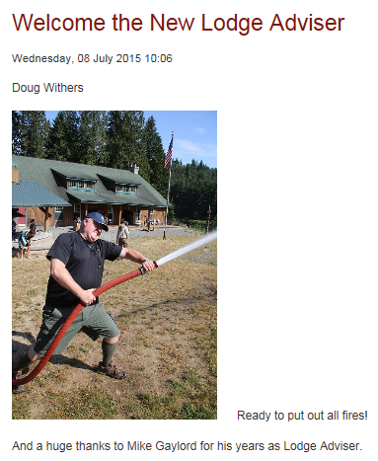
Doug Kupec – Production Team – Website
Notes:
Picture of putting out a fire and welcome/thanks to those volunteering

Slide 47
Doug Kupec – Production Team – Website
Notes:
Information on the LLD with the event, location, date, and what to expect. Also has a button for Registering for the LLD

Slide 48
Doug Kupec – Production Team – Website
Notes:
Ability to sign up for the event online through the council website
Includes notes to bring a medical form.

Slide 49
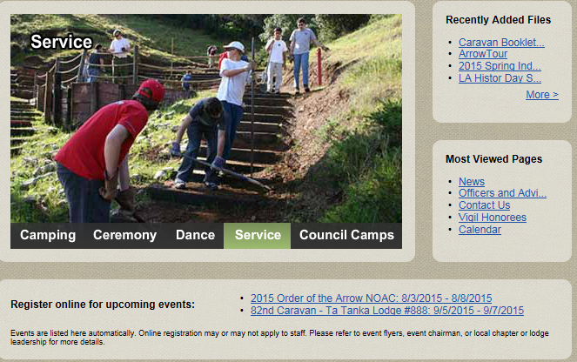
Doug Kupec – Production Team – Website

Slide 50
Website Basics
The lodge website tells a story
Doug Kupec – Production Team – Website

Slide 51
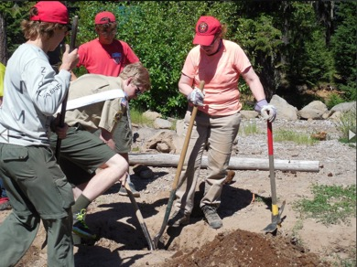
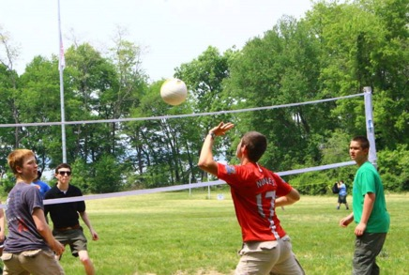
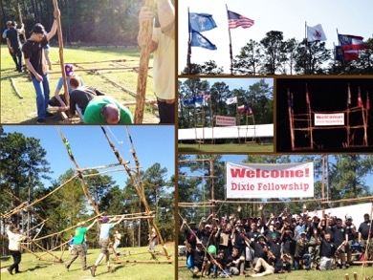
Website Basics
Engage the Audience
Pictures of past activities that promote Arrowmen having fun and participating
Don’t have pictures of Arrowmen standing around or staring at their phone
Doug Kupec – Production Team – Website

Slide 52
Website Technology
Doug Kupec – Production Team – Website

Slide 53
Website Basics
Which technology should you use?
There are many many platforms out there to use.
To name a few:
WordPress – many themes and plugins available
Drupal, Joomla, Weebly, Squarespace
Start with what your lodge youth and advisers already know
Some lodges use their council’s website/platform
Doug Kupec – Production Team – Website

Slide 54
Website Basics
Websites are PUBLIC
Ensure that your content is approved by your adviser before it is published
Once it is on the web, it is impossible to make it go away
Doug Kupec – Production Team – Website

Slide 55
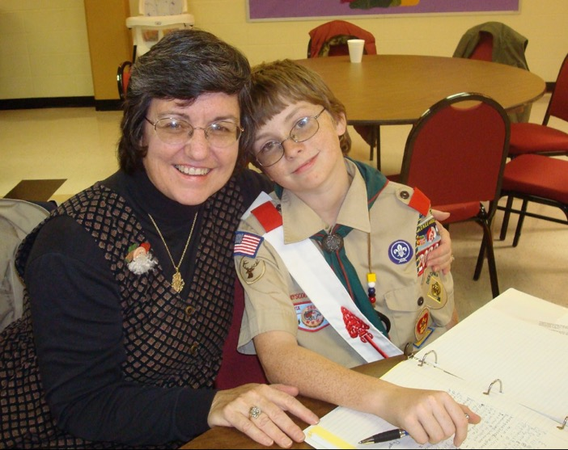
Website Basics
Remember your primary audience!
Doug Kupec – Production Team – Website

Slide 56
5 Minute Break

Slide 57
Session III : eNewsletters & Photo/Video

Slide 58
Enewsletters
Grant Phifer – Enews lead
Tonkawa Lodge
phifer6@gmail.com
Joe Daley – Production Team
Occoneechee Lodge
Joe.j.daley@gmail.com

Slide 59
Print vs. E-news
Pros:
Physical object
Cons:
Costly
Limited Audience
Pros:
Wider audience
Controlled release
Targeted
Reporting
Cons:
More difficult to customize
Limited space
Production Team

Slide 60
Enews Platforms
Mailchimp
Pros:
Design ability
Free for most
Cons:
Less private
Sends to a single list
Campaign Monitor
Pros:
Reporting tools
List management & personalization
Safer for the person receiving the mail.
Cons:
Costs money
Limited design aspects
Production Team

Slide 61
MailChimp

Slide 63
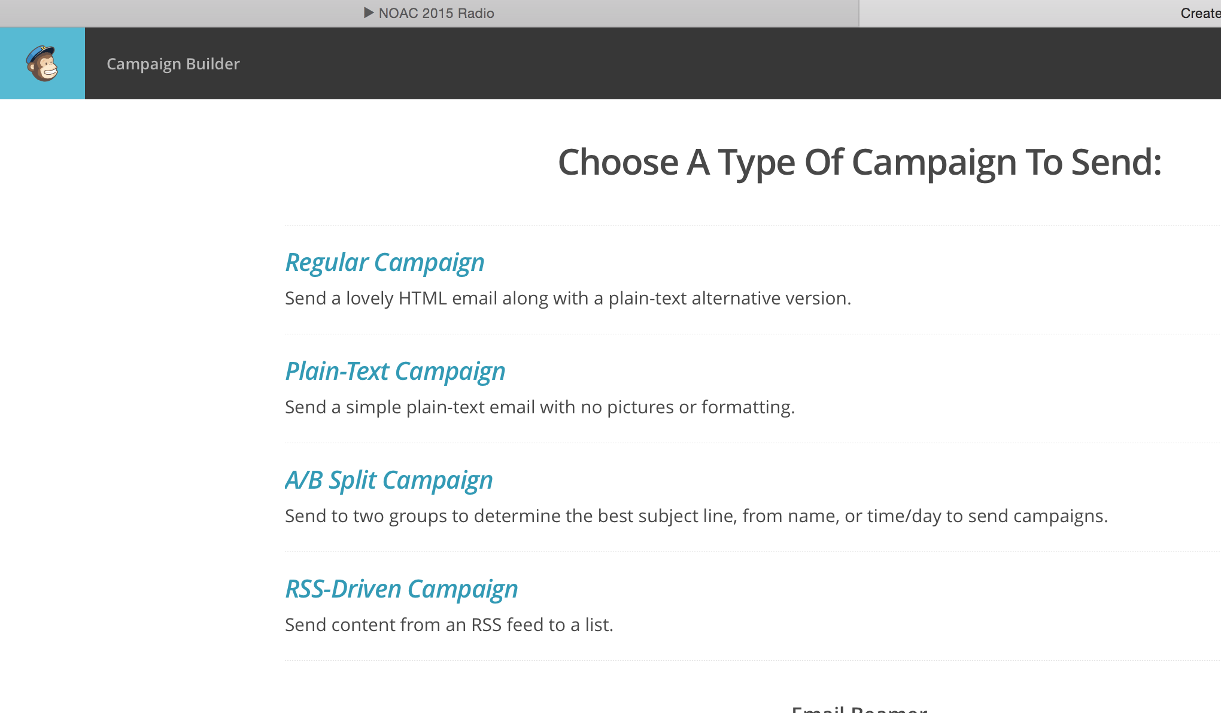

Slide 64
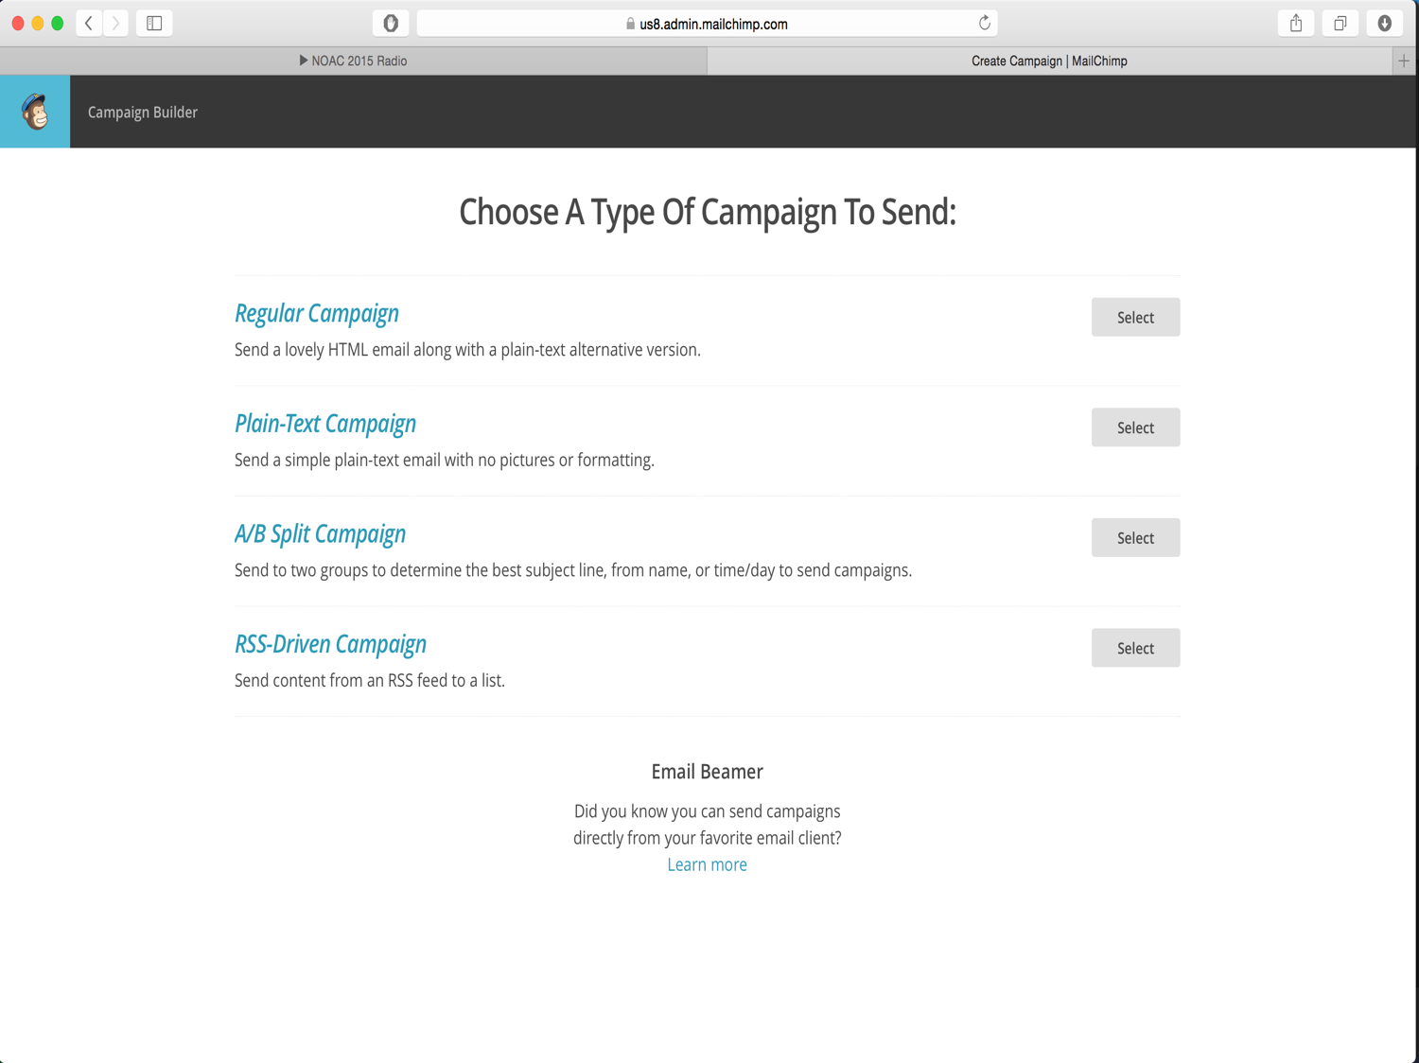

Slide 65
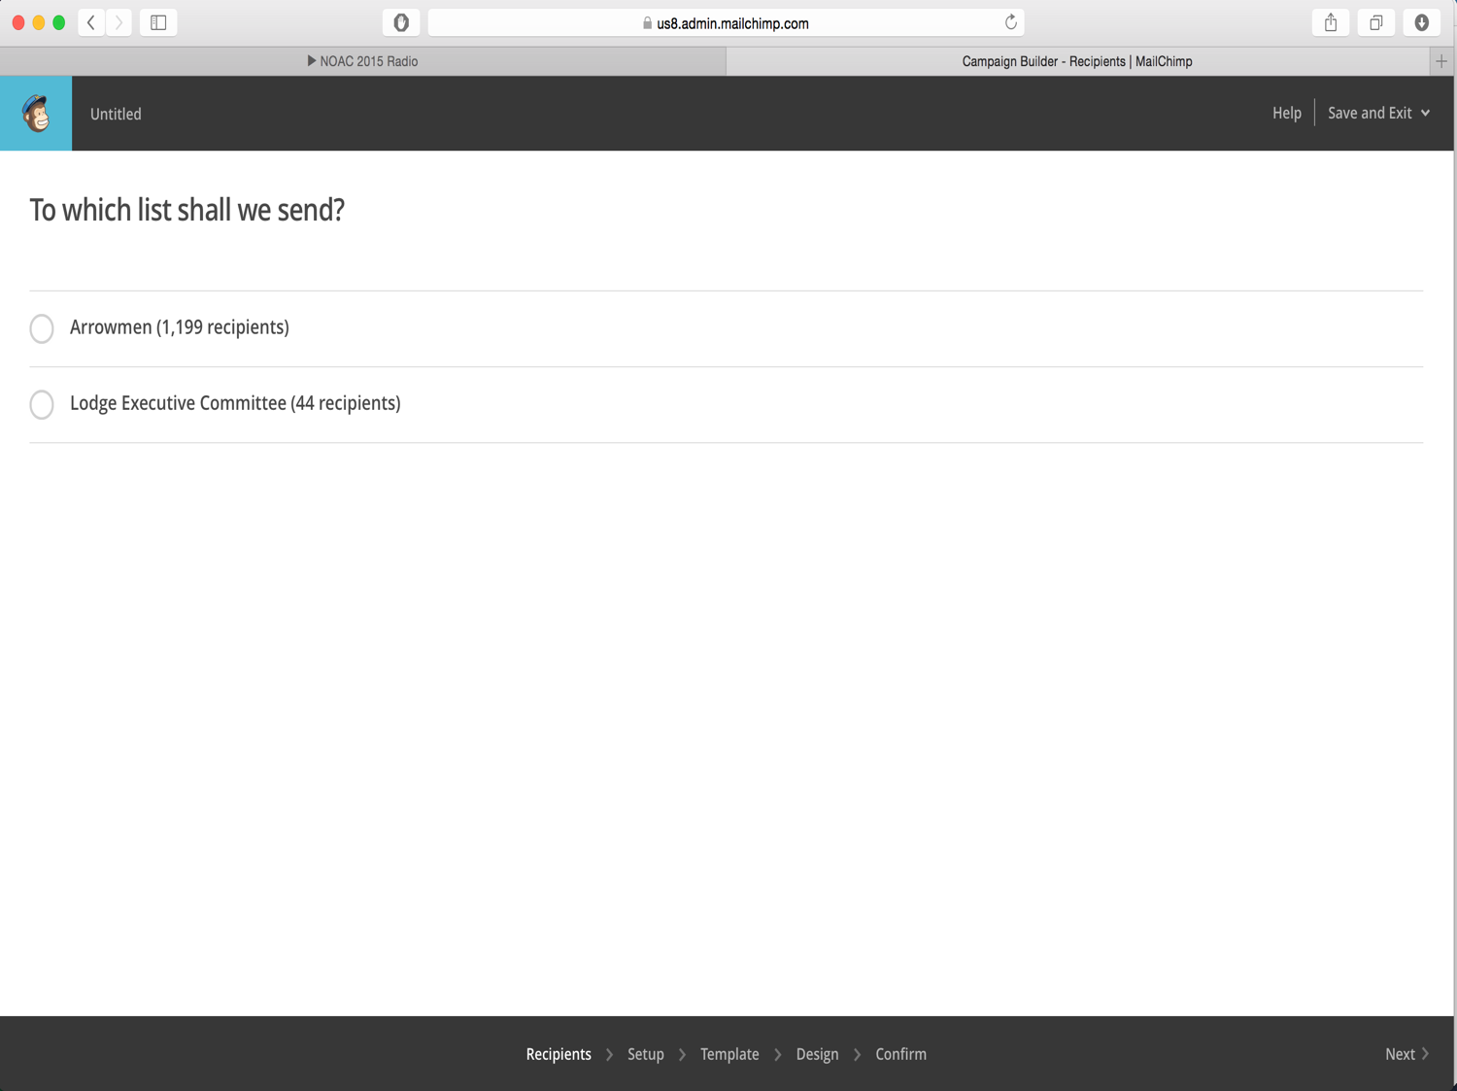

Slide 66
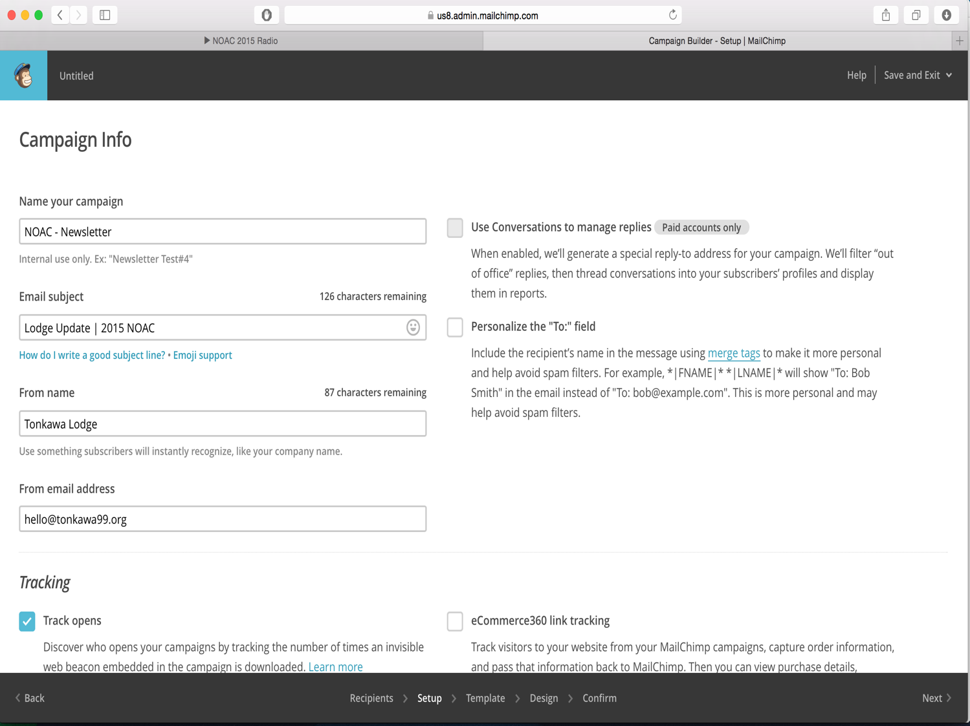

Slide 67
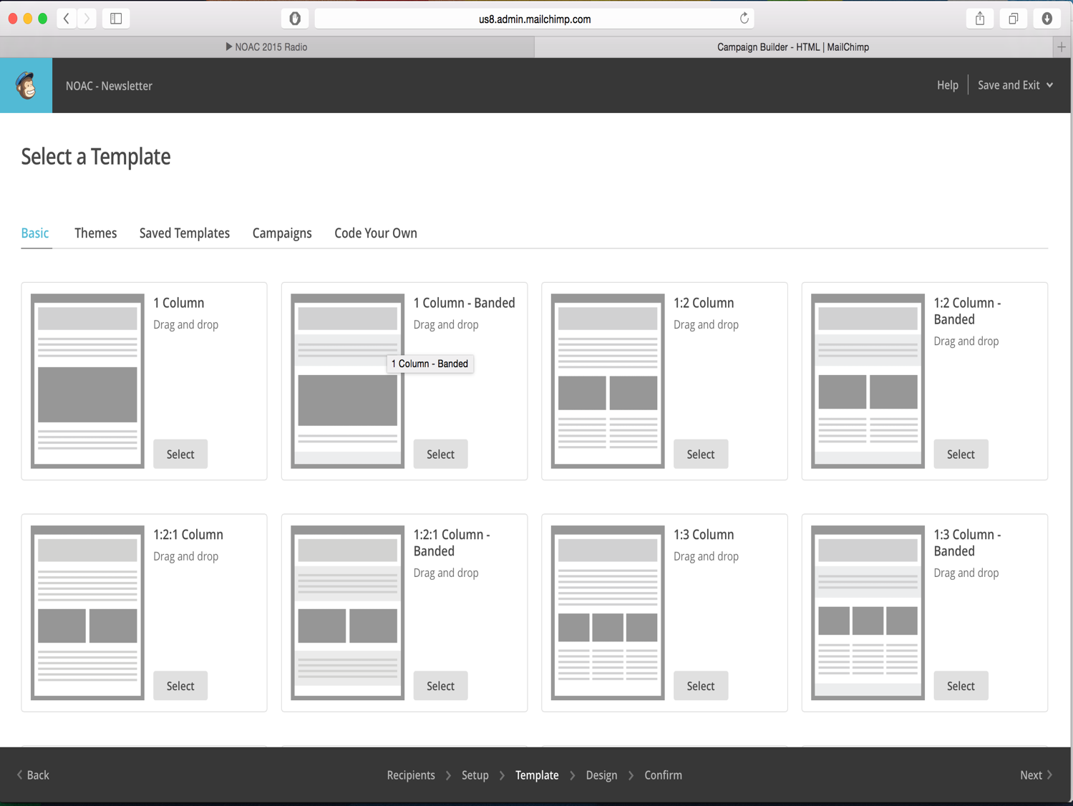

Slide 68
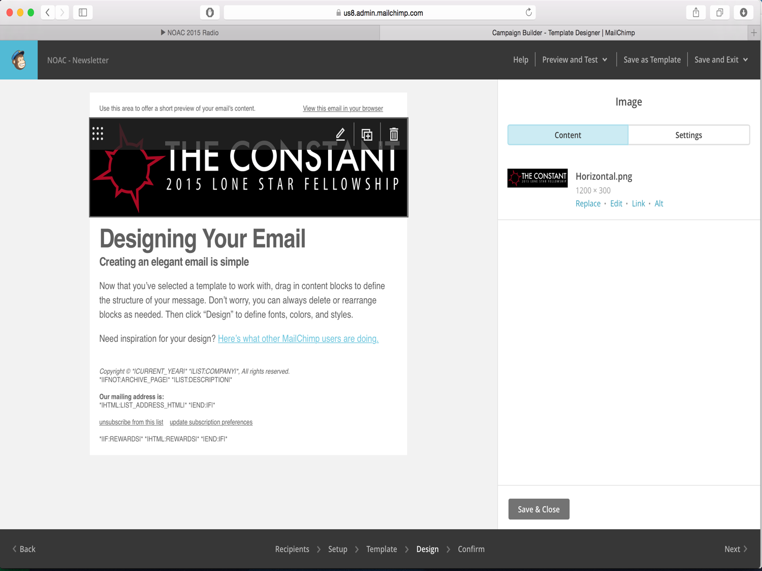

Slide 69
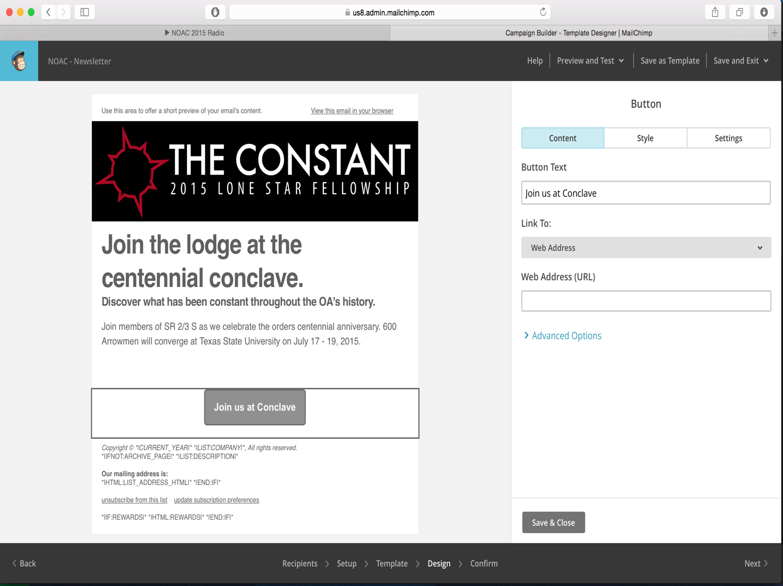

Slide 70
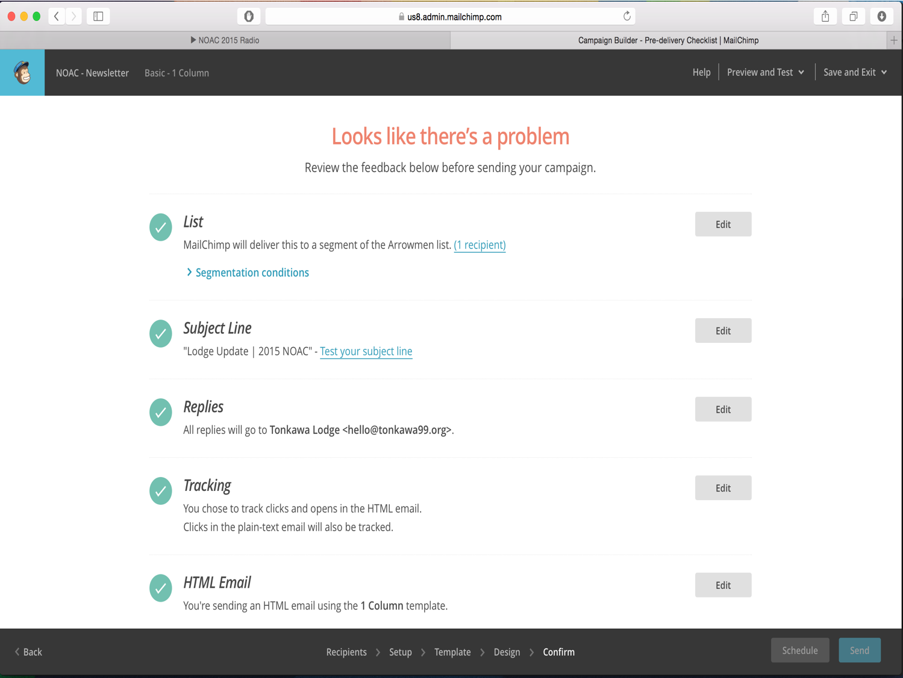

Slide 71
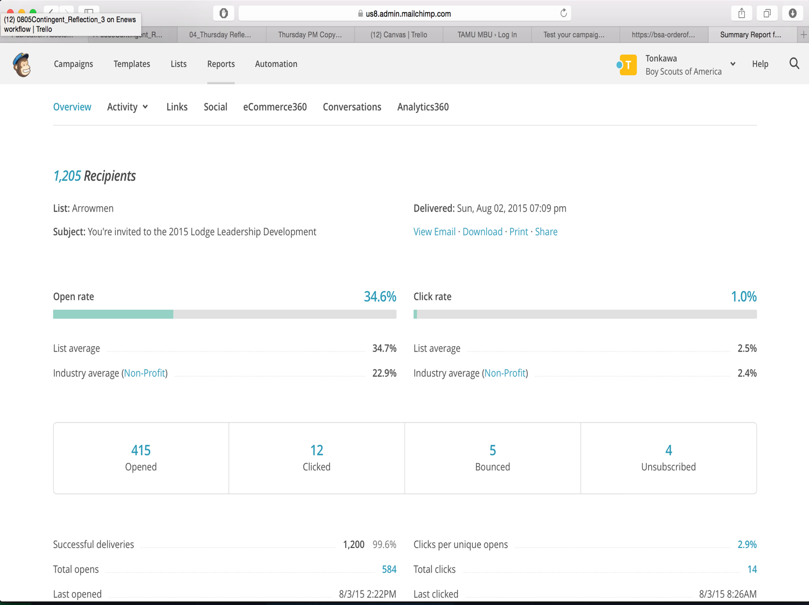

Slide 72
Campaign Monitor

Slide 73
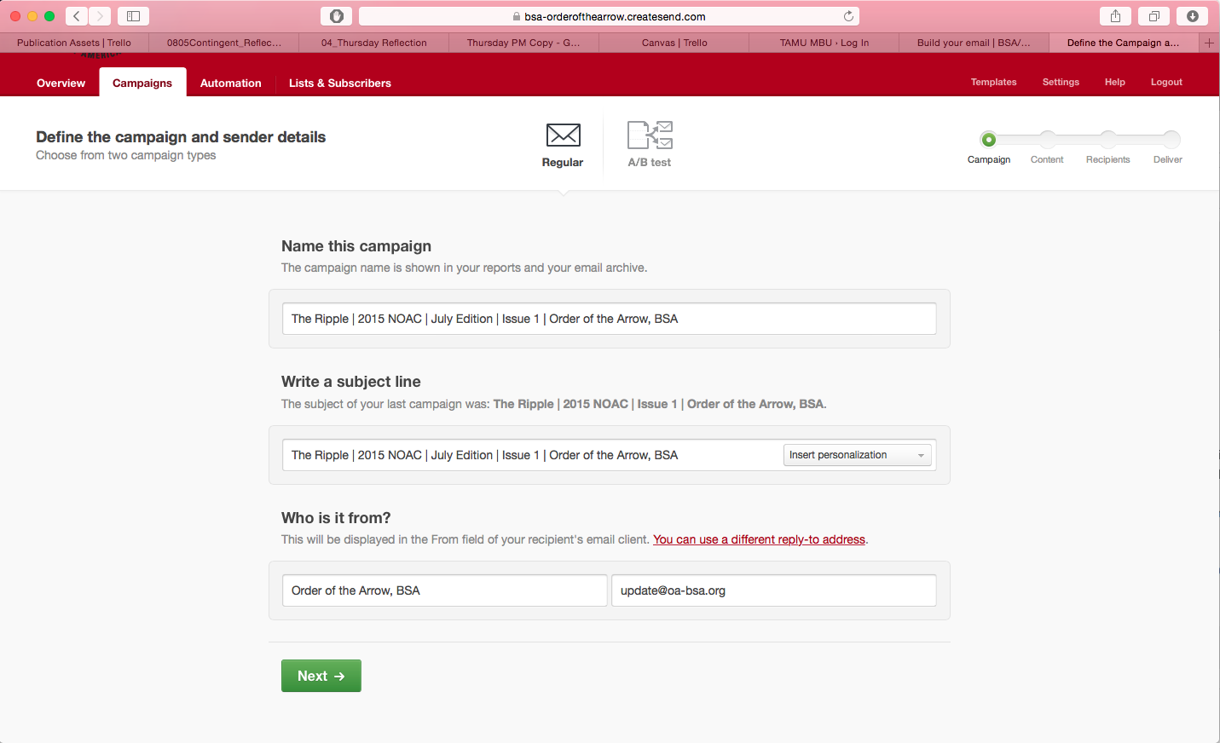

Slide 74
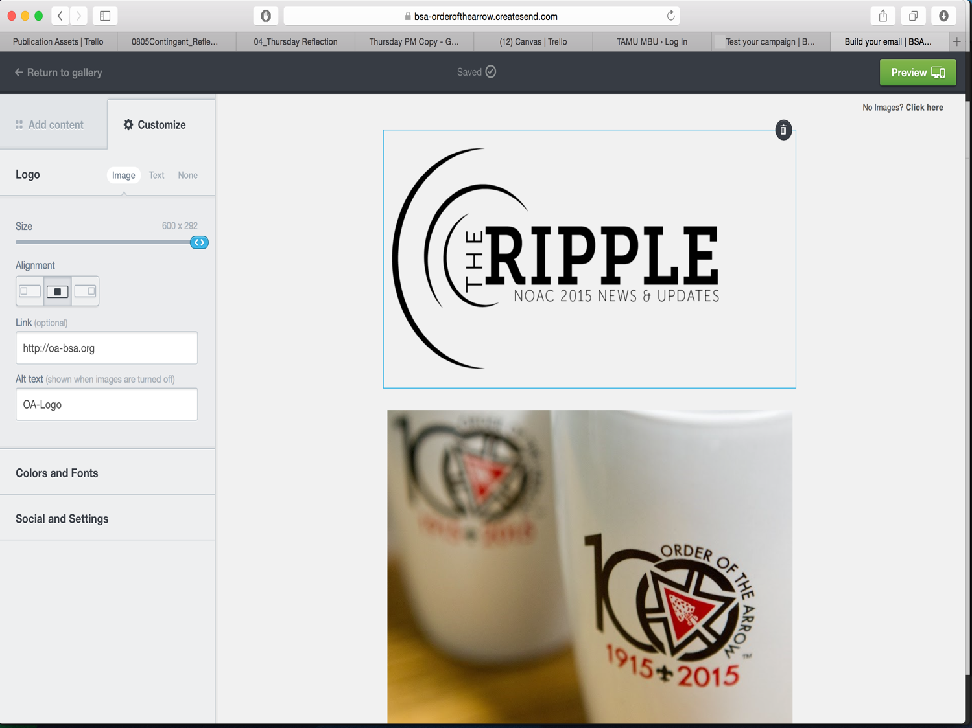

Slide 75
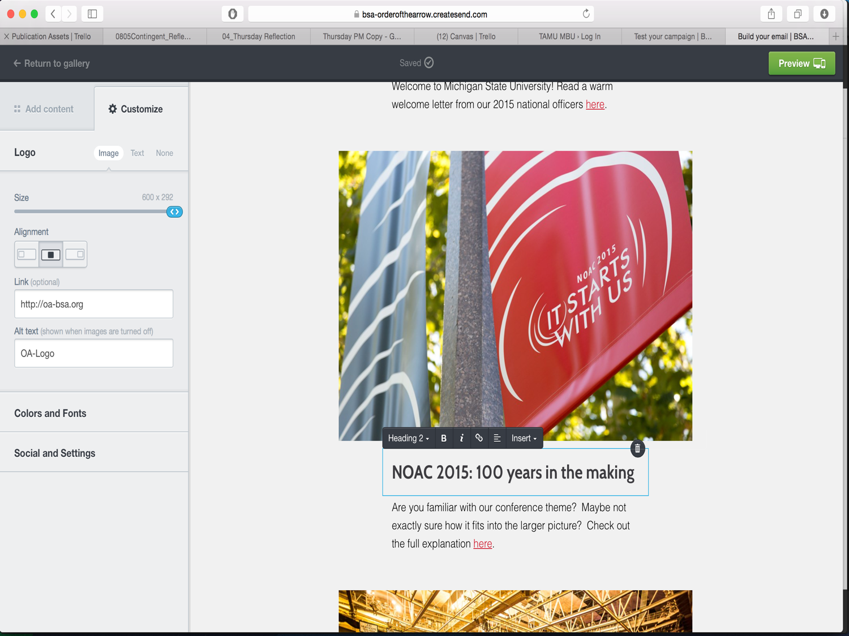

Slide 76
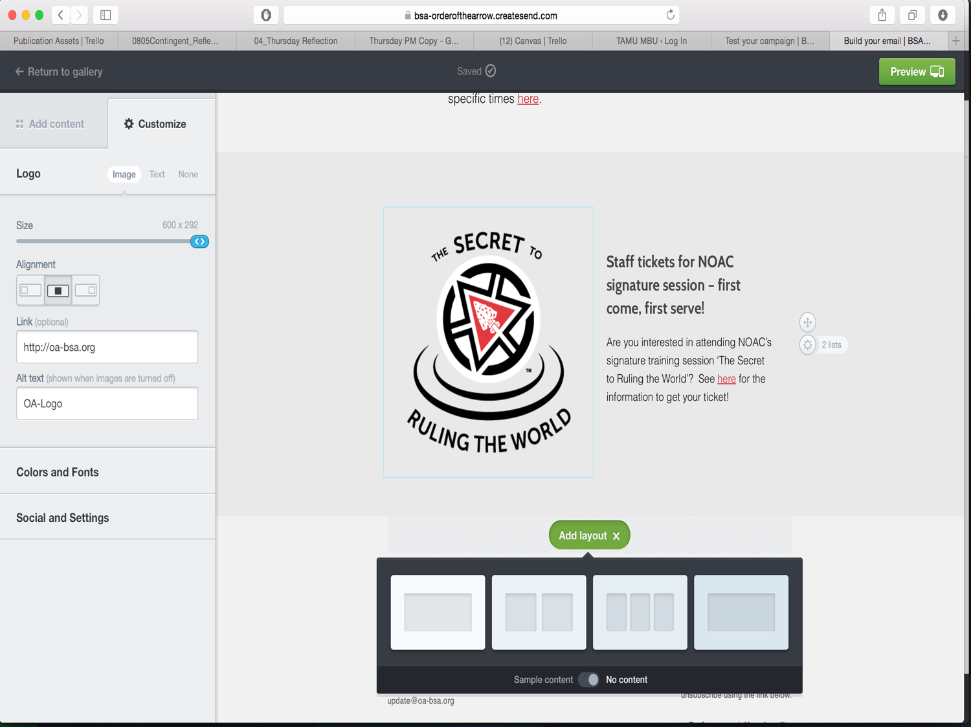

Slide 77
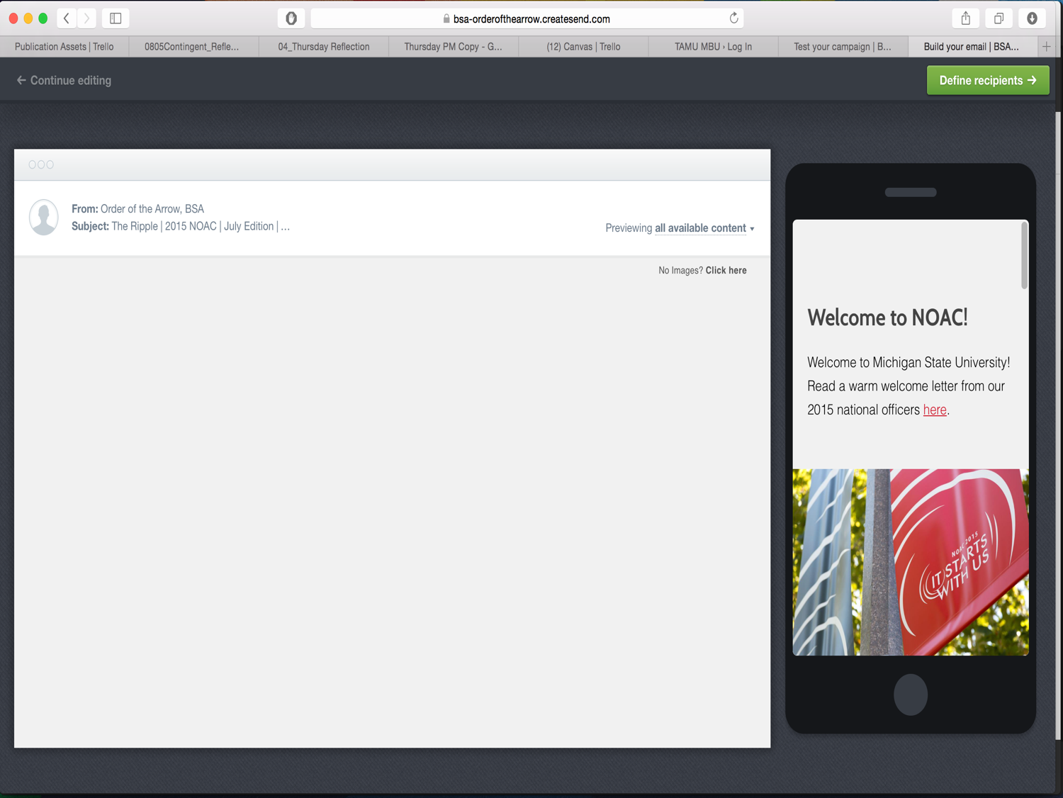

Slide 78
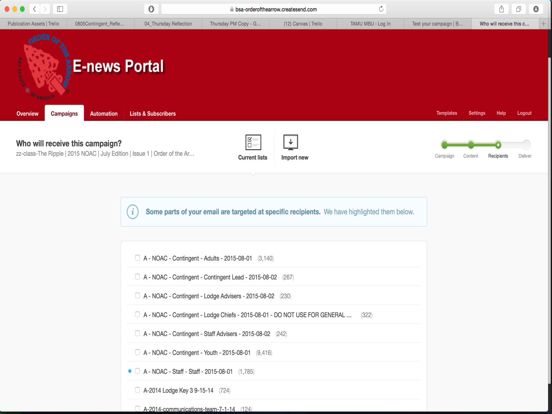

Slide 79
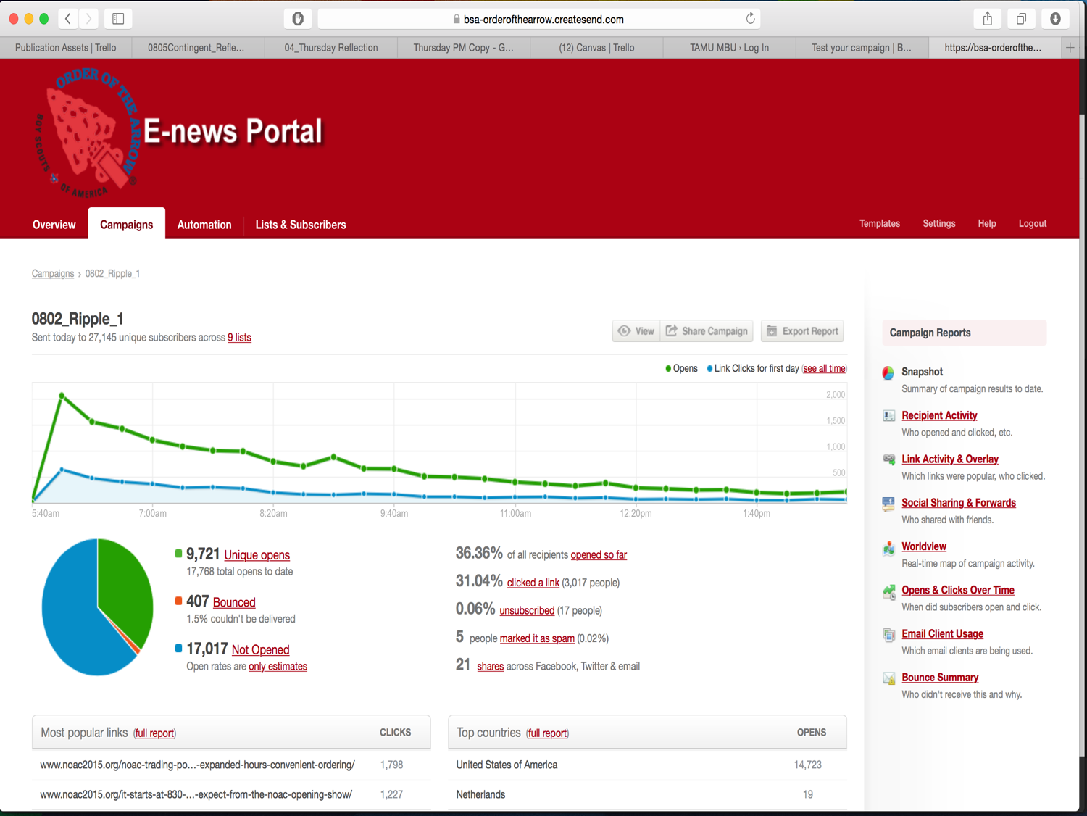

Slide 80
Photo & Video
Kevin Montano –
Lodge
kevtalk4@gmail.com

Slide 81
Why Incorporate Media?
Imagery resonates more, conveys better message than plain text
Media increases engagement

Slide 82
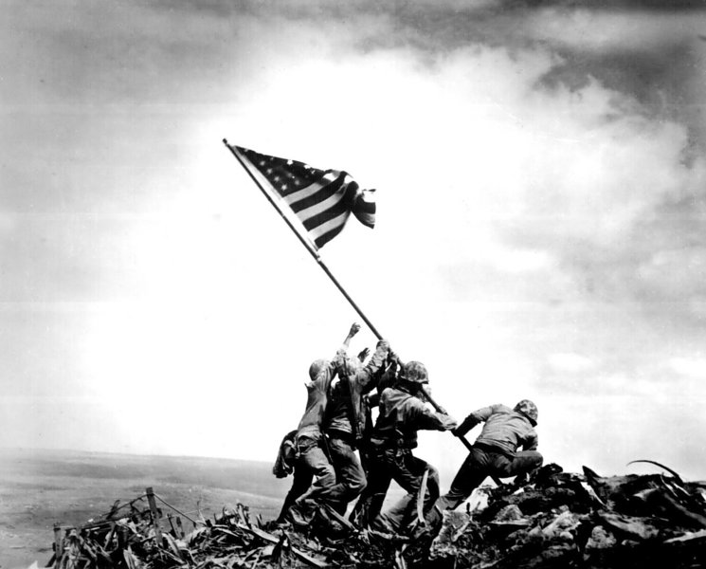
Images Create A Lasting Memory

Slide 83
Mobile Photography Basics
Get Closer – Zoom With Your Feet
Capture Expressions
Action > Posed
Consider Your Light
Capture What Interests You

Slide 84
Mobile Video Basics
Quality over quantity.
Engaging
Tell a story
Showcase something unique
Visually interesting
Always shoot landscape.
Consider audio.

Slide 85
Incorporating Media
Fit the channel to the media
Social Media
Twitter
Instagram
Facebook
YouTube
Vimeo
Website
E- News

Slide 86
5 Minute Break

Slide 87
Session IV : Breakout

Slide 88
Breakout Session
Teams of 4: Writer, Photographer, Videographer, Social Media
Come back with:
250-word Article
Photos of the story
Video Interview or Action Footage
Social Media Plan and Draft Posts
Mike DeSocio – Brand & Identity Lead

Slide 89
Ready, Set, Go!
Be back in this room in 45 minutes.
Bring Back:
250 word Article, Photos, Video, Social Media Plan

Slide 90
Session V : Conclusions

Slide 91
Key Takeaways
Communication is a process.
Communication has a purpose.
We need you to help tell the story of the Order.
Leverage your website to get the key information to those that need it.
Concentrate on the content (text & photos) more than technology.
Communication involves everyone.
Mike DeSocio – Brand & Identity

Slide 92
Group Presentations

Slide 93
Final Thoughts
Ned Lundquist – NatCo – General Assignment Team

Slide 94
Thank You!
Arrowman Press Corps Sign Up:
Youth Only
Email apc@oa-bsa.org to receive a sign up link (Include “APC Registration” in the subject line)
OA Communications Team Interest Form:
oa-bsa.org/oacomms

