Slide 1
“Panning for Gold: Discovering your Financial Resources”
Part One: “Know Your Members and let your Members
Know the Lodge”

Slide 2
Donors give to organizations and causes that they understand and connect with.

Slide 3
Fundraising Fundamentals
Donors: Who are they?
Cause: What is the Lodge’s “cause”?
Understanding: How do donors understand the Lodge?
Connection: How do donors connect with / to the Lodge?

Slide 4
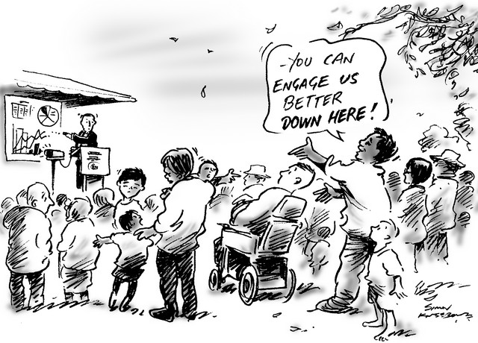
Stakeholders

Slide 5
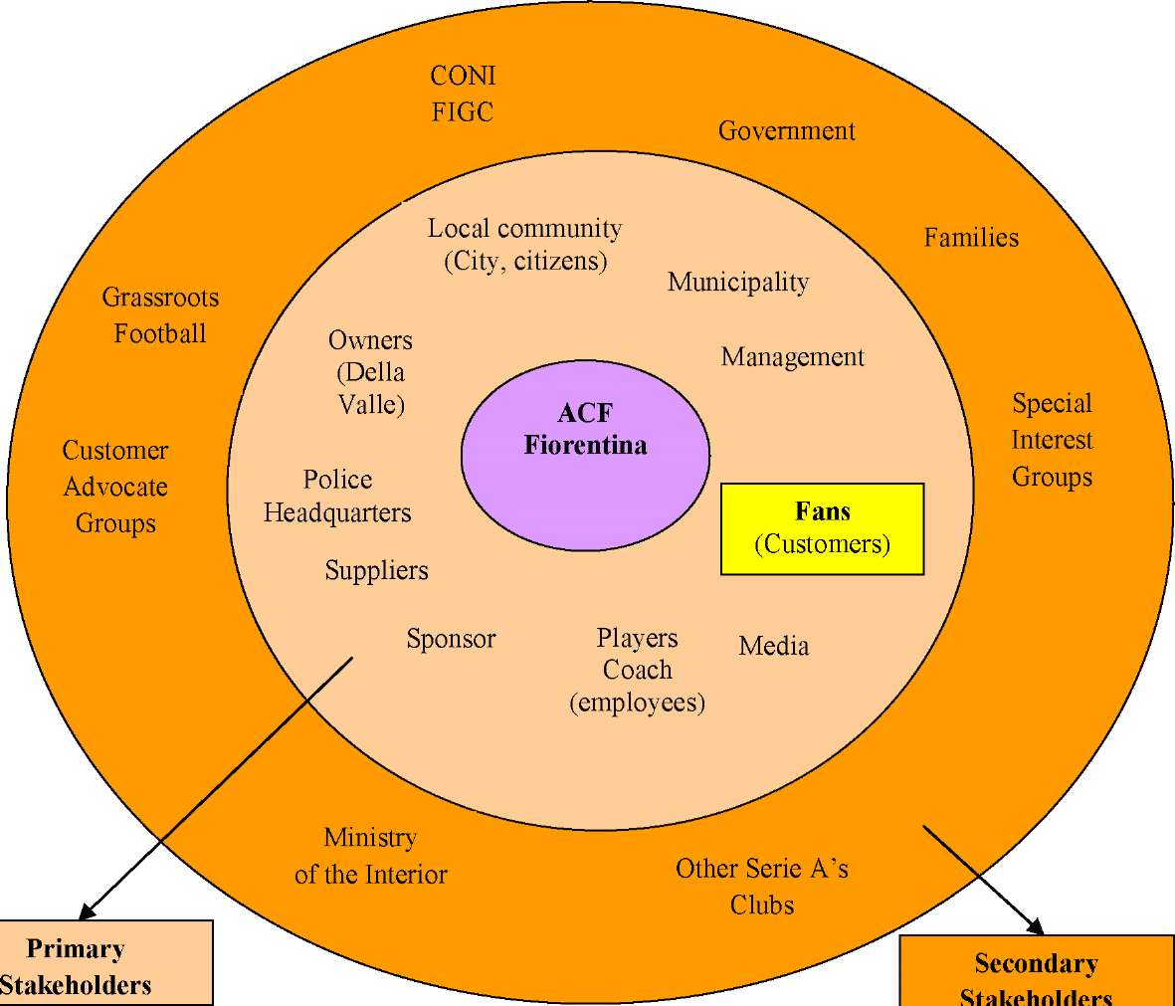
Stakeholders have varying degrees of connection to the Lodge

Slide 6
Who – What are the Primary and Secondary Stakeholders of your Lodge?

Slide 7
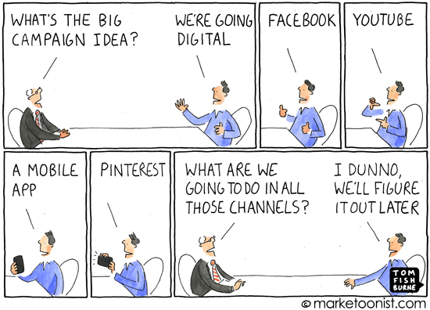
Creating Awareness (Marketing)

Slide 8
Connection
A. How does the Lodge connect with stakeholder groups?
B. Medium of connection
C. Events and participation

Slide 9
Implementation and Getting Started “It Starts With Us”
A. Anywhere, any time
B. Consistency
C. Moderation
D. On-going
1. It never ends
2. Learn as you go

Slide 10
Conclusion
A. Fundraising seeks to secure financial and material resources for the continued health of the lodge.
B. As we have seen, people give because they believe in the mission of the Lodge, but there are many variables involved – including who the person is and what resources they have available;
C. Critical in any of this is that we need to better identify our Stakeholders and communicate a greater understanding of the Lodge and develop a greater connection with our Stakeholders.
D. In the next two sections we will look at applying the same practices at the Council and Community level and then developing fundraising programs and implementing the all important “ASK.”

Slide 11
Have Fun!

Slide 12
For Training Resources and More Information Visit:
http://training.oa-bsa.org/noac2015

