Slide 1
A Time to ACT
Adapt. Collaborate. Thrive.

Slide 2
Obligation
I do hereby promise on my honor as a Scout, that I will always and faithfully observe and preserve the traditions of the Order of the Arrow, Wimachtendienk, Wingolauchsik, Witahemui.
I will always regard the ties of Brotherhood in the Order of the Arrow as lasting, and will seek to preserve a Cheerful spirit, even in the midst of irksome tasks and weighty responsibilities, and will endeavor, so far as in my power lies, to be unselfish in Service and devotion to the welfare of others.

Slide 3
Learning Outcomes
Understand the purpose and structure of the ACT Conference
Describe the HPL metrics and why they matter in measuring lodge performance
Define my role as a leader and accountability partner in promoting growth in the OA

Slide 5
Why are you here? Why did you decide to come to this Section ACT Conference?

Slide 6
WHY are you here? What has inspired you to stay involved, to give back as much as you do?

Slide 8
35,090

Slide 9
Key Performance Indicators
Unit Election Rate – the percentage of troops, crews, and ships that host an OA in a given year
Induction Rate – the percentage of candidates that attend an Ordeal
Activation Rate – the percentage of members that attend an OA event within their first six months as an Arrowman

Slide 10
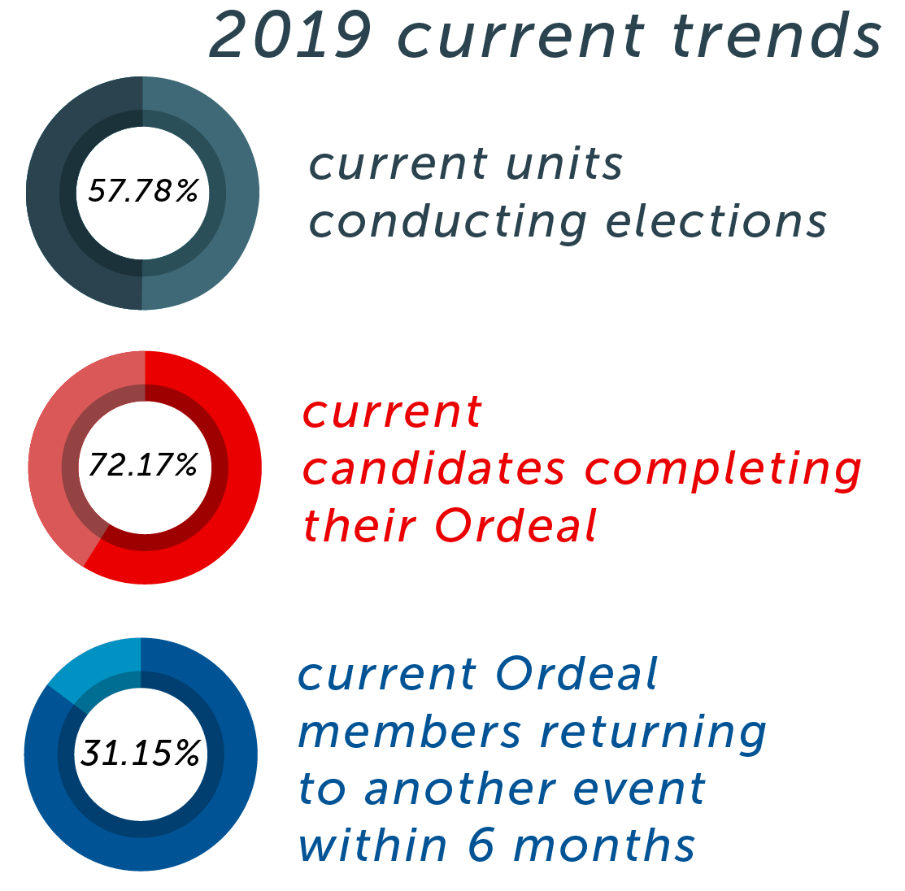

Slide 11
14.5%

Slide 12
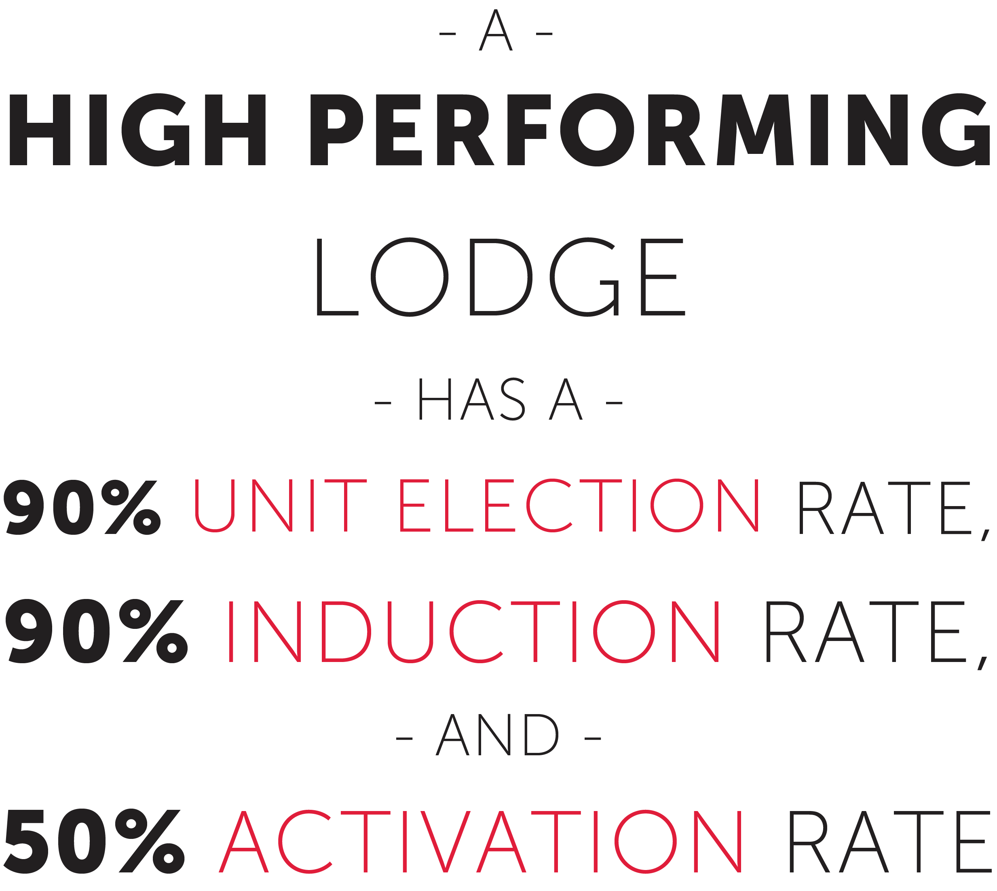

Slide 13
Staff Introductions

Slide 14
Making the Most of this Conference
Remember what you learn
Connect with the staff and your fellow delegates
Limit phone use
Follow-up
Pay it forward

Slide 15
Goal Setting & Accountability Partners
Lodges and sections are partners
Section wants you to achieve your goals
Will work hard to ensure success
Lots of follow-up, we must work together to be successful

