Slide 1
Catalyzing Your Vision
Session 3

Slide 2
Learning Outcomes
Understand why change is pertinent to the success of organizations around the world
Understand why the Order of the Arrow must change in order to Thrive
Develop the skills to become the catalyst back home

Slide 3
Change
“You are the change you wish to see in the world.”
-Mahatma Ghandi
"We do not describe the world we see; we see the world we can describe.”
-Rene Descartes
Notes:
Change is a scary word. Many people talk about change. Many people call for change. It happens with every election. The new person says they will be different. They will change the status quo. Followers and voters seem to like this banter and this promise for change!
UNTIL
Change happens. Or starts to happen. Or seems to be happening and it is NOT what some consider ”good” change. As a group we get nervous about change and how things are moving forward. CHANGE means we have to close this door and choose which is the CORRECT next door. Change means we have to let go and trust. It means we have to head down the path of progress….but we can’t always see the end.
CHANGE. How do we manage this ALWAYS TALKED ABOUT. ALWAYS DESIRED. ALWAYS RALLIED AROUND.
BUT
Always fear inducing and second guessing people will start to push against us.

Slide 4
Transition: 3 Step Process
ENDING
The Stage of “Dis”
engagement
identification
enchantment
orientation
Neutral Zone
The Most Difficult Period
Emptiness
Disorganization
Despair
1
Unfreeze
CHANGE
Refreeze
2
BEGINNING
Success depends on YOU
New Physical & Psychological Energy
Can be troublesome
Depends on time of Stage 2
3
Notes:
There are THREE steps to EVERY change or transition.
It might surprise you that change starts with ENDING. We have to examine where we are and why we are doing things. Albert Einstein is credited with saying, “The definition of insanity is doing the same thing over and over again, but expecting different results.” But that is how we generally do things. We try again and again. It is easier to tweak the existing process over and over. We might adjust, but do we really just END things and start over?
This seems scary. And it is, if you don’t realize this is really how things work. And HOW WE CAN MANAGE the process.
So we start by ending things. It is the ”Dis” stage. Dis-entangled, disengaged, dis-identification, dis-orientation. We stop doing things we CHANGE our process.
The second stage is the NEUTRAL ZONE. It is like neutral in your car. You don’t go anywhere. It is hard because you can hear the motor revving up, but nothing is happening. There are no procedures or protocol for doing something. We ended all of the operating parts in the last stage. This stage can be difficult for many because they don’t know what to do.
The third stage is where we BEGIN. This is the plan. This is the action. This is the change. This is where NEW happens. The success of stage THREE depends on how long you let people stay in stage Two. It is up to you as the change maker to manage this process.
In the middle you see Unfreeze, CHANGE, and Refreeze. This is the key to your three stages. You need to thaw out the frozen lines of communication, and the attitude of “that is the way we have always done things”. Those are frozen. You are stuck. It is as solid as a rock. So unfreeze the status quo, then CHANGE things, and you start to REFREEZE the new procedures and the new ways of doing things. Before long your Stage THREE of BEGINNING, and Refreezing, will seem like the “way we have always done it around here.” It won’t take that long. We promise.

Slide 5
WHY?
Why does your group exist?
Probe that answer with…
Why is that important?
Probe that answer with…
Why is that important?
Probe deeper…
Why is that important?
And again
Why is that important?
5
Notes:
Before you move to the 3 stages of Stop, change, start you need to guide a process with your chapter, lodge, section, or the whole Order. This is so simple. You will think it doesn’t make sense or it will not work because it is so simple. But we need to drill down to WHY WE DO THINGS. WHY ARE THINGS IMPORTANT TO US. The FIVE WHY’S will help you get to the REAL reasons we do things. Try this with anything. Let’s focus on the Order of the Arrow itself. Break into small groups of 5 to 8 and just play with this.
Why does the OA exist?
Why is that important? NO MATTER WHAT THE ANSWER IS the next question is WHY IS THAT IMPORTANT? And Repeat….take it to the FIFTH Why. If you can go to the 6th…do that. Play with the answers. NO MATTER what the response is see how far you can go with the Why. If it is silly and you cant go very far with it, then perhaps that wasn’t the real answer to the question. Select another answer.
Then try
Why don’t people join?
Why do people have a negative impression of the OA?
Why does the Ordeal exist?
Why does Brotherhood exist?

Slide 6
HEAT
It takes THREE things to make a fire:
HEAT – What’s your passion? How will YOU make a difference? How will you contribute?
FUEL – What feeds your passion? How do you refine your plan? How do you hone your craft?
OXYGEN – When do you take time to breathe? How do YOU find balance? How do you rejuvenate?
How does this relate to the Order?
HEAT –
FUEL –
OXYGEN –
OXYGEN
FUEL
Notes:
We are all Boy Scouts right? We know how to make a fire. We know we need some kindling, and a spark of some sort, and then if we blow on it…voila.. A fire.
So we have heat, Fuel, and Oxygen. Let’s think about this fire triangle and our own leadership or our ability to create some change. It starts with us. But HOW DO WE take care of ourselves? Have you ever flown on a plane? Think about the safety talk at the beginning of the flight. We put our OWN OXYGEN ON FIRST before helping anyone else.
So what are we passionate about? How can we make a difference. Think back to the last slide and what we did with the WHYS. How did you feel about those questions and answers. Which of those questions were you passionate about? What was sparked for you to think that YOU Could make a difference? Which of the FIVE WHYS really hit home with you?
How do you feed your passion? Is is leadership? Is it being an elangomat? Do you really like organizing the events? Are you a ceremonialist? How do you enage your passion in the ORDER? What makes you want to participate…and….what do you want others to see about our Order and all of the things that are important to us and to the THOUSANDS of Arrowmen that will follow us.
Oxygen. We have to find balance. And we have to breathe life into what we think is important. CHANGE is oxygen. Change is the key to making things move forward. Think about it…without change you would still be in the first grade. We need to stretch, grow and make things happen to sustain life, energy and our order. Bringing new people into the jobs we like to do is healthy and is growth. IT expands our ability to serve more, teach more and engage more.
Think about your FIRE TRIANGLE first.
Now think back to your FIVE WHY exercise. Now that we have some ideas about why things are important…let’s identify the Heat, The fuel nad the Oxygen in our Fire triangle. How will we bring life to these important reasons we exist.
REMEMBER WE ARE going all the way back to STOPPING CERTAIN THINGS. That is where CHANGE HAPPENS and how we can look at progress.

Slide 7
“those who chose you need you.”

Slide 8
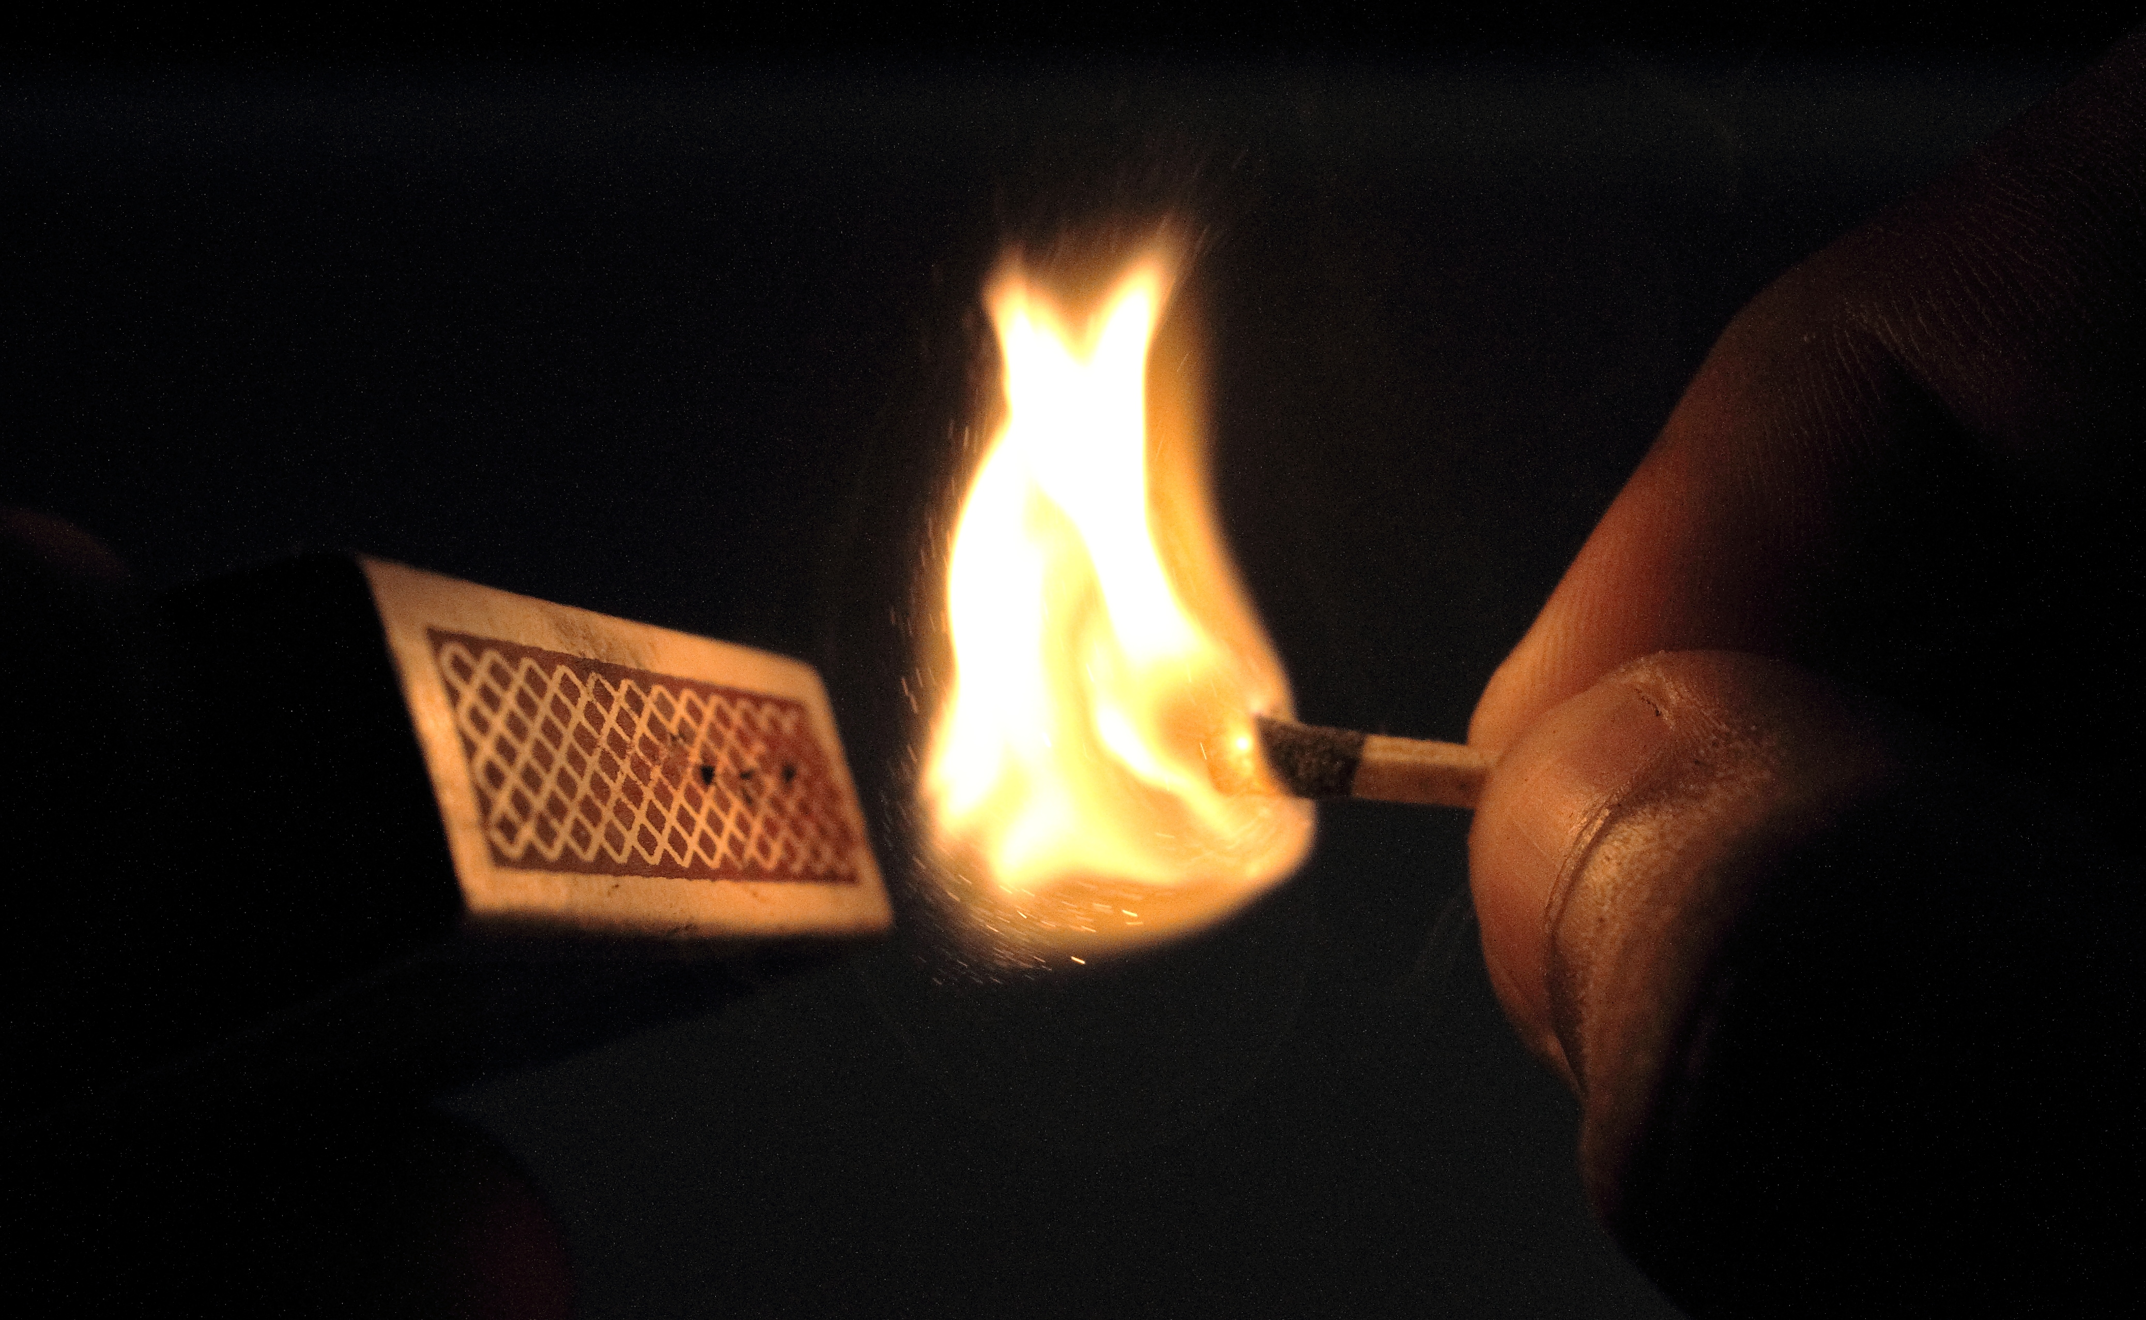

Slide 9
It is the person that unfreezes the status quo, it is the person that has the strength and courage to say, “we need to stop doing some things.“

Slide 10
The Process of Change
Laying the Groundwork
Recognize and raise awareness to the need for change
Identify key stakeholders
Begin building your team
Define your vision
Communicating a Shared Vision
Engage key stakeholders
Captivate hearts and minds

Slide 11
The Process of Change
Enabling Others
Use your team to drive change
Pursue measured, incremental progress
Focus on positive reinforcement
Continuing to Act
Emphasize continual progress
Ensure that plans are followed through
Plan for future action

Slide 12
What do you think are important characteristics of a goal?

Slide 13
Change is an inevitable part of every successful organization on this planet, and the Order of the Arrow is no different. We must be willing to take risks to innovate and progress our organization towards a state of growth.

