Slide 1
Activating the Future
Session 6

Slide 2
Learning Outcomes
Explain the stakeholders involved in activating Arrowmen.
Demonstrate ways to increase participation and engagement.
Create a plan to innovate and improve lodge activation rates.

Slide 3
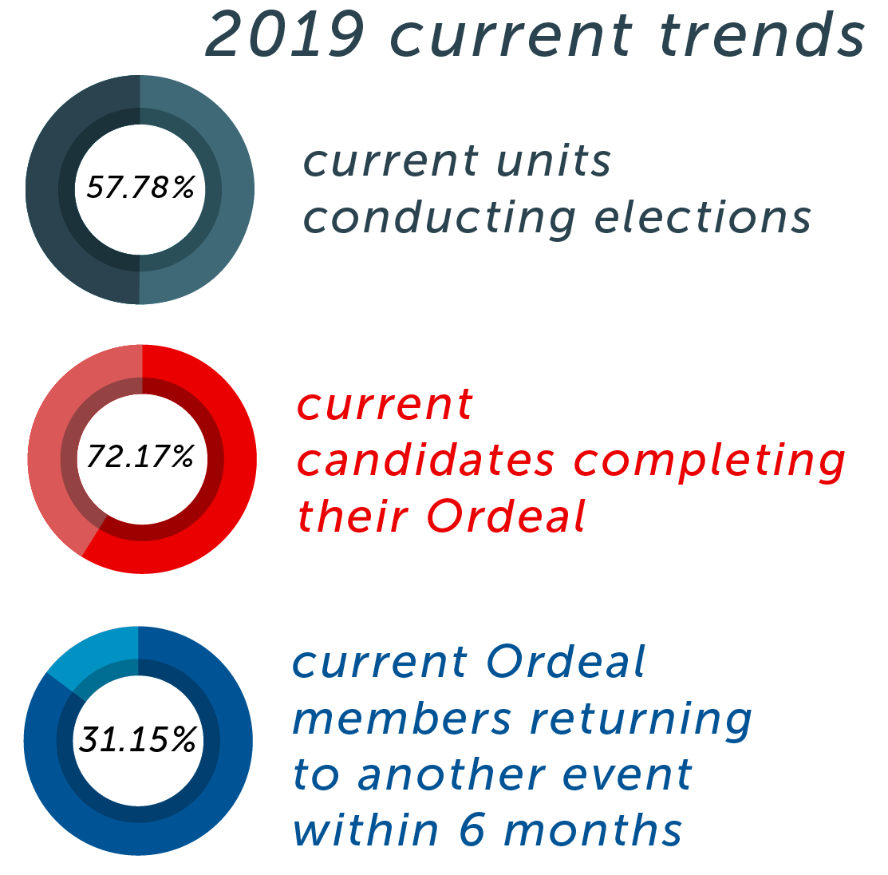

Slide 4
Activation Rate Definition
An event held within six months, but preferably within 90 days, following an induction weekend with the intent to involve new members, encourage retention at the local level, build personal growth, and ensure future involvement in the OA.

Slide 5
Lodge Breakouts

Slide 6
ACT Timer (5 mins.)

Slide 8
Making an Activation Event Meaningful
Purpose of an Activation Event
showing Arrowmen the benefits of the OA and get them hooked on our program!
There are many different events that quality as Activation.
Every Lodge does this differently

Slide 9
What’s Your Best Idea?

Slide 10
Activation Resources
Activation Event Guide
shares a variety of success stories, best practices, and timelines to follow to provide you with some inspiration and guidance in planning an activation event
Activation Mentorship Program Guidebook
outlines a program that provides individualized support for a new Arrowmen
Online Elangomat Certification Training
All of these resources can be found at oa-bsa.org/thrive.

Slide 11
ACTion Plan
How can your lodge hit the next benchmark to becoming a High Performing Lodge in the category of Activation Rate?

