Slide 1
The Trail Ahead
Session 8

Slide 2
Learning Outcomes
Recap the conference and identify key takeaways.
Initiate ways to adapt, collaborate, and Thrive to ensure the success and future of our organization.

Slide 3
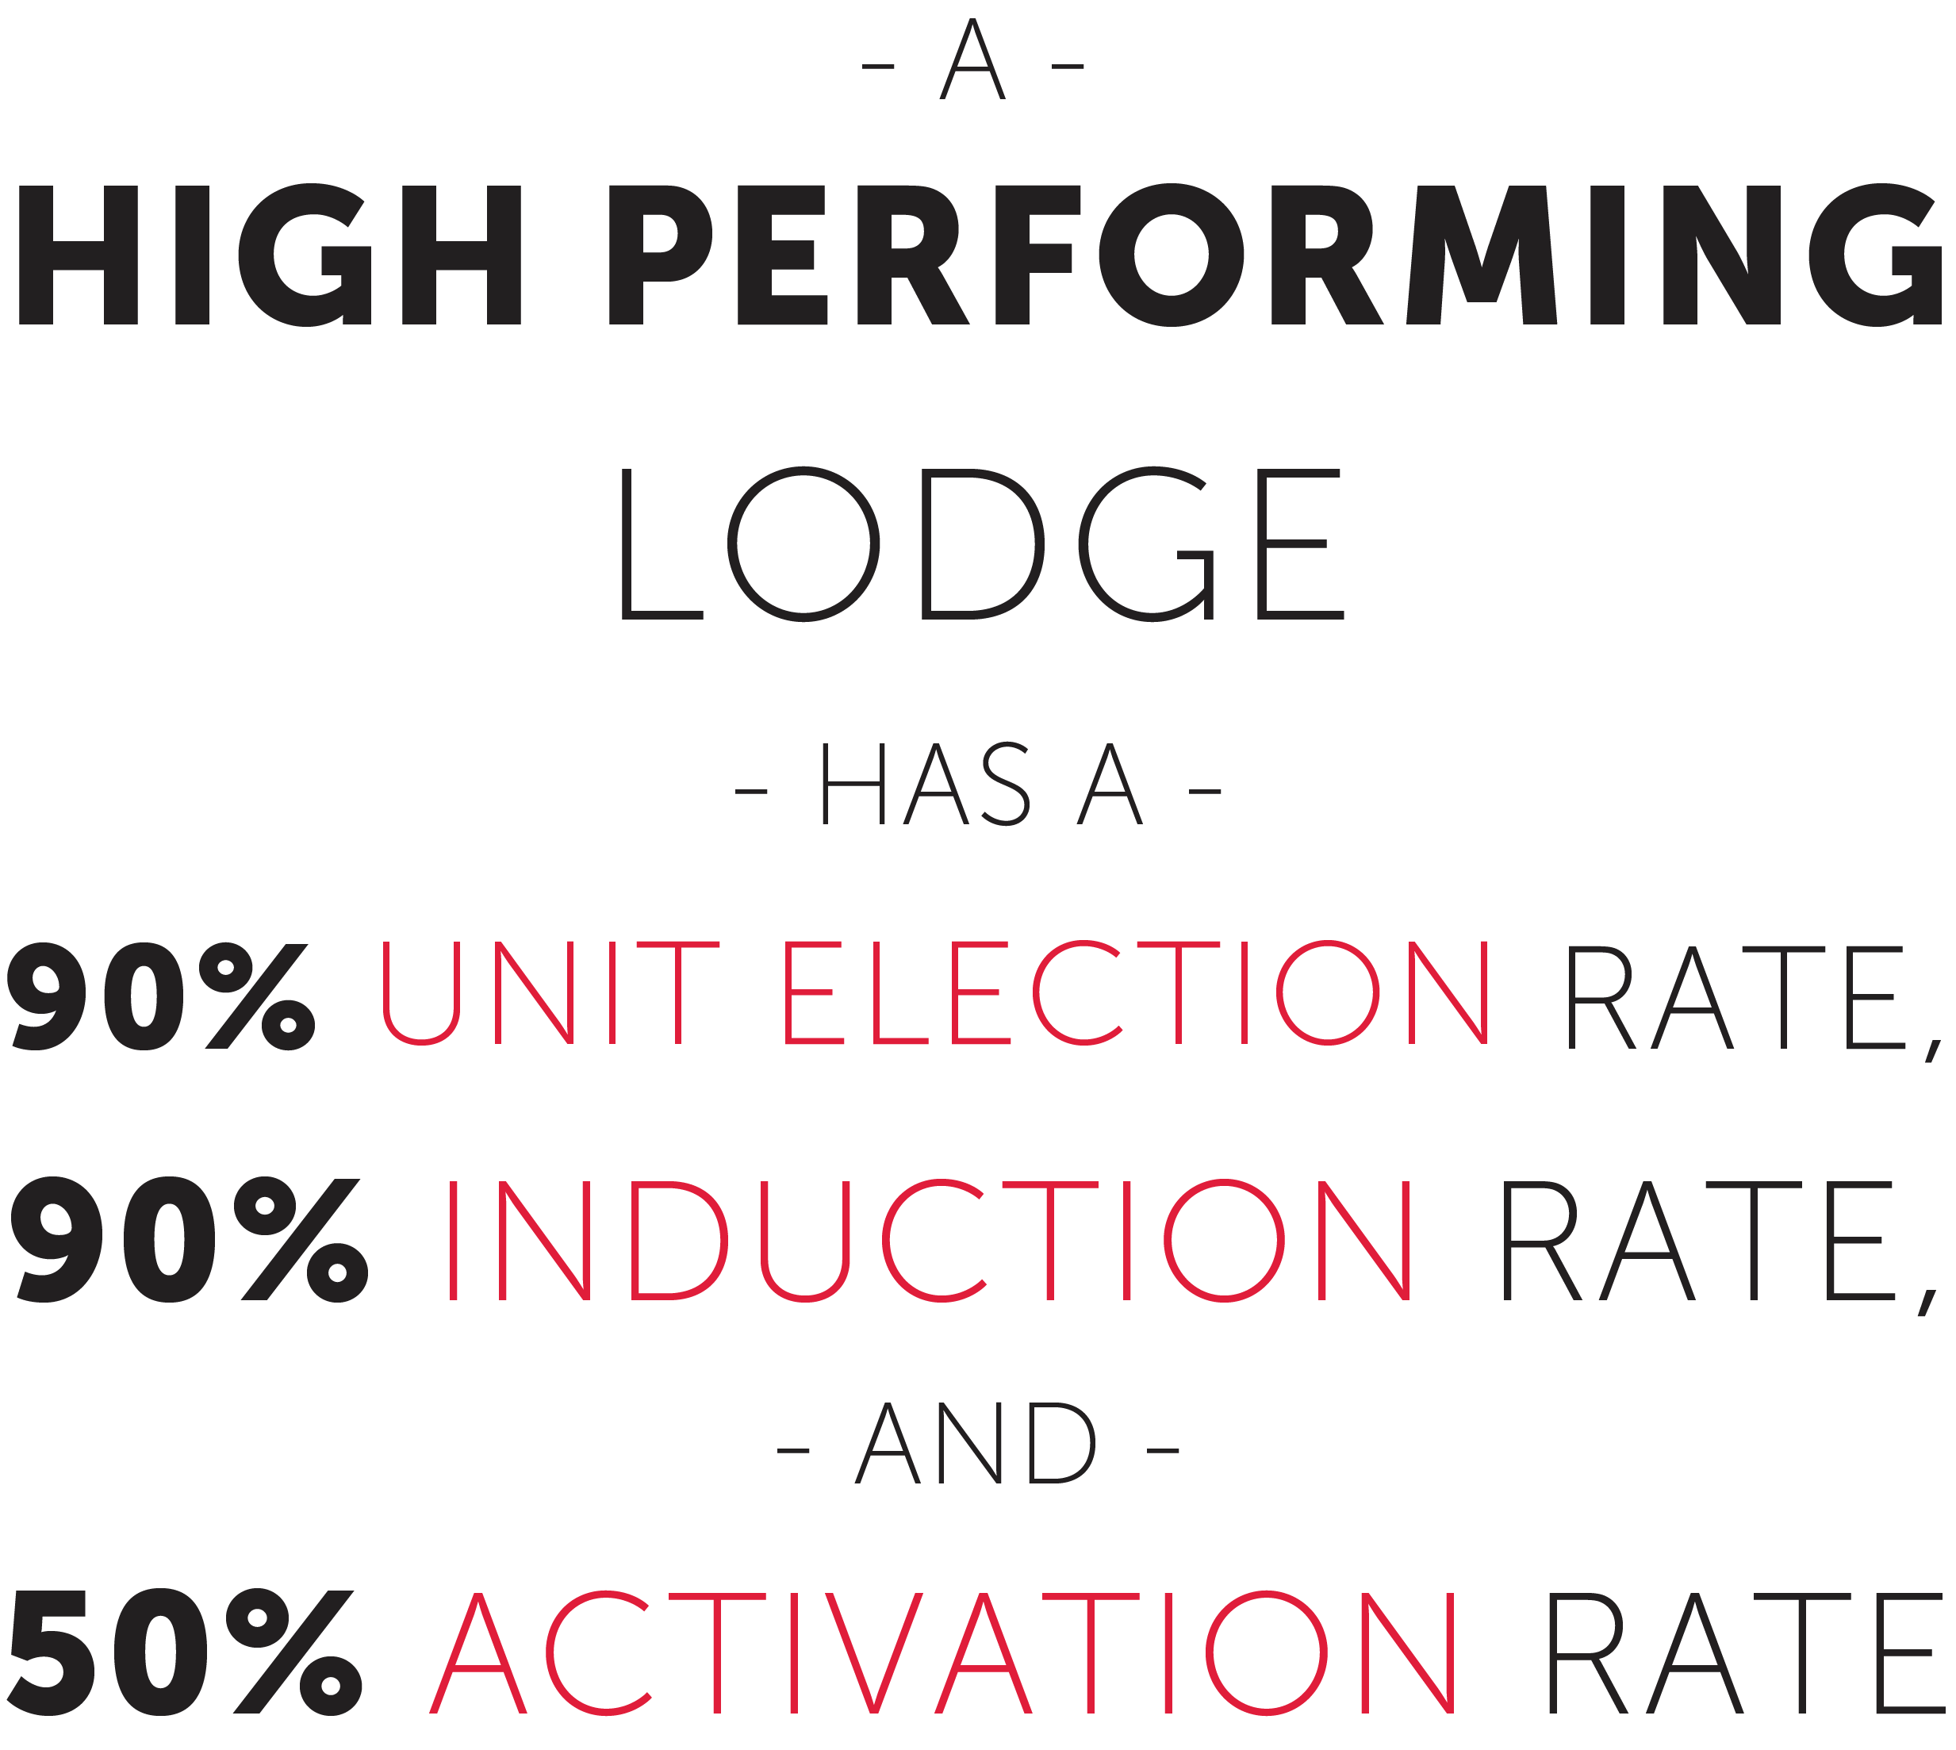

Slide 4
14.5%

Slide 5
ACTION PLANS

Slide 6
YOU ARE NOT ALONE

Slide 7
STAFF RECOGNITION

Slide 8
DELEGATE RECOGNITION

Slide 9
CLOSING REMARKS

Slide 10
SONG OF OUR ORDER

