Slide 1
Train the Trainer
Day 1: Plan

Slide 2
Opening
Notes:
Catchy opening chant, song, or dance sequence tailored to trainers’ talents. Choose to make your teaching shine or make a mess of it humorously. Review the syllabus for how to handle.
Goal is to do something complex but break it into parts and teach it to a subset of the group. Use how we teach multi-part songs at a campfire as your template. It should be longer and more complex than what someone can learn from a couple of repetitions. Tying it to the theme would be good.

Slide 3
Staff
Personalize this slide with names, lodges, locations

Slide 4
Objectives
Building great trainers and training teams
Developing splendid training courses
Spreading best training practices into your lodge and section

Slide 5
Schedule
3-day course
Day 1: Planning Your Training
Day 2: Developing Your Training
Day 3: Delivering Your Training
At end, you’ll have solid resources to take home to your lodge or section to Start Your Ripple

Slide 6
Participant Presentations
Purpose is concrete practice of techniques
We learn best by doing
Do not let its development detract from your NOAC experience (no all-nighters)
Ideally 5 minutes
Topics
Notes:
Emphasize that the presentation is a means of giving them something concrete to practice the techniques. Do not let creating it get in the way of participating fully in NOAC.
Staff should have brainstormed a list of topics suitable for these presentations. Five-minute presentations would be ideal, but that length may not be feasible given space and class size constraints. Topics do not need to be unique. They should be scouting or OA related.

Slide 7
Ice Breaker
Goals of ice breakers
Learn names
Learn something about people
Find commonality of purpose
Group Meeting Sparklers is a resource
Practice (these or others)
Merge Sort Name Game
Adjective-Noun Name Game
Notes:
Consider size of group and whether or not they can move around in choosing which game you use. Use something appropriate that trainers are comfortable using. Practice before using.
Throughout course, rearrange people in groups so that they meet more people.

Slide 8
Day 1: Planning Your Training
What is Training?
Deciding on Topics
Evaluation
Group Size and Methods
Building Your Training Team
Identifying Resources
People as well as Materials
Notes:
This is roadmap for the day. Mention that there will be a couple of appropriate breaks. Do NOT go into describing these at this point.
Goal here is to give participants an idea of where the day is going.
Throughout, trainers will model appropriate use of a variety of appropriate training techniques as mentioned in the syllabus. Inform participants of what technique is being used. This is the D of EDGE.

Slide 9
What is Training?
Brainstorm technique
Record all suggestions
Trim later (or not)
Scribe
good handwriting
written large enough
Go ...
Notes:
Training technique used here is brainstorming where we record all suggestions on flipcharts or whiteboard to get ideas expressed; trim later. Model good training practices by having a scribe with good handwriting who writes large enough.
Items mentioned should include: teaching, learning, of general ideas, of specific steps, multiple approaches

Slide 10
Deciding on Topics
Set topics such as Brotherhood Conversion
Set structure (such as LLD) but choose topics within that structure
Choosing topics can be the hard part
Even if topic is set, you still refine the syllabus and make it your own
Notes:
Lecture technique: generally not appropriate for scouting
Things to consider for topic choice on next slide.

Slide 11
Things to Consider when Choosing Topics (1)
Audience diversity
What audience wants
What audience needs
What has worked in the past
New items for previous attendees
Notes:
Extra parts not on slides
audience diversity (experience, needs)
what audience wants (surveys from previous course)
what audience needs (skills for a specific task, general skills, inspiration)
what has worked in the past
new items for previous attendees (don't repeat everything from previous offering; give them a reason to repeat)

Slide 12
Things to Consider when Choosing Topics (2)
Prerequisites
Resources available
Venue
Unique aspects of trainers or venue
Notes:
Extra parts not on slides
prerequisites (don't assume audience has background they may not; have to get the level right)
resources available (special talents of team members, developed sessions, hot topics)
venue (space available, size of group, assets and pitfalls)

Slide 13
Evaluation
Look at everything you see and consider whether it works
What would you change?
In all training, feedback is a gift, but it will only be accepted as a gift if it is wrapped as a present
Notes:
Use informal talk here. It is sort of an aside at this point in the presentation. But it is important; don't leave it out.
Start-Stop-Continue technique on next slide.

Slide 14
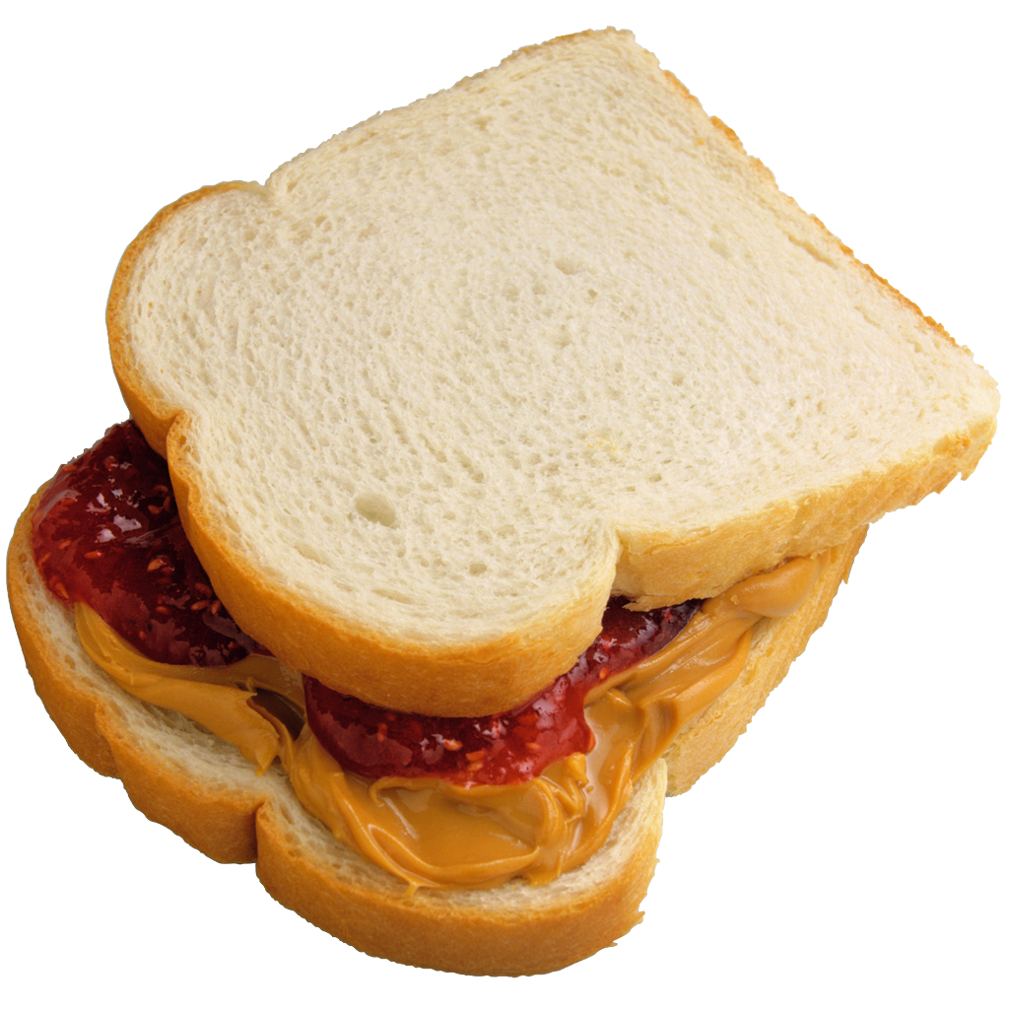
Start-Stop-Continue
Tool we can use for giving suggestions
What should we
START doing? (positive)
STOP doing? (negative)
CONTINUE doing? (positive)
Think of feedback throughout sessions
Notes:
Making a sandwich of suggestions
Maybe use SSC on opening or ice breaker
We will use SSC for presentations, but for now, participants can make notes to themselves about what is working (and not) in these sessions.
What would you say to trainers in a positive way?
Practice noticing positive aspects as well as negative as you take notes of what we teach.

Slide 15
Break

Slide 16
Group Size and Methods
BSA encourages 4 types of training
Small group: one-to-many approach
Personal coaching: one-on-one or two
Self-study: learn on your own
Centers of Excellence: observe good examples
Notes:
Use informal talk for beginning (types)
Small group: one-to-many approach
Personal coaching: one-on-one or two
Self-study: learn on your own
Centers of Excellence: observe good examples

Slide 17
Group Size
Aim to involve everyone
This group probably larger than is good
Break into smaller groups each led by trainer
Most OA training will be “small group”
Split sessions to reduce size
Need additional space and trainers

Slide 18
Methods
Lecture
Informal Talk
Demonstration
Case Study
Role-Play
Simulation
Buzz Group
Notes:
This is a quick overview of material that will be covered in more depth on Day 2. Maybe demonstrate the methods with a narrator and a great deal of humor.

Slide 19
Which Method Works Best?
People learn best if they are involved and active
Make content “sticky” through variety
Match methods to kind of topic
More stationary for explaining why
More active for showing how
Include audience as much as possible
Notes:
Show rather than tell

Slide 20
Building Training Team
Who are Good Trainers?
Characteristics of Good Trainers
Roles of Trainers in a good Training Team
Recruiting Good Trainers
Ask directly
Let them know they will be mentored
Give them useful and positive feedback
Practice, practice, practice to gain confidence
Notes:
Brainstorm; leave flip sheets on wall for reference; encourage people to take pictures of sheets to take info back with them.
Want people who can keep it REAL
Responsive
Energetic
Active
Live -> live what you are training

Slide 21
Break

Slide 22
Identifying Resources
Materials and People
Resources abound
People with varying skills
Published course outlines
When using non-BSA resources, check for conflict with BSA values
Check for language and grey areas
Respect copyright
Acknowledge sources
Notes:
This should be an informal talk and discussion. Display of some printed resources available all three days. Have one-page sheet of this course's resources as a handout.
Resources abound
People with varying skills (survey skills and catalog information for reference)
Published course outlines (LLD website, OA Training website)
When using non-BSA resources, be sure they don't conflict with BSA guidelines
Check for language and grey areas
Respect copyright
Acknowledge sources (helps for others to find more information)

Slide 23
Summary and Wrap-up
Review topics
Discuss “homework”
What are expectations for next day?
Do not let prep interfere with NOAC experience

Slide 24
Train the Trainer
Day 2: Develop Your Training

Slide 25
Objectives
How people learn
Training tools
Presentation Media
Time Management
Syllabus Development
Preparing and Practicing

Slide 26
How People Learn
People learn best when:
They understand why
They have a variety of ways presented
Experiential – Learn by doing
Timing is right
The process is positive and encouraging
Notes:
Introduction: One important aspect in developing your training session is having an understanding of how people learn. Knowing the different factors in how people gain knowledge will help you in putting together a training that be more effective.
Not everyone learns things in the same way, so including a variety of methods and tools will help ensure that you can reach the most participants in your session and share your knowledge with them.
Understanding why something is important for them to know:
• “What’s in it for me?” is an important aspect in getting people to learn. When the participants understand that the training contains things that benefit them, it gets their attention.
• Not everyone taking the course are there for the same reason, some are there because they want to be, others are there because they have to be. The sooner participants understand why this training is of value to them the more focused they become.
Having freedom to learn in their own way:
• People learn in different ways- some by watching (visual), some by listening (aural), some by doing (tactile). By varying the training styles used, it allows participants to gain knowledge through the type of learning they are most comfortable.
• A single teaching method should only be used for about 10 to no more than 20 minutes so it keeps the participants engaged in the learning process.
Learning is experiential:
• The most effective learning is by doing, living through it. (Patrol method- demonstrate then practice) Sharing own experiences to illustrate training points.
• Time is right for them to learn:
• Taking on a new position, needing to know how to do something because they will be using those new skills shortly. (Example- setting up a tent because they will be going camping that weekend) Unplanned teaching moments – problem or challenge arises, solving that gives high motivation to learning.
Process is positive and encouraging:
• A course filled with positive reinforcement and fun will enhance learning.
Conclusion:
• Understanding how people learn, and what motivates them to learn, will help you in putting together effective training sessions. Using variety in your training that brings in different aspects, Aural, Visual, and Tactile, will allow people to learn through the method that best suits them

Slide 27
Training Tools
Notes:
Introduction: Having knowledge of the variety of tools you can use, allow for you, as a trainer, to use different methods to share your knowledge. It keeps the training session interesting.

Slide 28
Types Of Delivery
Lecture
Large group
Introductory lesson
Little or no background or experiences
Participants get to listen to an expert
Advantages/disadvantages
Notes:
Trainer Instruction: This section is in part a review of the styles of training, but more emphasis should be given to advantages and disadvantages of each type, and the determining factors for why you would use these different styles.
Lecture
• Large group
• Introductory lesson
• Participants have little or no background or experiences to share
• Participants get to listen to an expert
• Give advantages/disadvantages of this method, noting it is rarely used in Scouting sessions.

Slide 29
Types Of Delivery
Informal Talk
Less technical
Material relatively new, some experience
Allows some discussion
Preferred method in Scouting
Advantages/ disadvantages
Notes:
Informal Talk
• Less technical information, or familiar to participants
• Material relatively new, but participants have some experience relative to the topic
• Allow to discuss or take questions from participants if time allows
• Preferred method in Scouting over a lecture
• Give advantages/disadvantages

Slide 30
Types Of Delivery
Demonstration
• Step by step instructions
• Show and do
• Instructor prepared and practiced
• Materials for all participants
• Large Training aid
• Advantages / disadvantages
Notes:
Demonstration
• Show a skill by doing it using step by step instructions
• Plenty of time available to show and do
• Instructor prepared and practiced
• Materials for all participants
• Training aid large enough to be seen by all (or camera/ screens available to aid in visual clarity
• Participants should have an opportunity to see, then do the skill
• Note limitations of this method, class size can be a factor to consider

Slide 31
Types of Delivery
Case Study
Actual events
Real life situations
Advantages/ disadvantages
Notes:
Case Study
• Actual events involving a judgement call
• Presentation of the situation, orally or handout, for analysis or resolution
• Real life situations give immediate relevancy to the training
o (Note, while these may be real life situations, use different names, locations. Possible sources can come from news articles, personal experience or knowledge.)

Slide 32
Types of Delivery
Role-play
• Act out roles
• Own dialog
• Allows to look at multiple points of view
• Outcome not predetermined
• Sets stage for discussion
• Role-play less structured, Case study intentionally guided and structured
Notes:
Role-play
• Act out roles presented in an open-ended situation
• Own dialog within context of roles and situations
• Allows to look at multiple points of view
• Outcome not predetermined
• Sets stage for discussion
• Role-play less structured, Case study intentionally guided and structured
Case Study – re-evaluation of an actual event. Role Play is typically fictional
• Both avoid “black and white” – “right or wrong” situations to encourage discussion, examination and reflection

Slide 33
Simulation
• More complex than Role-play.
• Requires known skills - mimic real life
Advantages/ disadvantages
Notes:
Simulation
• More complex than Role-play. Places participants in environment of the situation.
• Requires putting known skills into practice, uses the situation to use a combination of skills that would mimic real life

Slide 34
Presentation Media
Notes:
Presentation Media
Flip Charts
• Demonstrated prepared Flip charts
• Pitfalls to avoid
• Advantages/ disadvantages

Slide 35
PowerPoint
Self Study
Read by an individual to learn
Often accompanied by audio
Instructor support
Assists learning
Participant overview
Notes:
PowerPoint
Describe what PowerPoint can be used for, using the above points.
Trainer’s Note: PowerPoint is used quite frequently in Scout Training sessions, making it important to highlight what a PowerPoint is for, how to use it effectively without it becoming a distraction, can use a sample of the Good, Bad and Ugly of PowerPoint slides. If putting this together yourself, make sure you follow the best practices of PowerPoint use, such as same look for every slide- every slide having same border design, lettering of the same type, good contrast for ease of reading, writing in the same location, clutter free, limited writing to main points

Slide 36
PowerPoint Purposes
Help recall information
Supports the material
Identifies key learning points
Provides Interest & Variety
Clarifies points
Particularly for visual learners
Notes:
Purposes of PowerPoint presentations

Slide 37
PowerPoint Mistakes
Too many words
Unreadable font
Unfam. Acro’s
Inappropriate clip art
Distracting animations
Unneeded sound
Notes:
Some of the common errors Presenters make when putting together a PowerPoint presentation.
Note: Most of these will be shown in the following slides.
Too Many Word
Unreadable font
Unfamiliar Acronyms
Inappropriate clip art
Distracting animations
Unneeded sounds added,

Slide 38
Notes:
Ask what the participants think about this slide

Slide 39
Notes:
How about this one?

Slide 40
Notes:
And this one?

Slide 41
Notes:
Ask what is wrong with this… a good time to point out contrast. Also note the multiple logos scattered around it.

Slide 42
Trainer’s Recognition
The leadership training recognition plan is intended to honor demonstrated performance and tenure of trained leaders in all areas of the Scouting program directly involving units. Leaders interested in collecting recognitions for the sake of the emblem only should be counseled as to the true intent of the plan.
The Scouting leader who has shown interest and dedication by giving up personal time to attend a learning event should be properly and publicly recognized. Whatever format the recognition takes, it should be sincere and impressive, and the participants should be made to feel they have accomplished something worthwhile. The training committee should encourage Scouters to qualify for the various awards, provide opportunities for completing their requirements, and see proper records are kept. Recognition will establish status for the training and the awards in the eyes of all youth, adult leaders, chartered organizations, and the general public.
It is important to the recognition plan that all awards be presented in a dignified manner at an occasion befitting the achievement. Immediate recognition of achievement could be given by presentation of the award in the presence of the unit membership and representatives of the chartered organization. Occasions for formal recognition should also include meetings with the chartered organization, roundtables, and council and district meetings. Recipients of awards might be recognized at the annual meeting of the district or council, and an announcement in the council newsletter and in other news media is also recommended.
Keep in mind an important objective is to encourage other leaders to strive to be fully trained. Properly handled, the awards presentation can serve to prompt others to seek training and recognition.
Notes:
Demo of too many words. …

Slide 43
Trainer’s Recognition
Honor leader’s efforts
Sincere and impressive
Status for the awards
Encourage others
Notes:
Lists the same things as on the preceding slide, but has it cut down to the key points

Slide 44
Presentation Media
Flip Books
White Board
Demonstration Materials
Handouts
Notes:
These are other items that can be used for Presentation Media, if you have these materials show them while going through each one.
Flip Books
• Small group
• Limitations
• Similarity to Flip Charts
• Show Flip-book stand – handout of basic design
White Board
• Marker colors to use/ avoid
Demonstration materials
• Large enough for all to see
• Enough materials for all participants if they are “seeing and doing”
• Alternate means to increase visibility might be use of cameras and display on screens or TV’s
Handouts
• Relevant to topic
• Allow for alternate information delivery method, for self-study or review
Conclusion:
By knowing when best to use the various delivery methods, adapting to the number of participants, fitting the training delivery method to the information being given, coupled with presentation media that helps reinforce and give variety to the training,

Slide 45
Time Management
Your Own Methods
Time Keeper
Personal practicing of delivery
Notes:
Keeping an eye on the time allowed for each section of the training helps keep the trainers focused, and ensures you get through the material you need to present.
(Possible video – a short video on someone talking slow, realizing they have little time left, and either just ending their talk mid-sentence or doing speed talking)
Time management tools:
Time clock – your own method
• “Egg Timer”
• Smart phone or other timing device
• Alarm settings
Time keeper
• Member of training team who can give signals for how much time left
• Clock visible to trainer in back of the room
Watching the clock and knowing where in the presentation you need to be at a given time
Personal Practice of delivery
• Going through the session multiple times, possibly taking a video of session, allows you see how long each area generally takes, so you can trim off talk where needed to fit the session length.
Trainer’s Instruction: Add in advantages and disadvantages to each of the Time Management types, so participants will have a better idea of which methods will suit their own personal styles, or limitations if they are working by themselves or a small group of trainers who are doing other things, limiting how well they can track your time keeping.
Possible video could be a simple timer running through this presentation, or video of a presenter going slowly, then having to speed up or end a presentation abruptly.

Slide 46
Syllabus Development
Notes:
This session is meant to give the participants a “how-to” guide on the various steps used to build a syllabus, as well as time to break into Buzz Groups to develop their own basic syllabus.

Slide 47
Building Your Own Syllabus
Decide on course length
Set defined Objectives
Break topic into separate sections
Decide on methods of delivery
Find out anticipated audience size,
Evaluate: Start-Stop-Continue method
Write it out, try it out
Notes:
Building your own syllabus:
When doing training on specific topics, you will probably encounter times when a training syllabus is unavailable, or is inadequate for your needs.
• Decide on time involved for the course (this may be already set)
• Set defined Objectives for the session or course
• Break topic into separate sections with highlights of items to be covered
• Decide on methods of delivery (styles
• Find out anticipated audience size, knowledge base
• Evaluate: Start-Stop-Continue method as discussed on Day 1
• Write it out, try it out
o Have it written down, at least in a rough draft form, so you can go through it and ensure the order and desired outcomes are met.
o Check timing expected vs. reality. Try going through the session and seeing if it meets the time limit, or fills the time expected.

Slide 48
Finalize The Syllabus
Put it into a format you can follow
List resources used
List materials needed
Put together Hand-Out materials
Notes:
Go over the points on the slide, then do a demonstration:
Trainers Instruction: Using the course trainers, put on a demonstration of how to gather as a buzz group to discuss the above steps in building a syllabus.
This should be scripted enough so it will show each participates in developing the syllabus and course to be given.

Slide 49
Buzz Groups
Notes:
Buzz Groups:
Some considerations should be having specific topics each group will work on. Audience size, participant background (I.E. Non – OA members being taught what the OA is about)

Slide 50
Preparing And Practicing
List of all items needed
Prepare Presentation Media
Handouts
Materials
Props
Songs
Games
Notes:
This session if to focus on how and what to prepare prior to doing a training session, and methods of practicing the training.
A good trainer will practice their presentation so they are sure of their delivery and can feel comfortable in being in front of the participants of the course.
Preparing:
• Go over the entire session and make a list of all items you will need.
• Prepare Flip-Charts or PowerPoint or other Presentation media you will be using and review it to make sure it adequately reflects the points you are making.
• Handouts- gather together the handouts you intend each participant to walk away with, and come prepared with extra copies for walk-ins. Dependent on the size of the course registration, a good practice is adding 10% to the totals of expected participants. (Know if there is a means of making additional copies at the facilities, if so, additional copies beyond what you prepared for can be made on site.)
• Materials enough for each participant
• Demonstration materials and practice materials, might want to consider adding extras for participants to have a new one if they make an error.
• Consider props, songs, games, that might be added to enhance the training and make it more memorable. Look for means of involving the Participants at relevant times to give some variety to the presentation.

Slide 51
Practice
With an Audience
Don’t read or memorize
Use of Presentation Media
Be aware of Body Language and Posture
Use video
Check for bad habits
Notes:
Practice:
• When possible, with an audience.
• Teaming up with other trainers can be helpful. Ask for an evaluation of the practice.
• Don’t read or memorize.
• Use of Flip Charts, PowerPoint or other presentation media should be enough to bring to mind the discussion points. Notes on stories or examples should be short, enough to give the reminder of what you want to say without it being set down word for word.
• Be aware of posture and body language
• Making a video of the practice can be valuable in being able to see if you are doing what you think are doing. Keep hands out of pockets, don’t “dance”, but have some dynamics that can emphasize points through body language.
• As part of the evaluation, if practicing with other trainers, have them pay particular attention to any habits you might have that could be distracting, rather than engaging.
Be Prepared
Try to anticipate possible questions that might come up from the session. As a trainer, you might not be an expert in the topic at the beginning of your assignment, but before the actual presentation, doing homework on topic should make you familiar enough with the topic that you can answer most questions that arise. Be familiar with the whole training course being given so you will know if answers to the questions will be in a following session.
Conclusion:
Closing statement on the importance of preparing and practicing, how it is about leading by example, showing you are prepared and practiced gives confidence in the topics your session covered. This influences your audience.

Slide 52
Summary and Assignments

Slide 53
Train the Trainer
Day 3: Delivering Your Training

Slide 54
Managing Group Behavior
What factors can affect group behavior and how they respond to your presentation?

Slide 55
Types of Disruptive Behavior
What types of disruptive behavior are you likely to experience?

Slide 56
Changing Group Dynamics
As a Presenter, how can you change the group dynamics?

Slide 57
Changing Group Dynamics
As a Presenter, how can you change the group dynamics?
Take a break

Slide 58
Changing Group Dynamics
As a Presenter, how can you change the group dynamics?
Take a break
Song, cheer or other activity

Slide 59
Changing Group Dynamics
As a Presenter, how can you change the group dynamics?
Take a break
Song, cheer or other activity
Change the room layout/format

Slide 60
Changing Group Dynamics
As a Presenter, how can you change the group dynamics?
Take a break
Song, cheer or other activity
Change the room layout/format
Change the presentation style

Slide 61
Changing Group Dynamics
As a Presenter, how can you change the group dynamics?
Take a break
Song, cheer or other activity
Change the room layout/format
Change the presentation style
Call upon the disruptive personality (non-confrontational)

Slide 62
Changing Group Dynamics
As a Presenter, how can you change the group dynamics?
Take a break
Song, cheer or other activity
Change the room layout/format
Change the presentation style
Call upon the disruptive personality (non-confrontational)
Discuss how everyone will participate before others repeat

Slide 63
Changing Group Dynamics
As a Presenter, how can you change the group dynamics?
Take a break
Song, cheer or other activity
Change the room layout/format
Change the presentation style
Call upon the disruptive personality (non-confrontational)
Discuss how everyone will participate before others repeat
Call out disruptive personality (directly, last step effort)

Slide 64
Changing Group Dynamics
Other ideas?

Slide 65
Break
(Start setup for presentations during break)

Slide 66
Participant Presentations
Everyone gives a 2-3 minute presentation on a topic of their choice

Slide 67
Learning from Experience
General Observations and Comments?
What was done well?
Constructive feedback?
What didn’t work well? Why?

Slide 68
Creating your Ripple
Develop your personal action plan
Do or do not, there is no try. - Yoda

Slide 69
Review and Discussion
Day 1: Plan
Day 2: Develop
Day 3: Deliver

Slide 70
Evaluation
Please complete the cell evaluation
Thank You, and safe travels home!

Slide 71
For Training Resources and More Information Visit:
http://training.oa-bsa.org/noac2015

