Slide 1
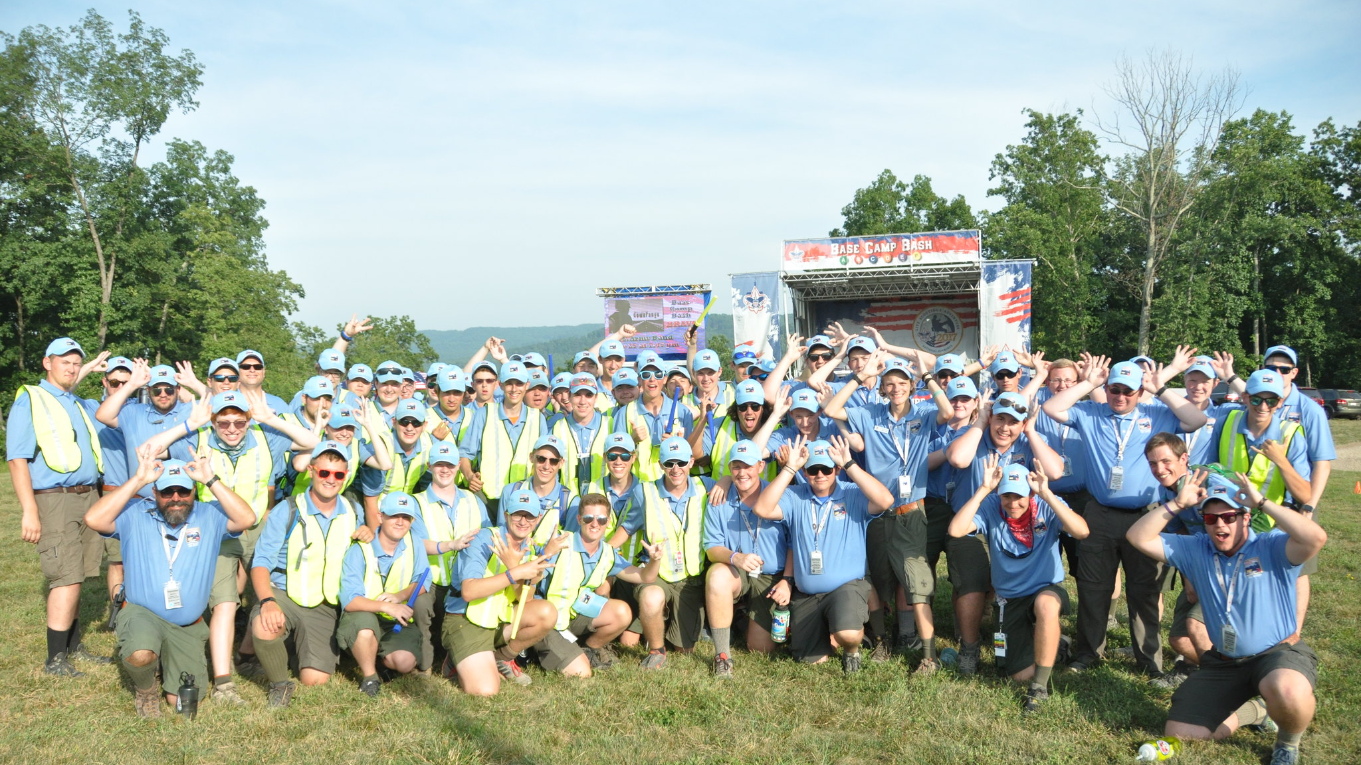
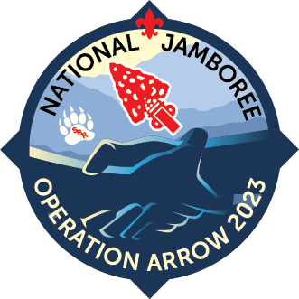
Introduction
Thank you for promoting Operation Arrow 2023! The personal connection you make with each Arrowmen listening to your presentation will be what brings them to the jamboree.
This slide deck is multi-purpose. It can be used for promotion as a winter banquet, conclave, in addition to an induction training, etc.
The ultimate purpose is to encourage Arrowmen to learn more at oa-bsa.org/jamboree and to register at jamboree.scouting.org.

Slide 2
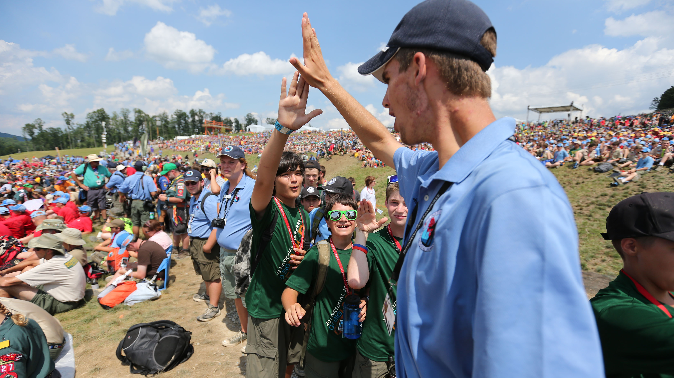
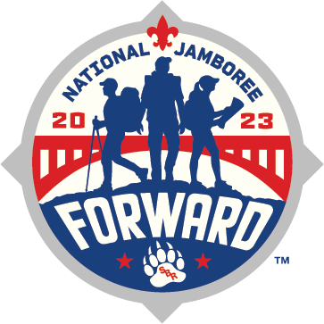
Operation Arrow 2023
2023 National Jamboree at the Summit Bechtel Reserve

Slide 3
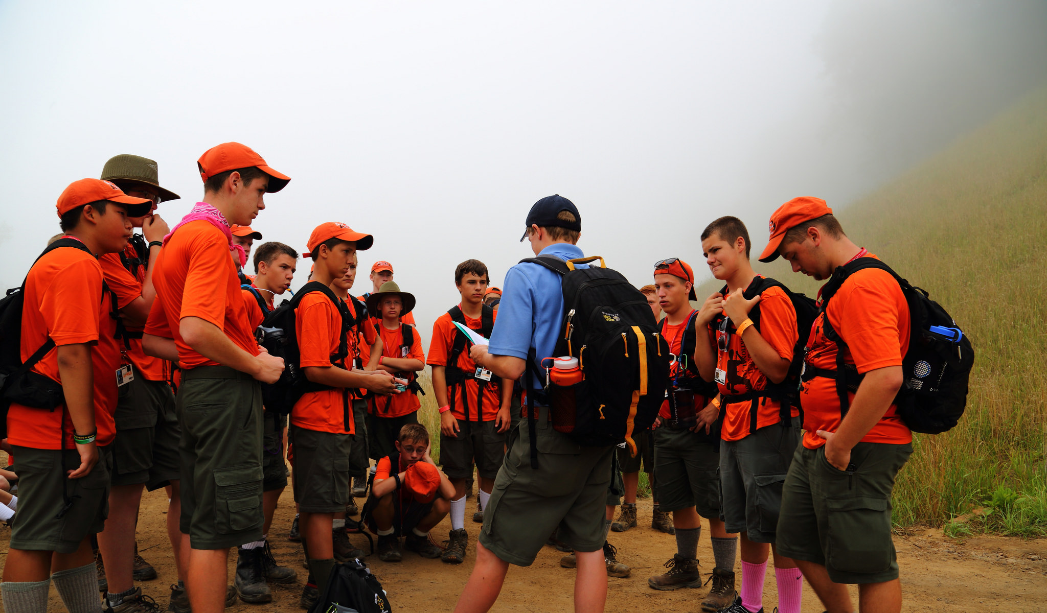
Overview
Operation Arrow is your opportunity to experience the 2023 National Jamboree while providing service with your fellow Arrowmen. The Jamboree will take place July 19-28, 2023 at the Summit Bechtel Reserve in West Virginia.
• Make life-long friends.
• Be part of putting on the largest Scouting event since 2017 and the 2023 Order of the Arrow Program of Emphasis.
• Experience the Summit Bechtel Reserve.
• Engage in new, fun activities and shows.

Slide 4
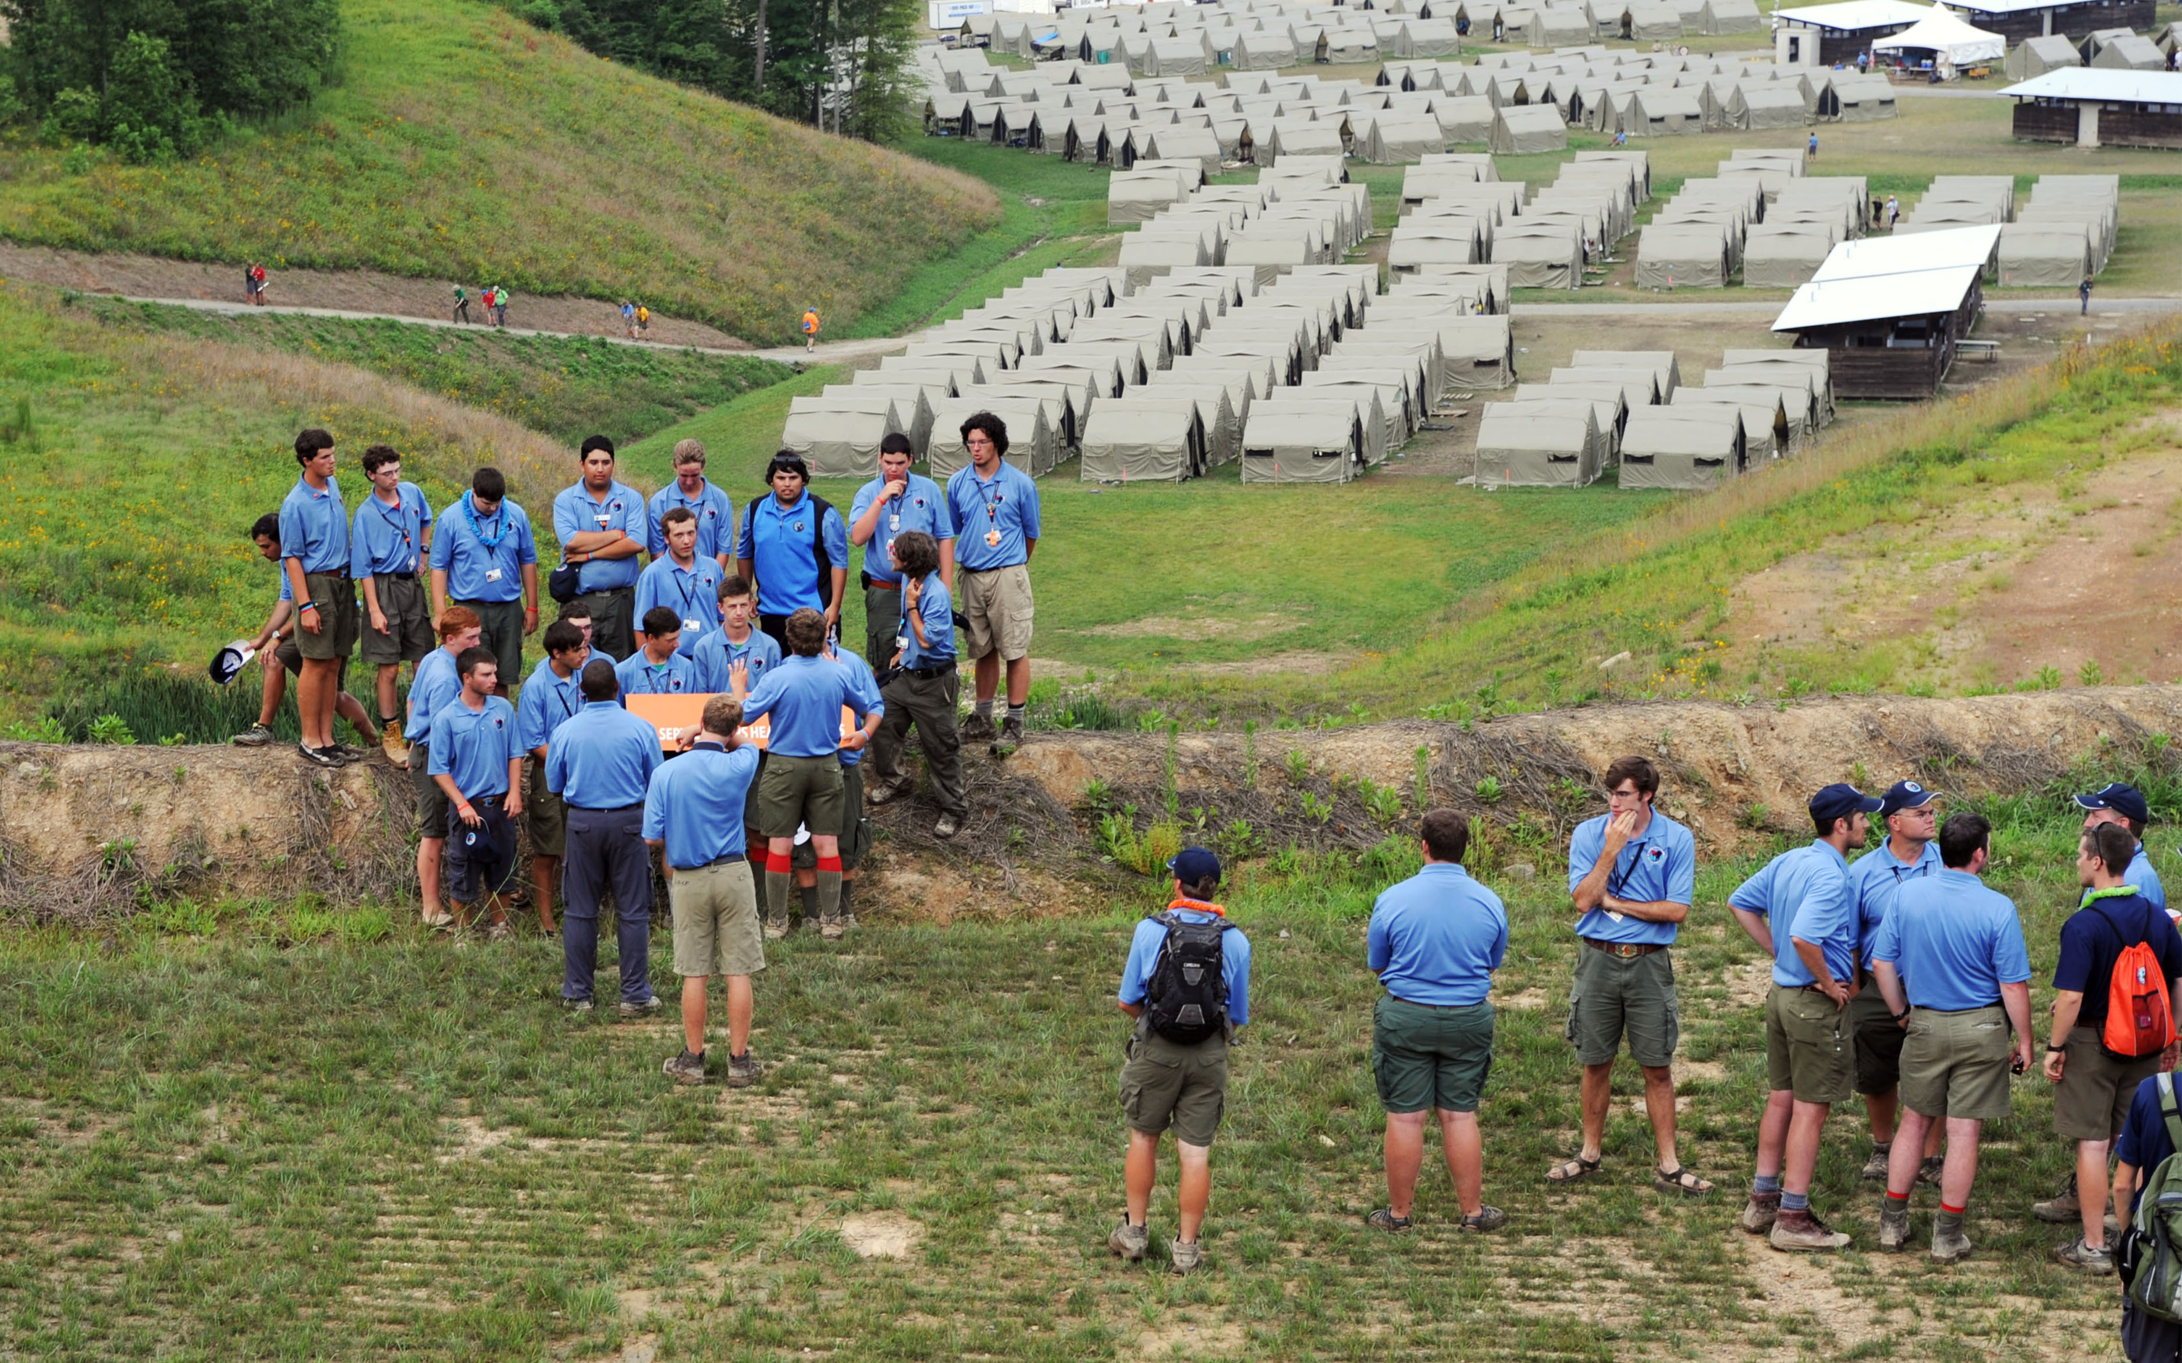

Summit Bechtel Reserve (SBR)
Situated in the wilds of West Virginia near River Gorge National Park.
  10,000-acre Summit Bechtel Reserve is adjacent to 70,000 acres of a federally protected national river area.
The third jamboree to be held at SBR.
One of four National High Adventure Bases.
More than 20,000 Scouts and Scouters will explore all kinds of adventures—stadium shows, pioneer village, adventure sports, patch trading, and more—in the heart of one of nature’s greatest playgrounds.

Slide 5
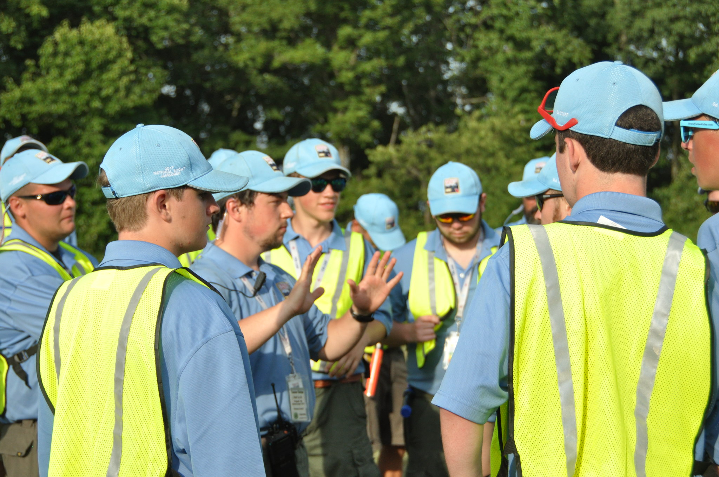
OA Service Corps
The OA Service Corps are the logistical boots-on-the-ground for the jamboree.
Mobilize to operate welcome day for all particpants.
Coordinate the movement of jamboree supplies, materials, and tools.
Provide guidance at the arena shows.

Slide 6
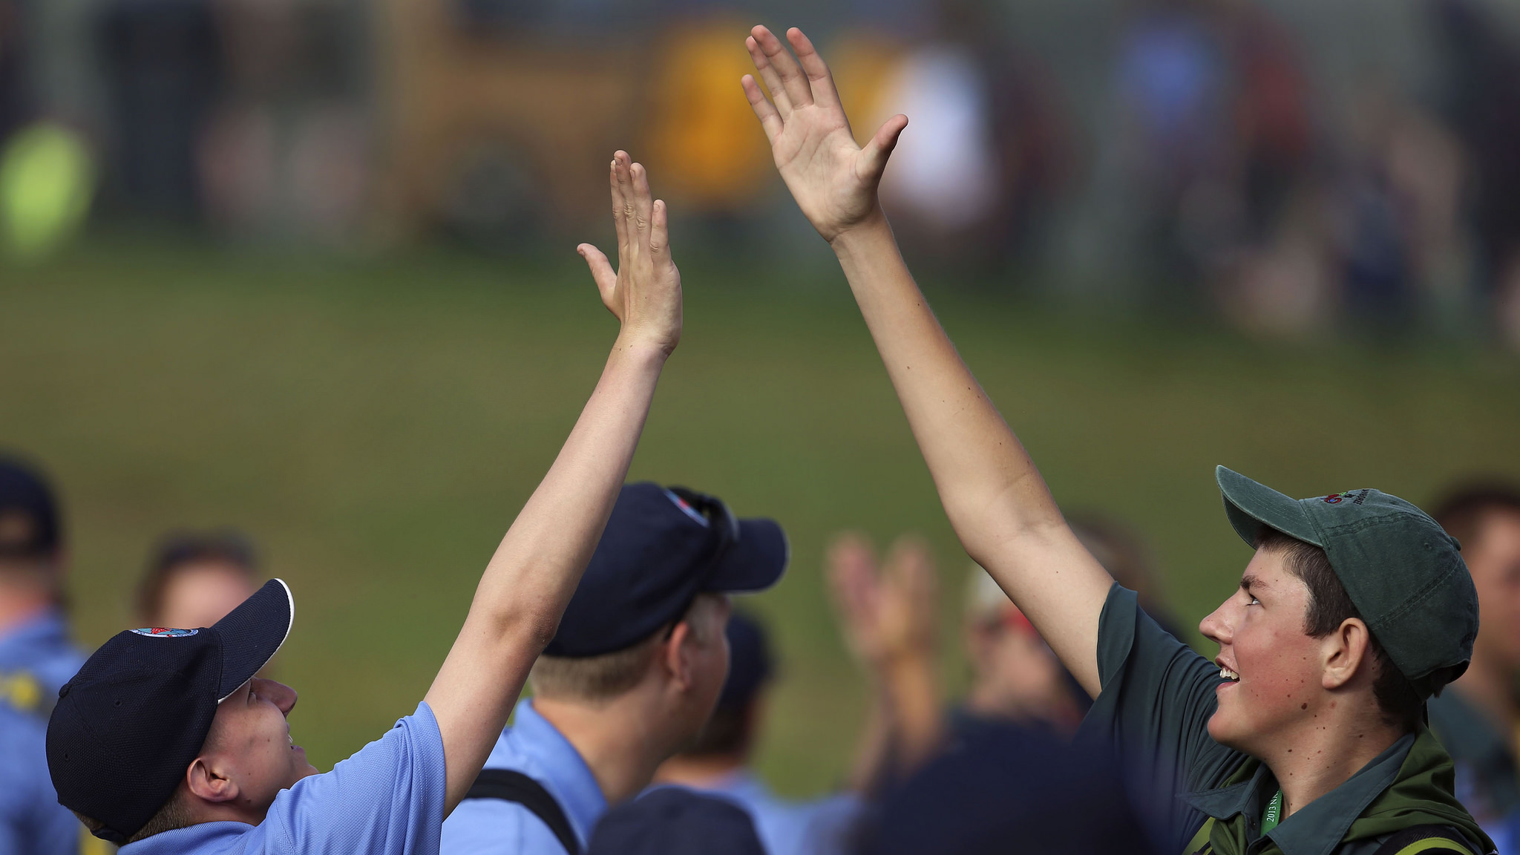
Summit Apex
The OA Service Corps is the high adventure aspect of the 2023 National Jamboree and the second component of Operation Arrow. Summit Apex Staff provide program such as:
Field Activities – new and unique large-scale experiences promoting networking with Scouters from across the nation.
Apex Feast – unique jamboree dining experience.
Evening Bonfire / Rally – an inspirational and motivational celebration in the evenings of the jamboree.

Slide 7
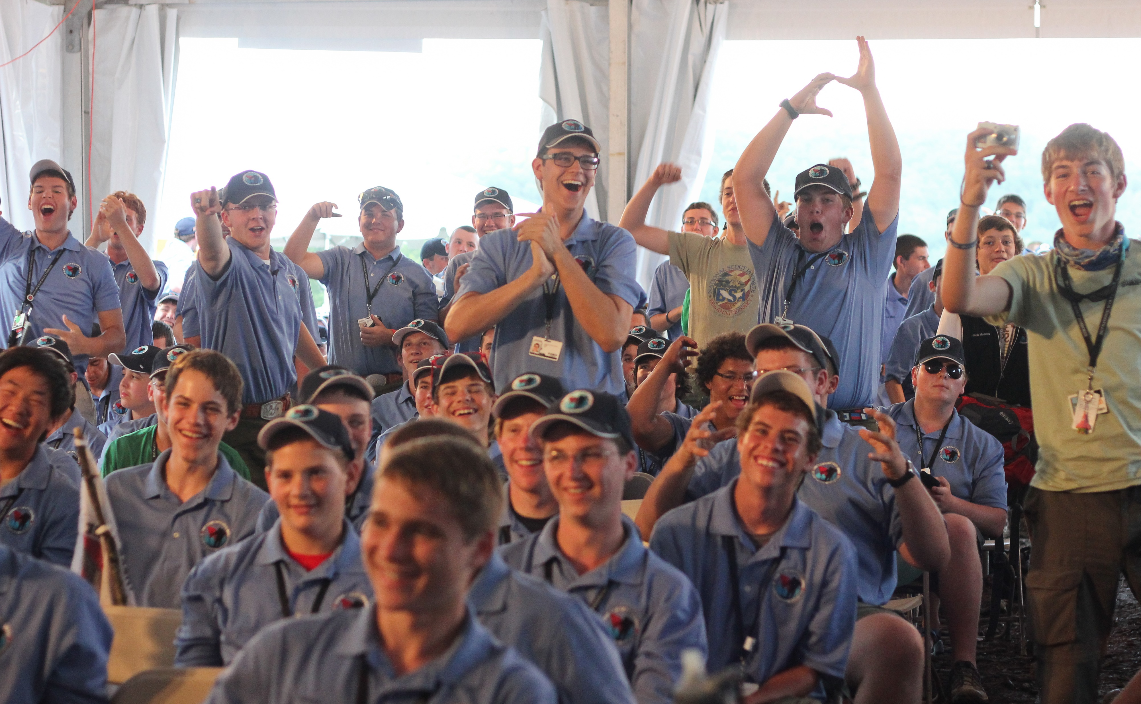
The Fun!
Operation Arrow staffers do not just provide the essential logistical service to the 2023 National Jamboree. We also have scheduled free time to experience all the exciting program planned.
Mountain biking
BMX
Skateboarding
Canopy Tours – ¾ mile zipline
Unique opportunities like access to OA HQ
Shooting sports and MORE!

Slide 8
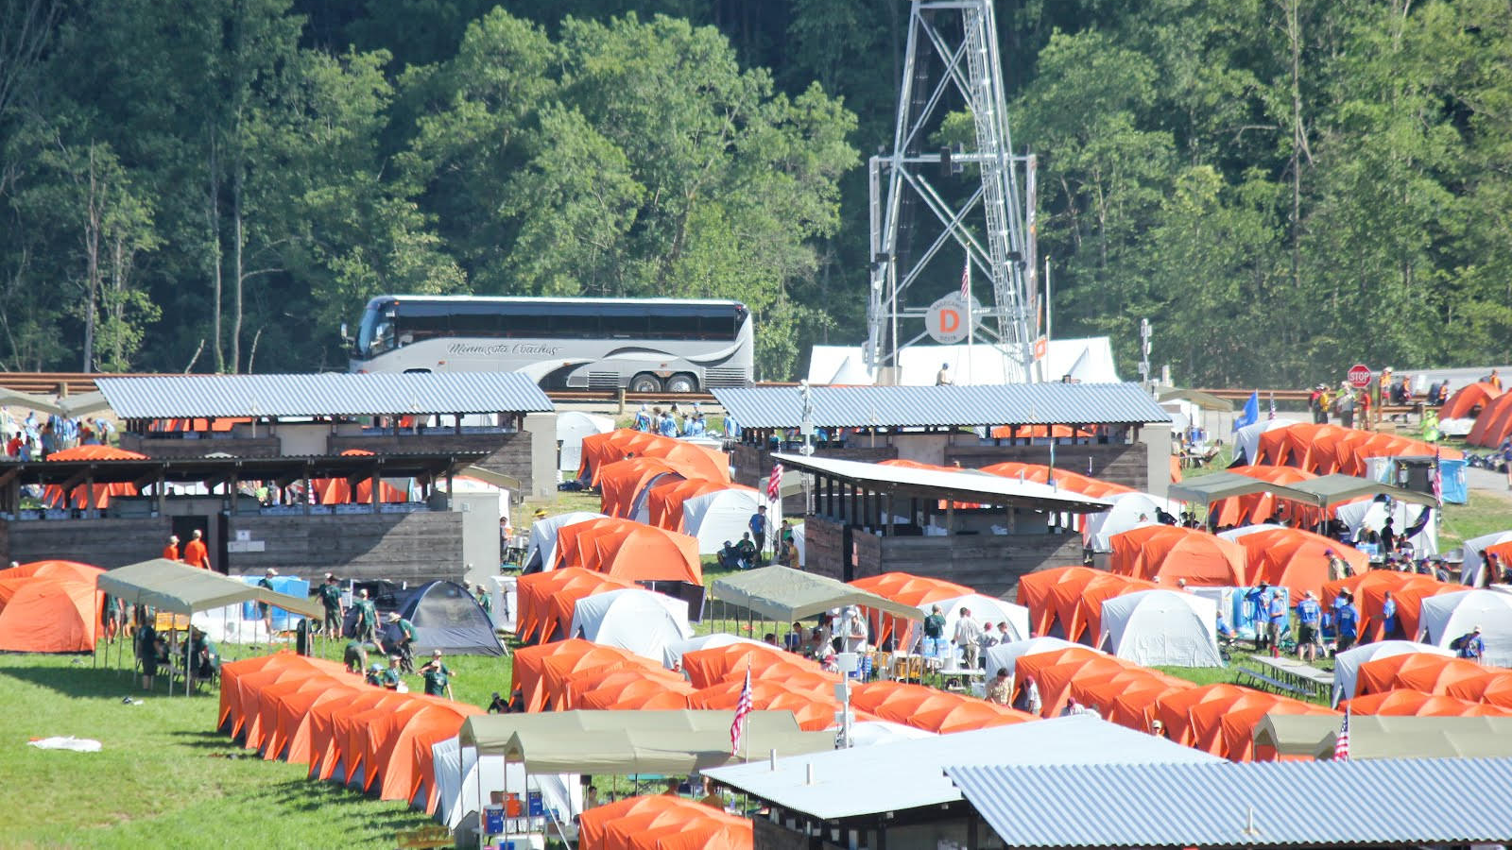
Registration is Open!
Operation Arrow is the thriftiest way to attend the 2023 National Jamboree. Young adults even get an additional discount. Register today at oa-bsa.org/jamboree.
Applicants 34 years of age and older:
Session 1 (July 16-22, 2023) – $700
Session 2 (July 23-29, 2023) – $700
Session 3 (July 16-29, 2023) – $1200
Applicants 16-33 years of age:
Session 1 YAJ (July 16-22, 2023) – $400
Session 2 YAJ (July 23-29, 2023) – $400
Session 3 YAJ (July 16-29, 2023) – $675

Slide 9
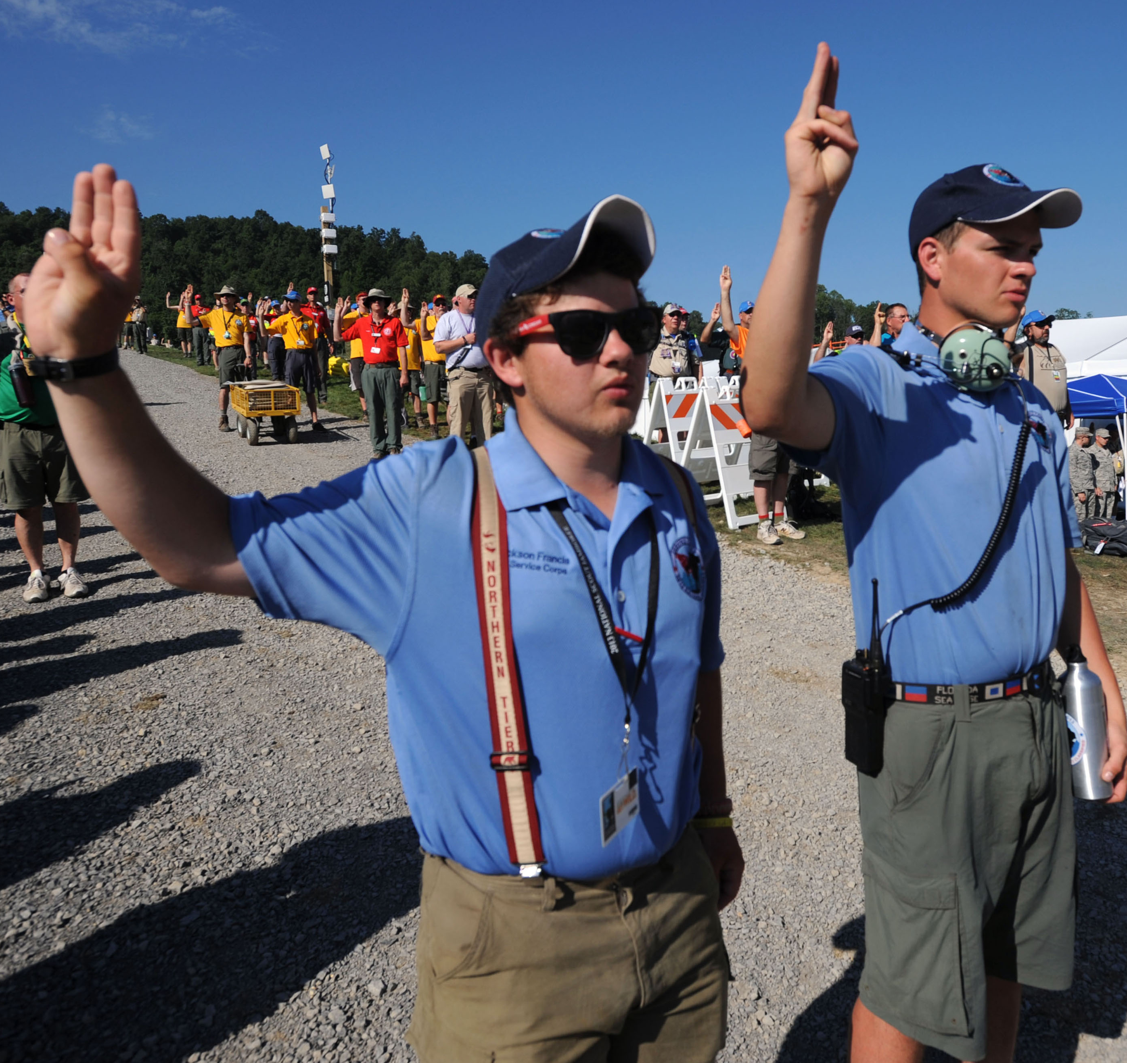
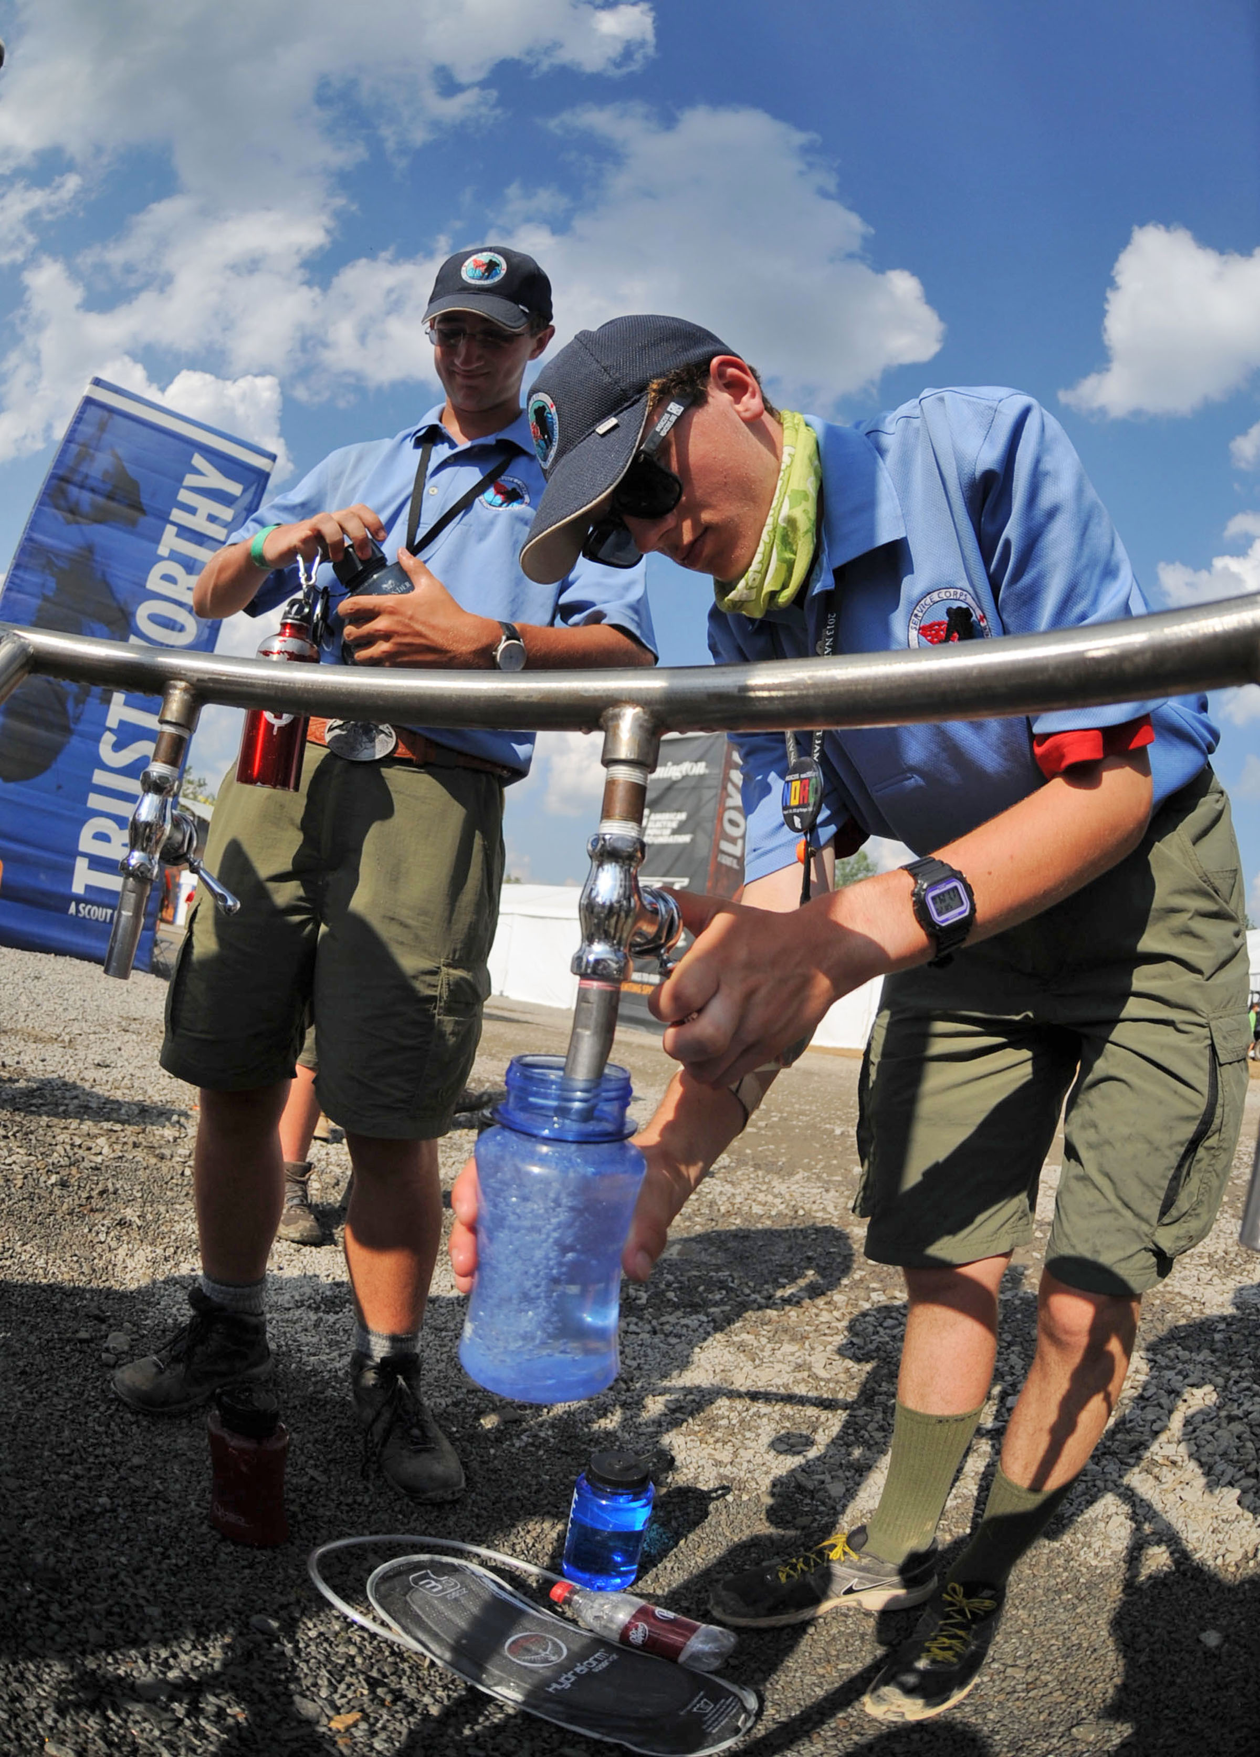
Will you answer the call?
Learn more at oa-bsa.org/jamboree

Slide 10
Operation Arrow 2023
2023 National Jamboree at the Summit Bechtel Reserve

